Slide 1
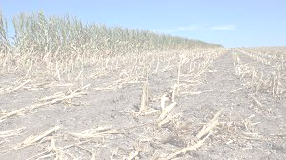
Weather Extremes in Iowa:
Tracing the Impacts of Climate Change on Flooding and Drought
Fatemeh Ganji, Matt Kavanaugh, Padmore Mantey, Taylor Vroman
Notes:
T

Slide 2
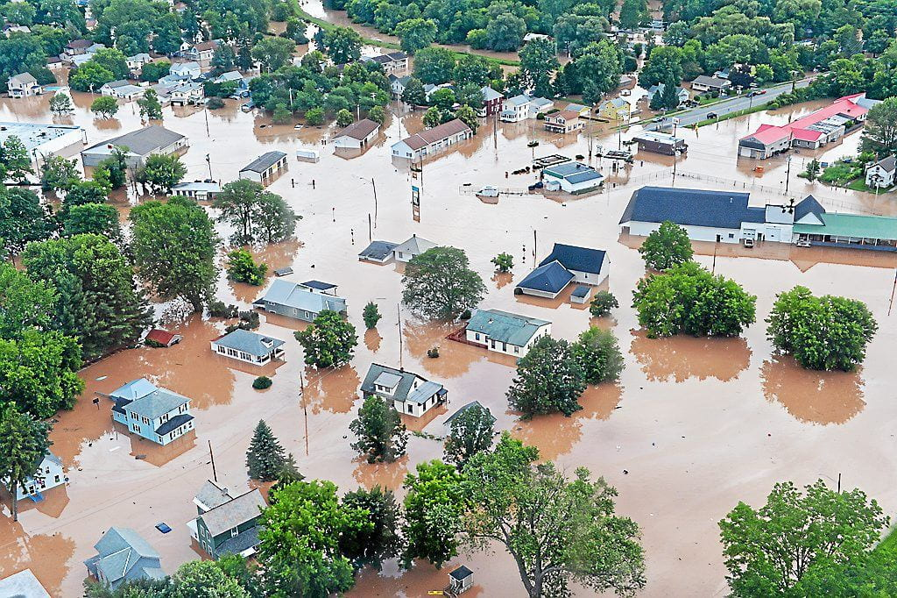
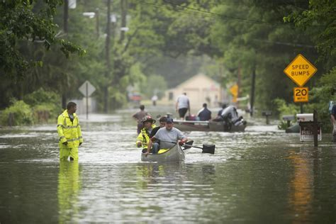
Flooding
Floods are amongst the most deadly and dangerous natural disasters
Leads to substantial loss of property and life, including crops
Contributes to substantial erosion and motion of soil and sediment
Often damage or destroy agricultural systems as well as natural habitats
Being able to predict and prepare for floods can save lives and protect against major financial losses
Notes:
T

Slide 3
Main Types of Floods
Pluvial Floods:
Better known as flash flooding, they are the most unpredictable and hence dangerous type of flooding
Fluvial Floods:
Known as river floods, they occur when a river overflows its banks during periods of heavy precipitation and excessive runoff.
Coastal Floods:
Often created by storm surge, they are created when sea levels rise in a coastal area, endangering settlements along the shore
Notes:
T

Slide 4
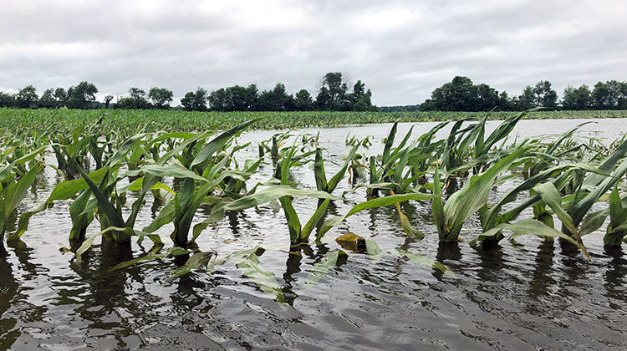
Climate Change and Human Activities Amplify Drought and Flooding Severity
Climate Change
Altered climate patterns
Increased frequency of extreme events
Human activities
Deforestation
Excessive water extraction
Poor water management
Intensive agriculture
Urbanization
Notes:
M

Slide 5
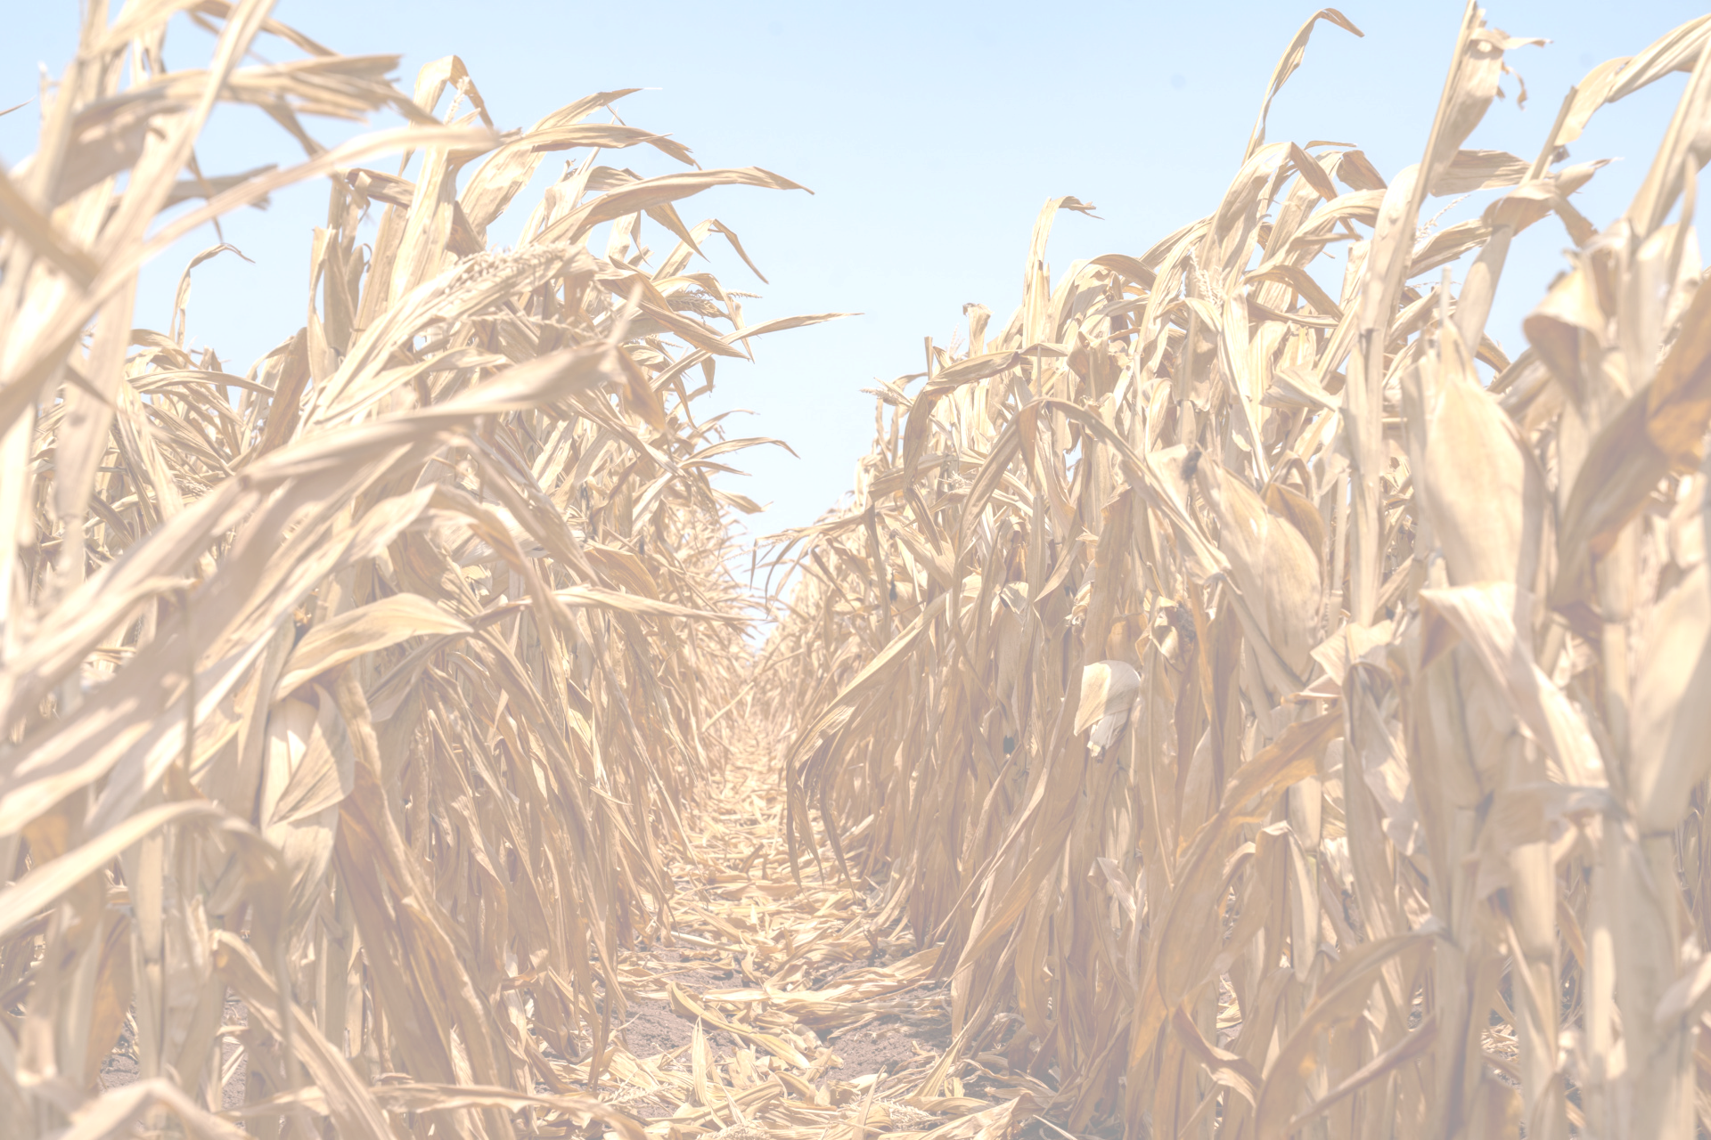
Types of Drought
Meteorological drought
Reduced precipitation duration and/or intensity
Hydrological drought
Deficiency in surface and subsurface water supplies
Agricultural drought
Inadequate soil moisture to meet the needs of a particular crop at a particular time
Socioeconomic drought
Occurs when physical water shortages start to affect the health, well-being, and quality of life of he people, or supply/demand
Notes:
M

Slide 6
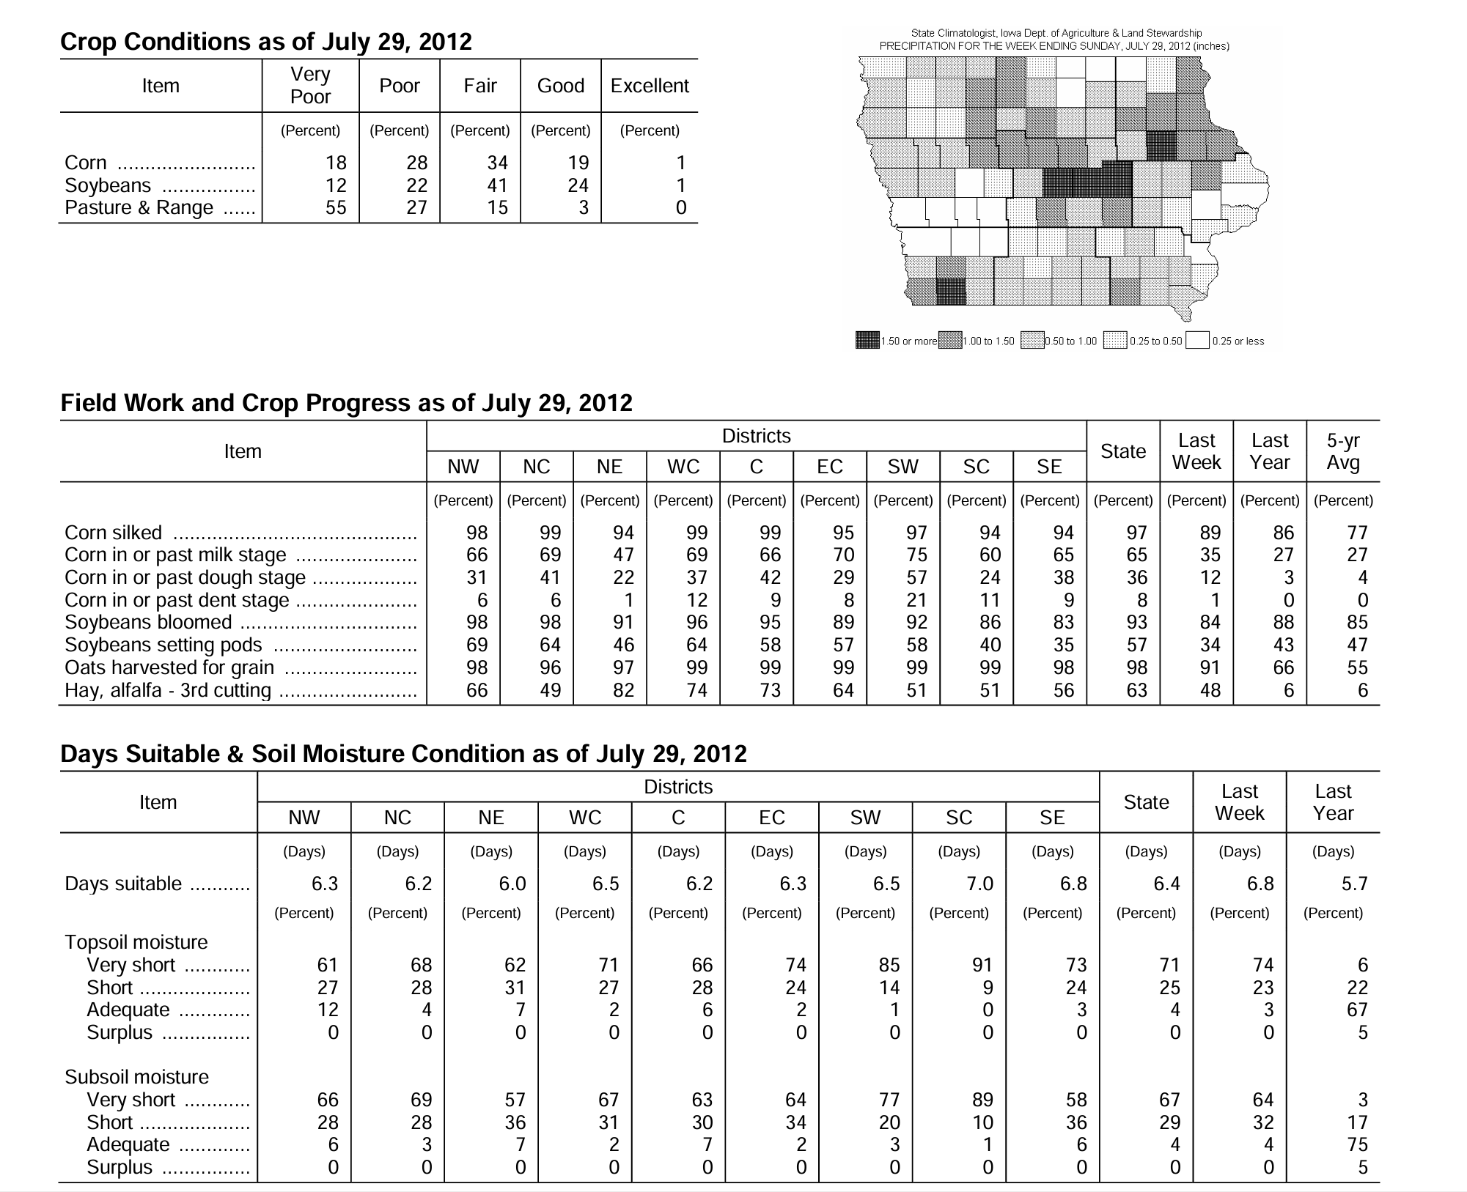
From https://www.nass.usda.gov/Statistics_by_State/Iowa
Example of crop conditions for Iowa during the severe drought of 2012.
Note the high percentage of crops in poor/very poor condition, as well as a high frequency of premature development.
Notes:
M

Slide 7
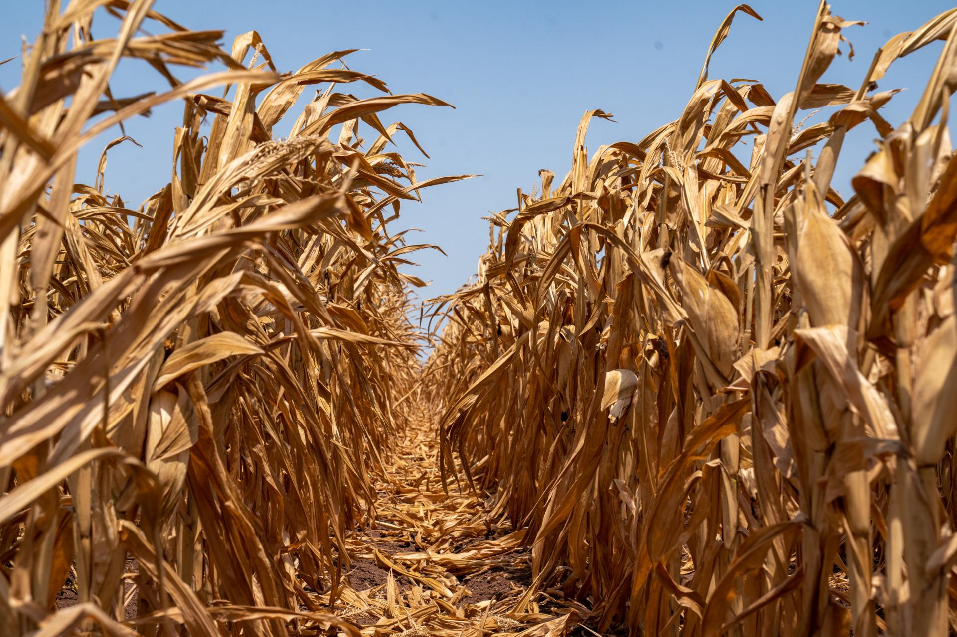
Flood/drought monitoring is crucial for effective water resource management
Enables quick actions to address water scarcity
Provides data for effective planning and resource allocation
Facilitates responsible distribution of water resources
Aids in crop management and resilient infrastructure development
Notes:
M

Slide 8
Consequences of Drought
Water Scarcity | Limited availability for agriculture, industry, and households
Crop Failure | Reduced yields, economic losses in agriculture
Food Shortages | Lower agricultural productivity contribution to insecurity
Economic Impact | Losses in agriculture, higher prices of food and commodities
Ecological Consequences | Habitat degradation, loss of biodiversity, ecosystem stress
Social Displacement | Migration in search of water and resources
Impact on Energy Production | Reduced hydropower, increased risk of wildfires
Notes:
T

Slide 9
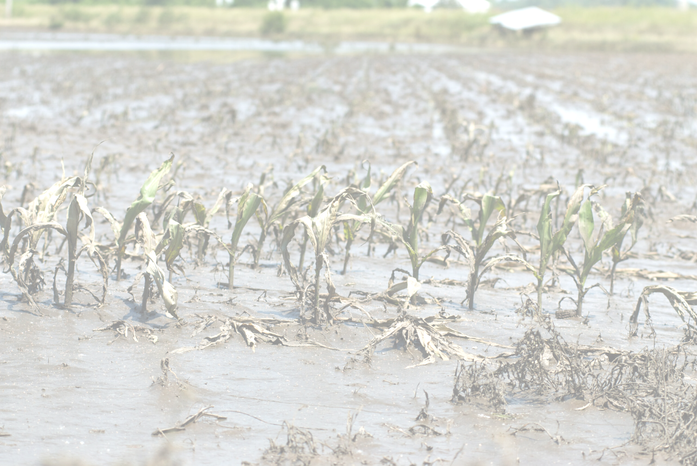
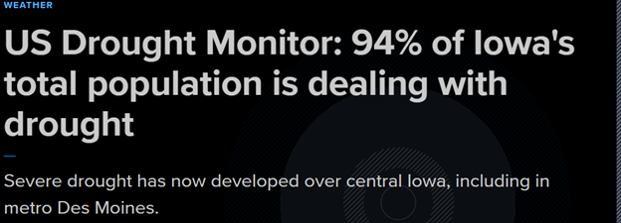
Frequency of climate change related events are on the rise
Notes:
T

Slide 10
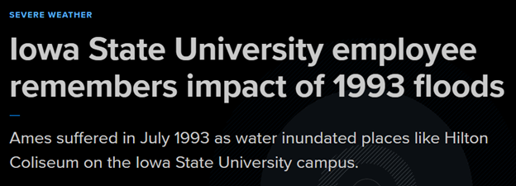
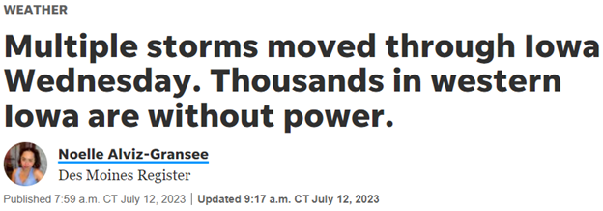
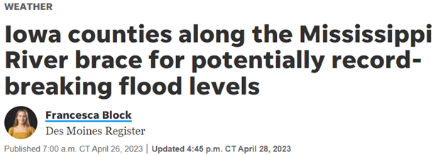
Frequency of climate change related events are on the rise
Notes:
T

Slide 11
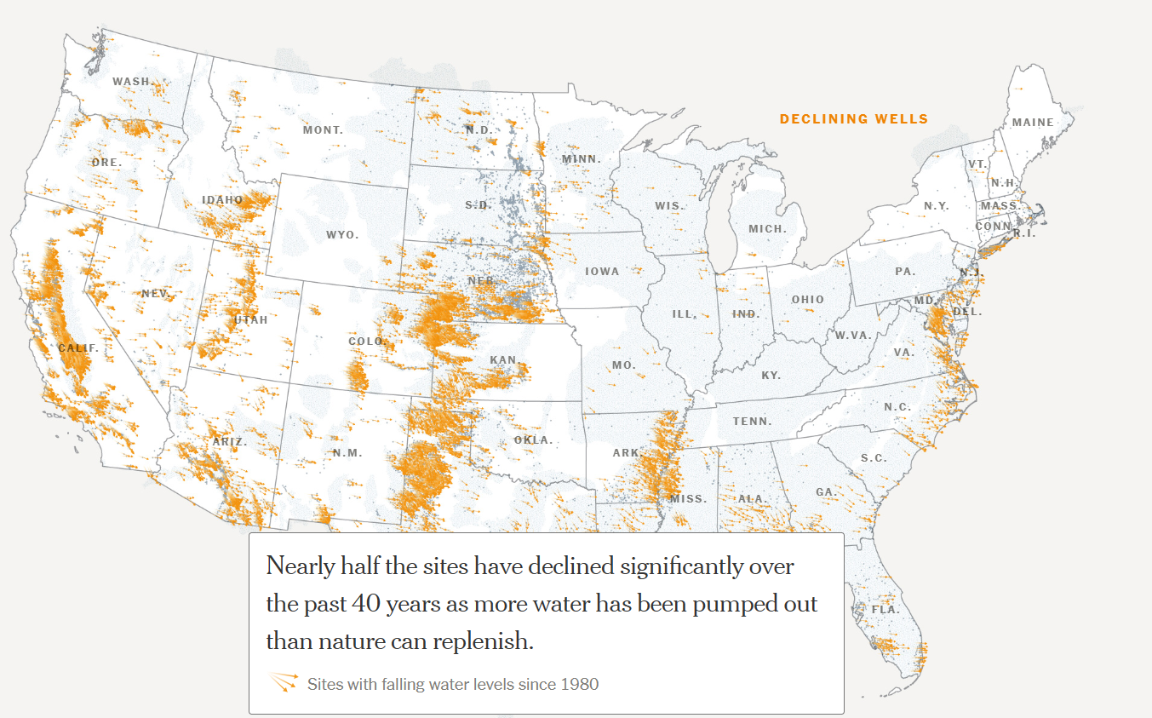
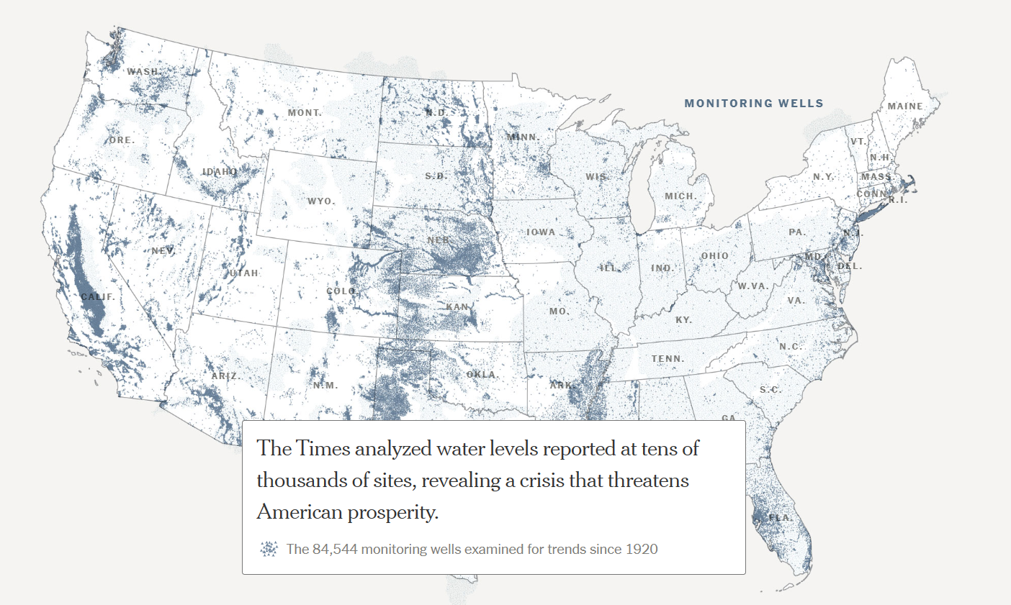
Vision: accessible website as a resource for general public
Develop a tool that anyone can use
Historic flood and drought data for Iowa + current data + links to tool + extreme events around the state + definitions = all in one place
Need: many resources available, can be difficult to determine quality
Website: interactive, visualization tool
Focus: drought and flood to show effects of climate change (today: drought)
Example:
Notes:
T

Slide 12
SPI, and SPEI
Standardized Precipitation Index (SPI): Based on Rainfall Probability Function.
Standardized Precipitation Evapotranspiration Index (SPEI): Based on the Rainfall and Evapotranspiration Probability Function.
Widely used index to characterize meteorological drought on a range of timescales.
Available through GRIDMET in Google Earth Engine.
Notes:
P

Slide 13
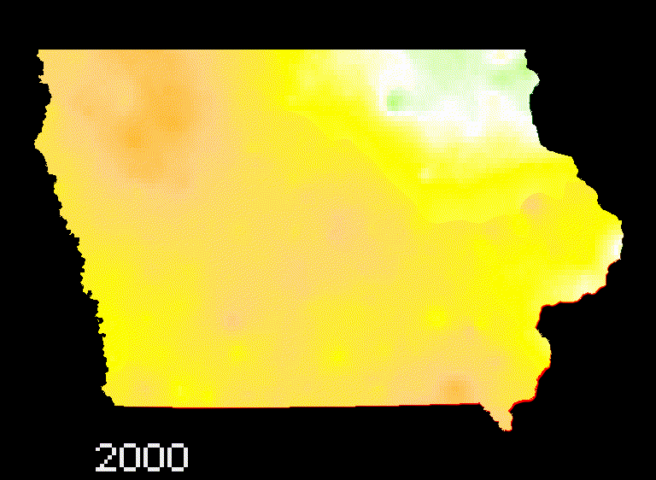
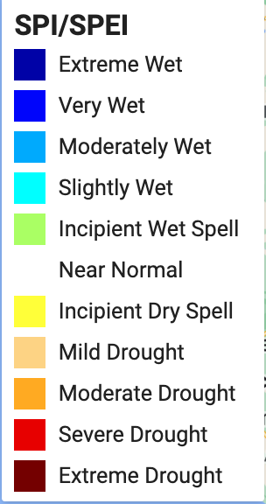
SPI-12 months for 2000-2022 in Iowa
Notes:
P

Slide 14
Example of crop conditions for Iowa during the drought of 2012.
Note the high percentage of crops in poor/very poor condition, as well as a high frequency of premature development.
Notes:
P

Slide 15
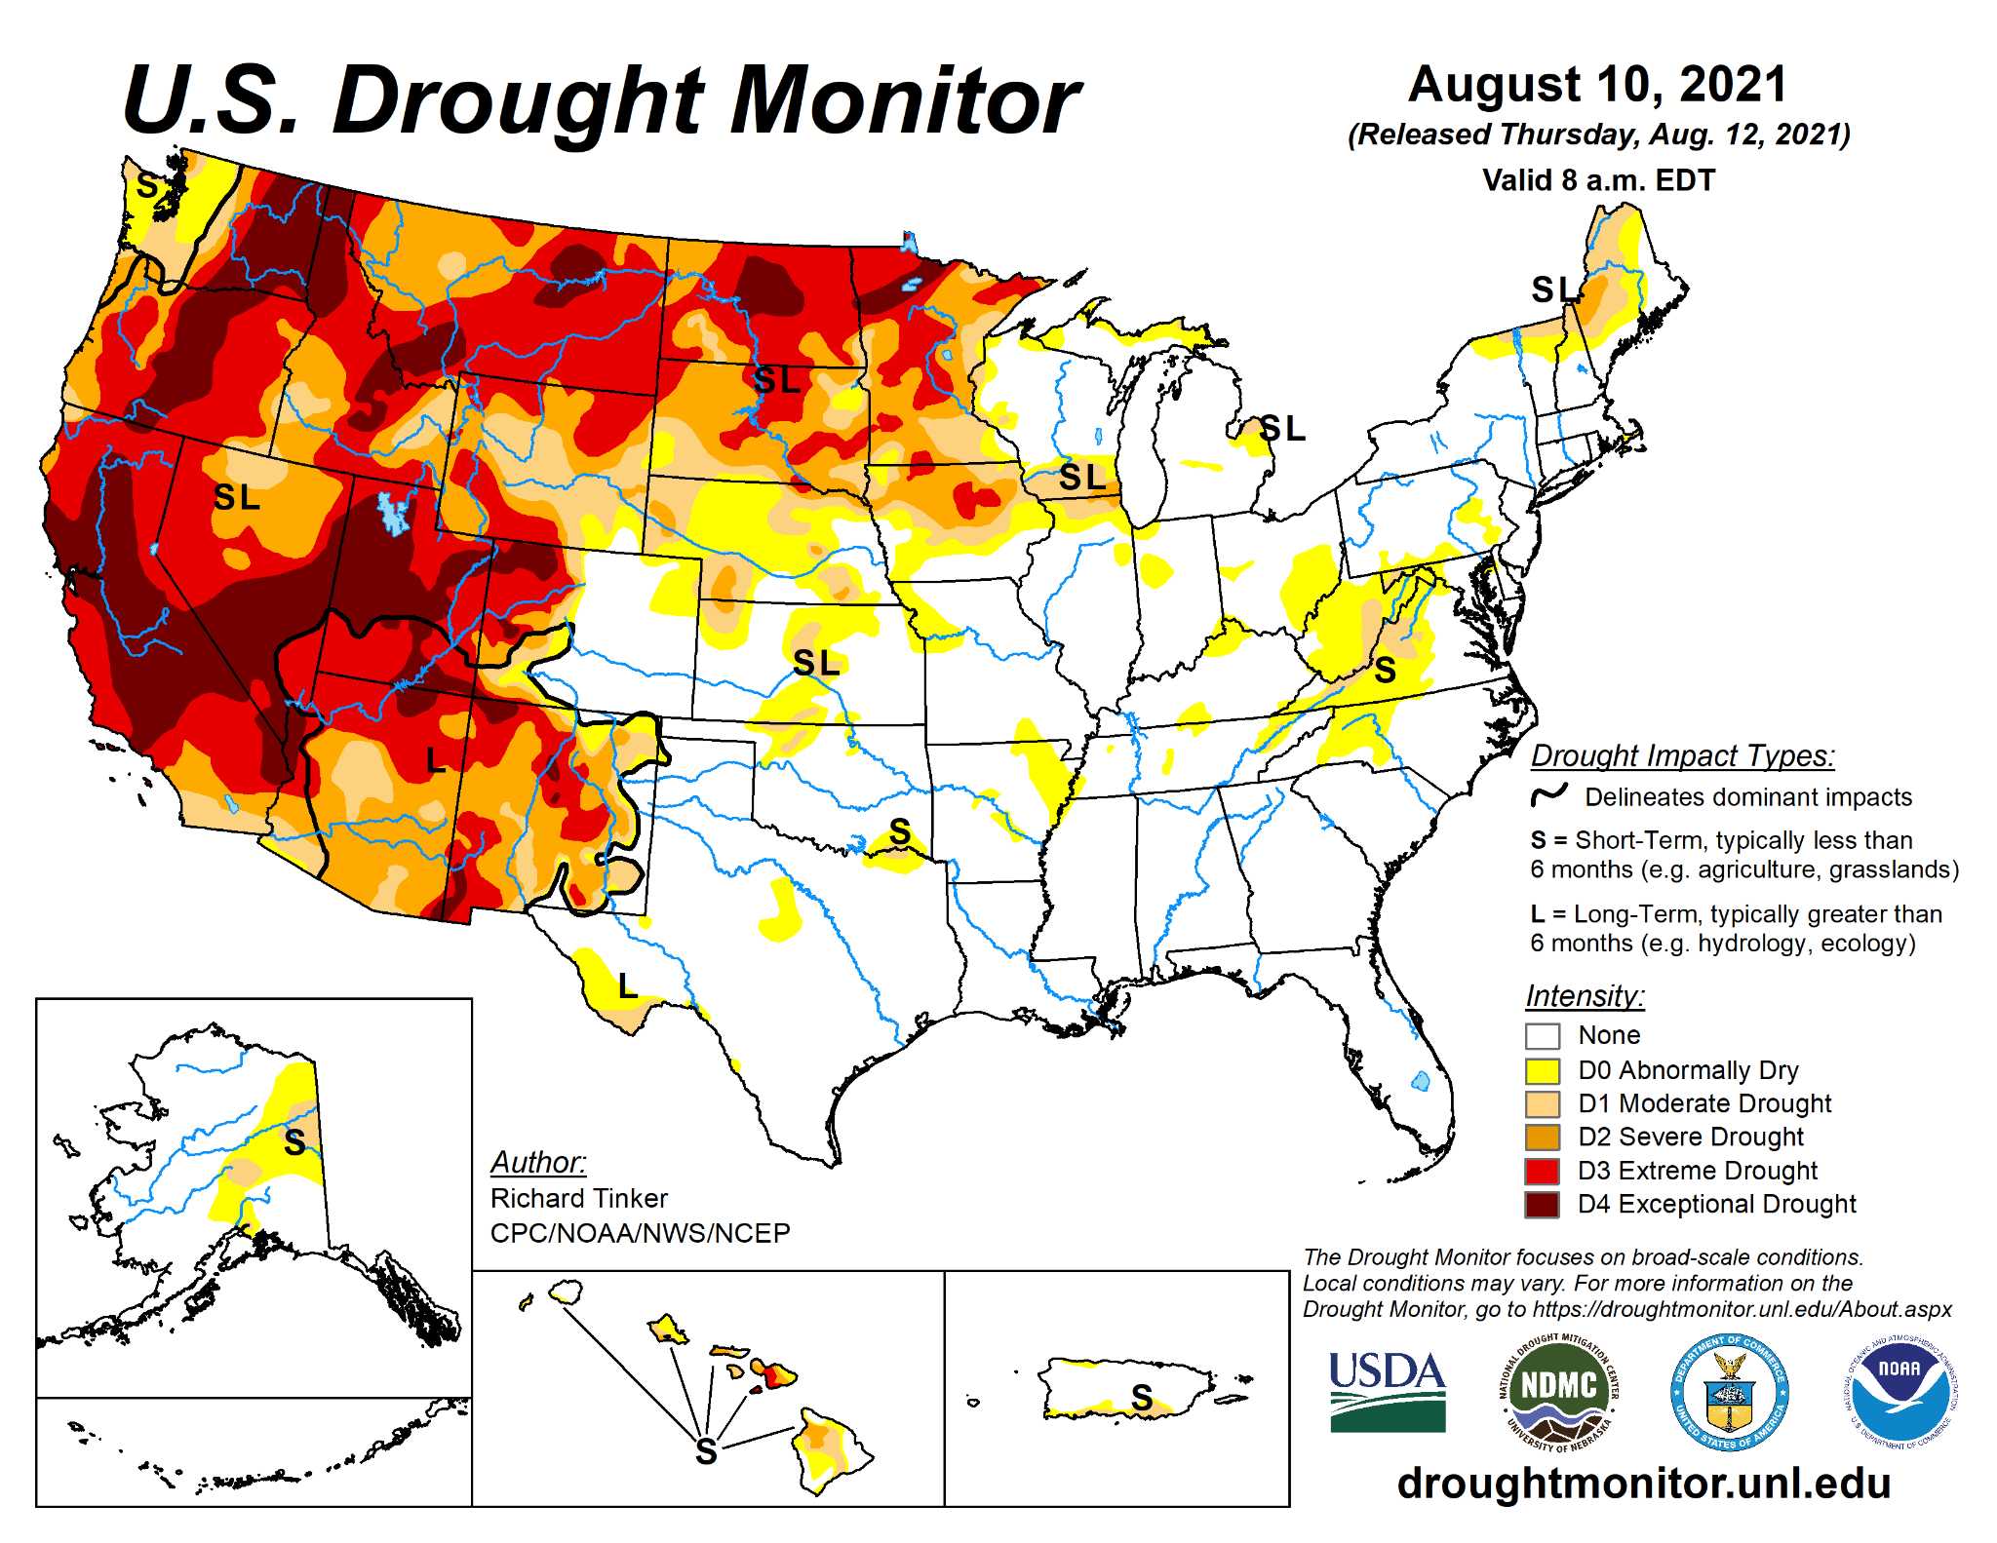
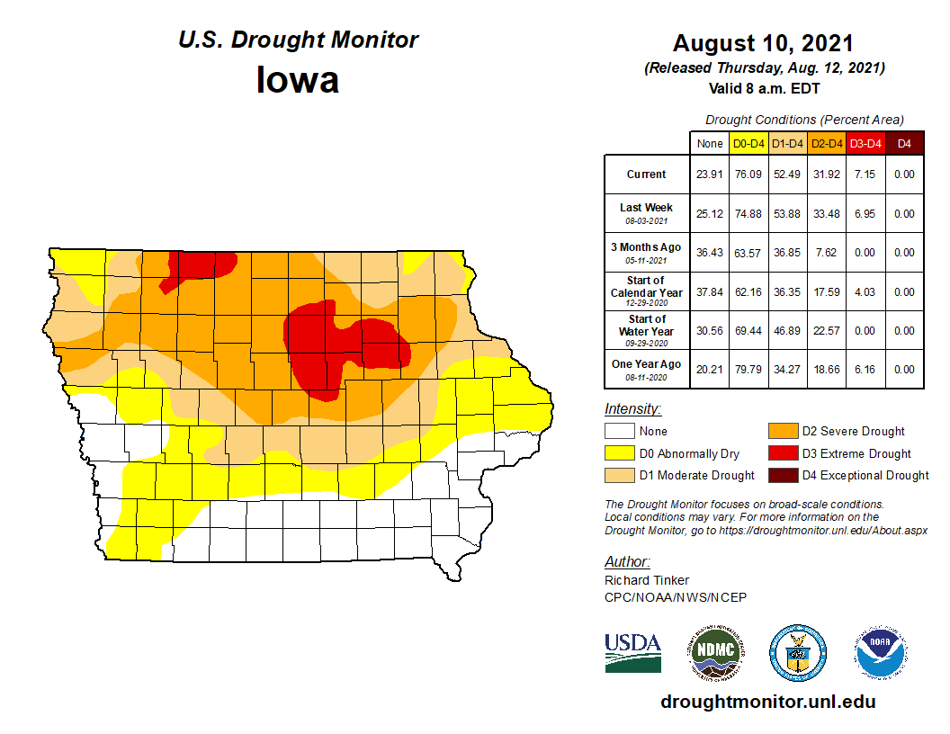
Drought Monitoring Tools
Notes:
P

Slide 16
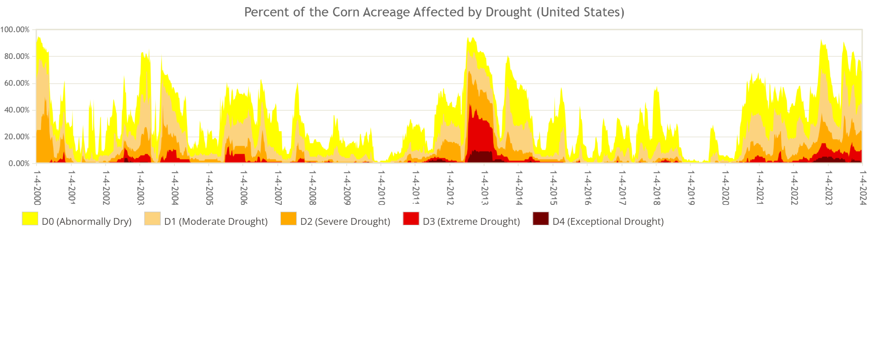
Drought Monitoring Tools continued…
Source: https://agindrought.unl.edu/
US Agricultural Commodities in Drought:
Notes:
P

Slide 17
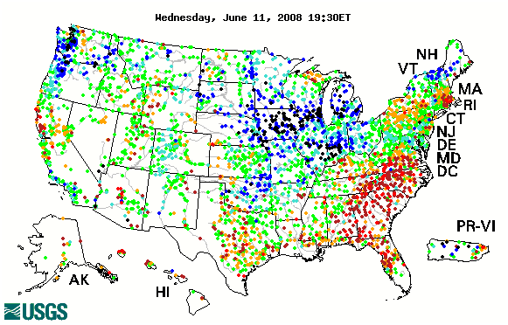
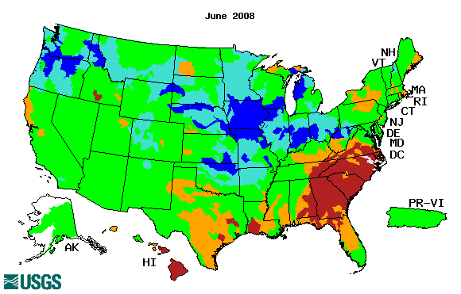
Streamflow from the USGS
Source:
https://waterwatch.usgs.gov/
Notes:
M

Slide 18
Rainfall Deviation
A deviation in rainfall from its Long Period Average (LPA) of 30 years (1987- 2016) is considered as fairly credible indicator of drought.
Dataset: CHIRPS
30+ year gridded rainfall data (from Jan-1981 to present.)
0.05° (~6km) spatial resolution
Combines satellite rainfall measurements with ground station data
Band: Precipitation
Notes:
F

Slide 19
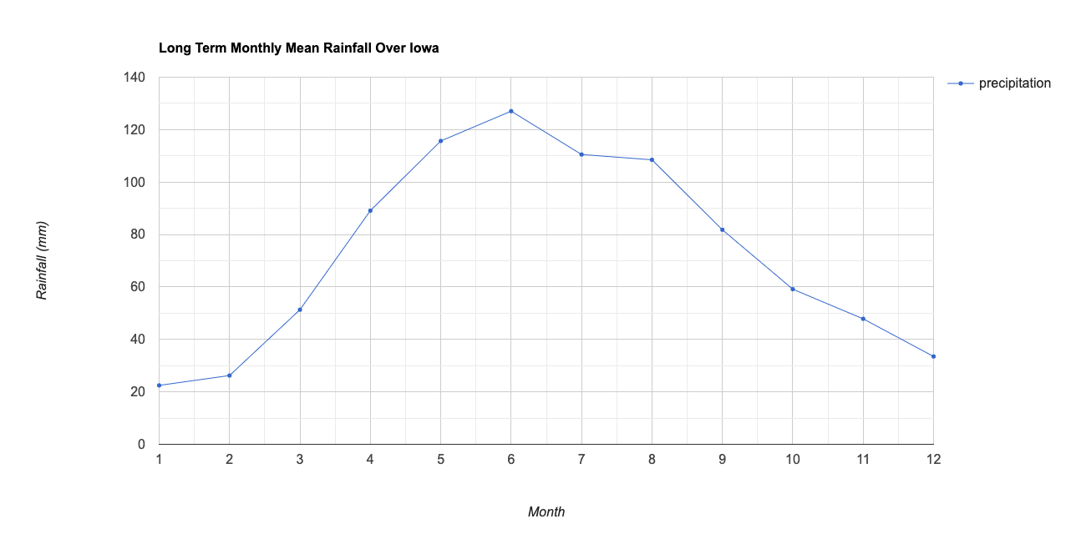
Long Period Average of monthly precipitation for 30 years (1987- 2016) over Iowa
Notes:
F

Slide 20
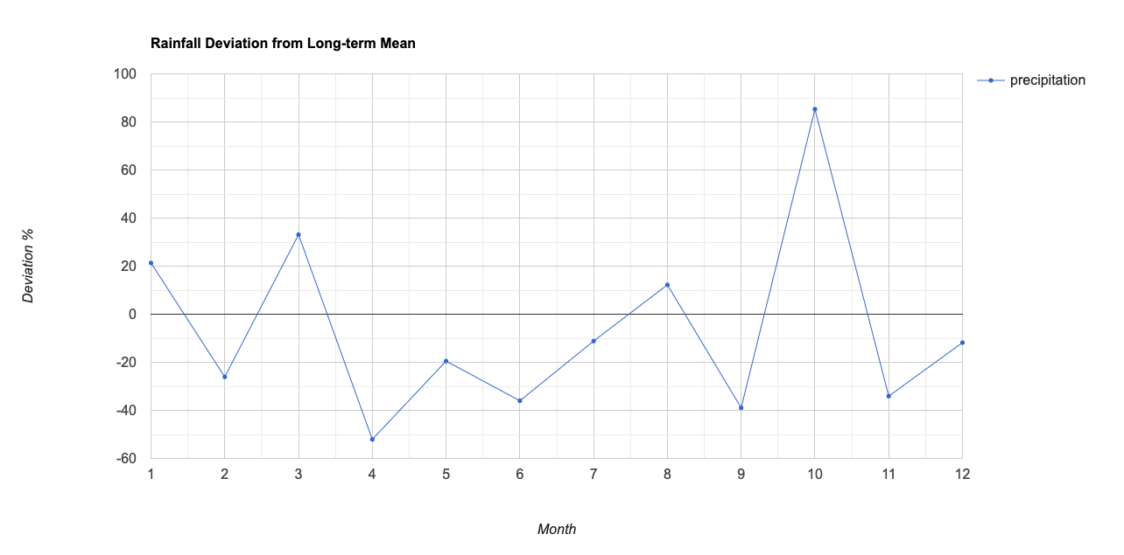
Deviation of monthly precipitation in 2021 from LPA
Notes:
F

Slide 21
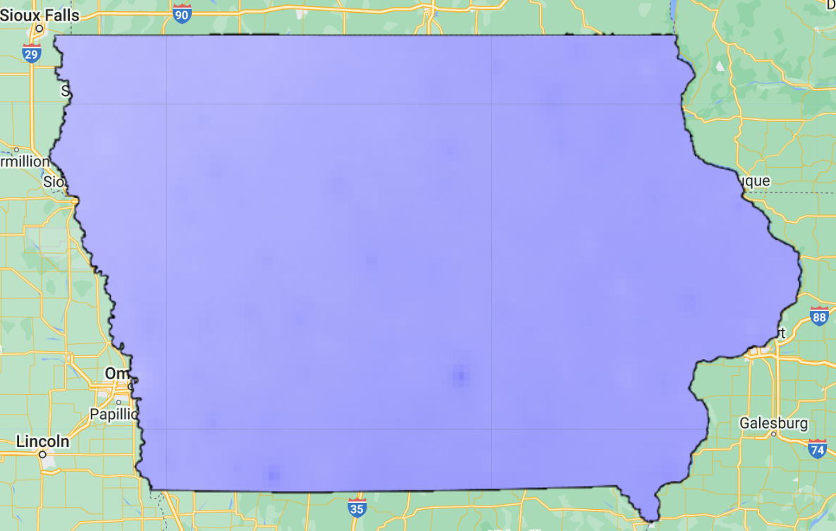
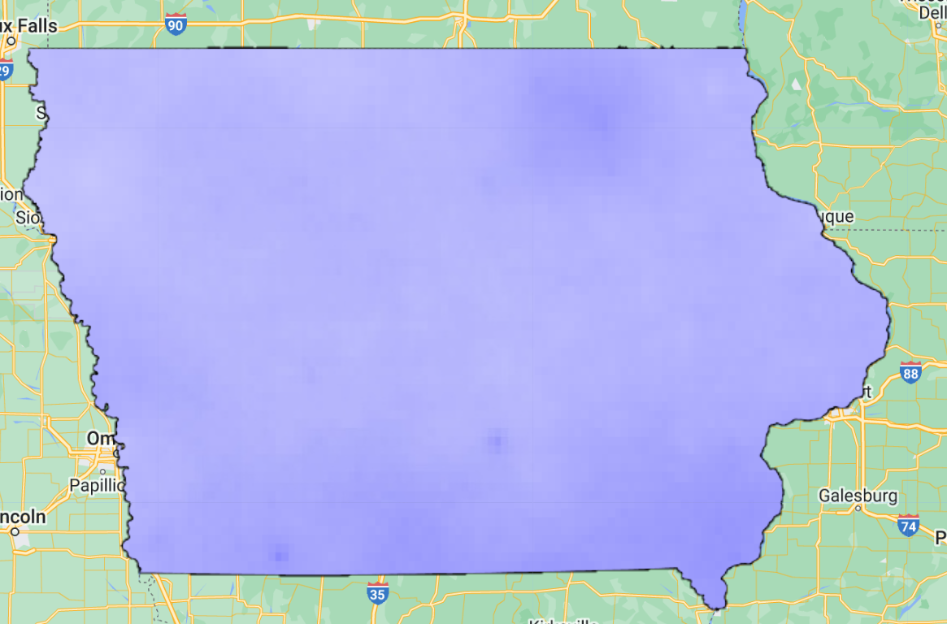
Annual sum of monthly average precipitation over 1987- 2016 | Annual sum of precipitation in 2021
Notes:
F

Slide 22
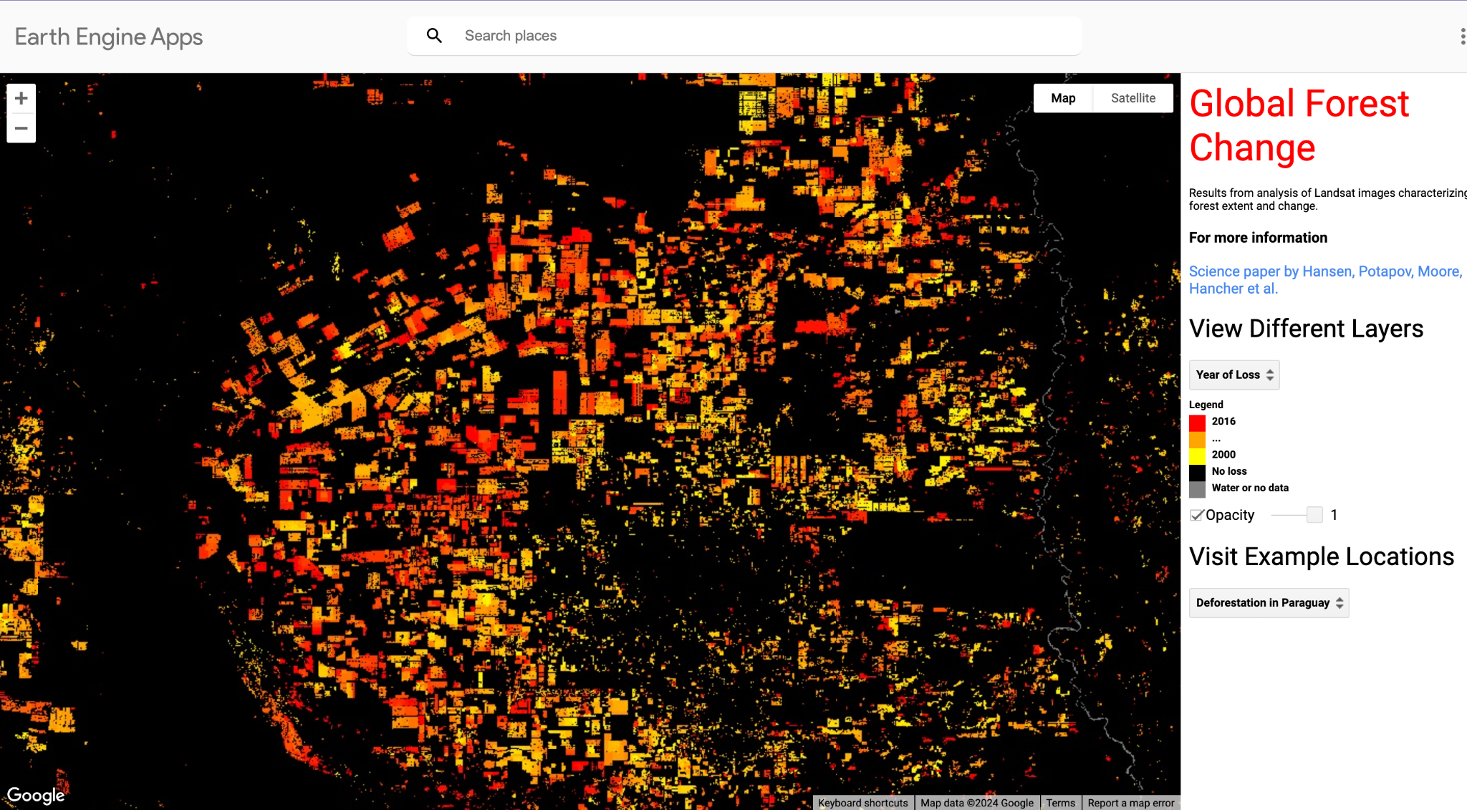
End goal/future work
https://www.earthengine.app/
Notes:
P

Slide 23
Thank You.
Any questions?

