Slide 1
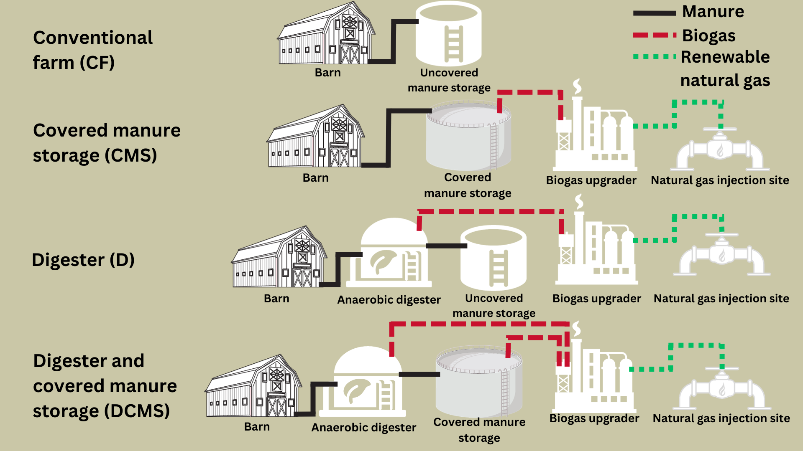
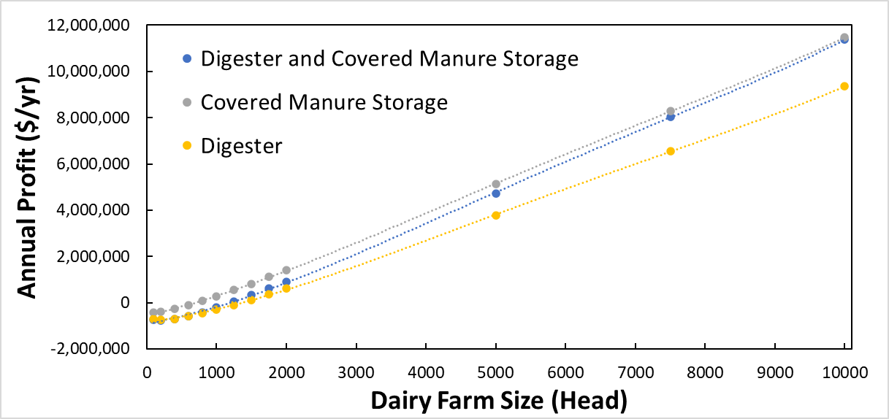
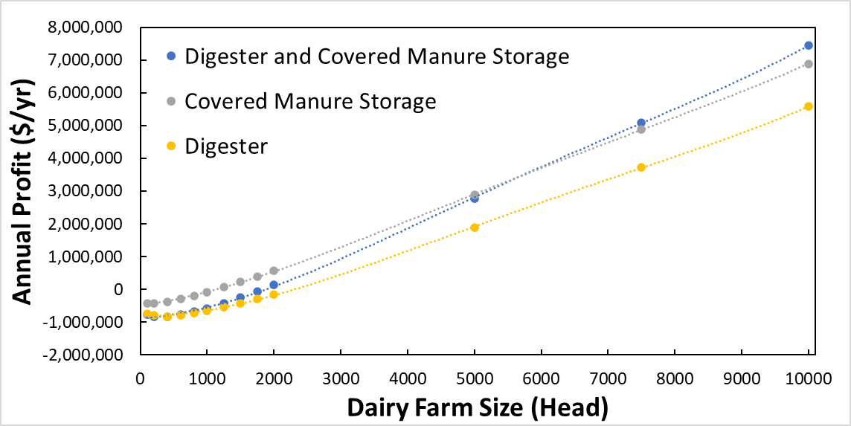
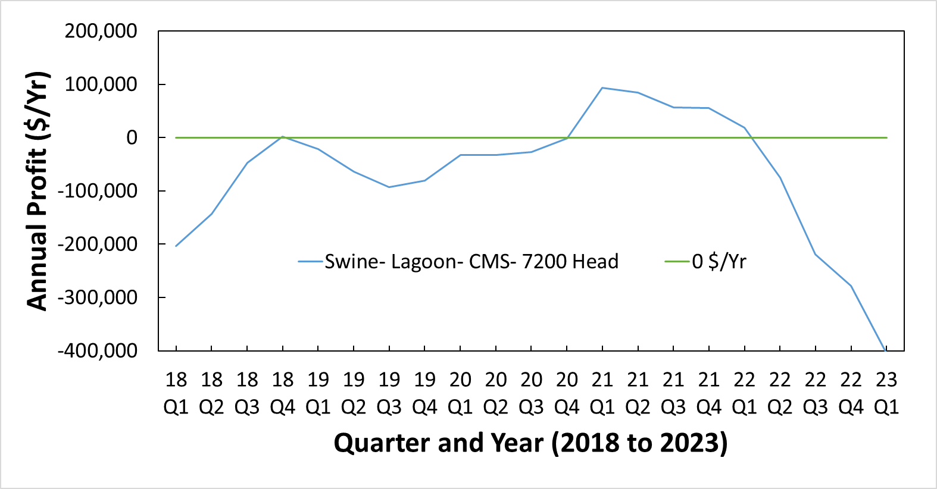
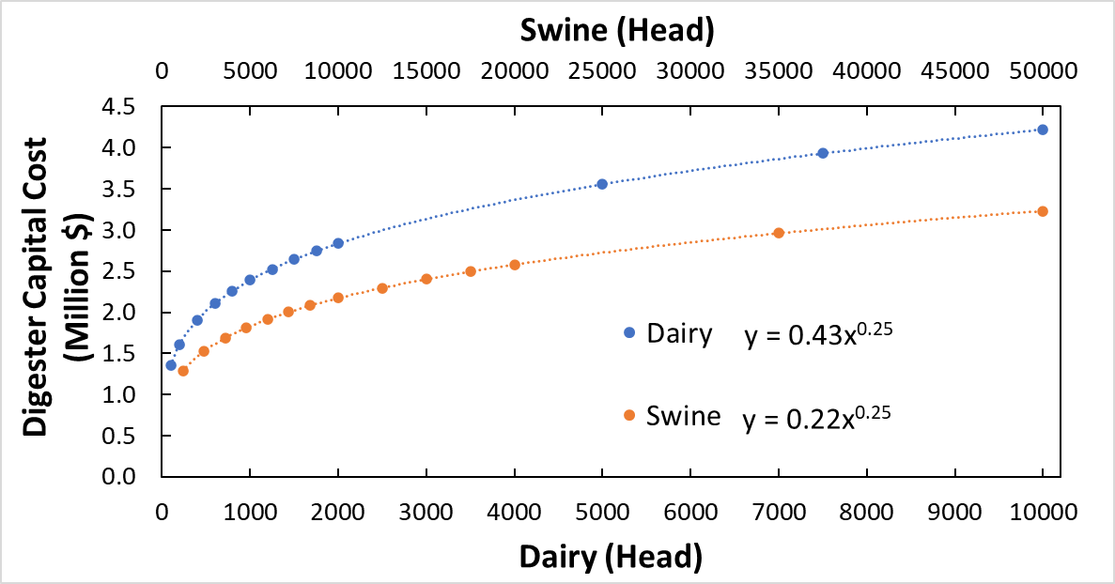
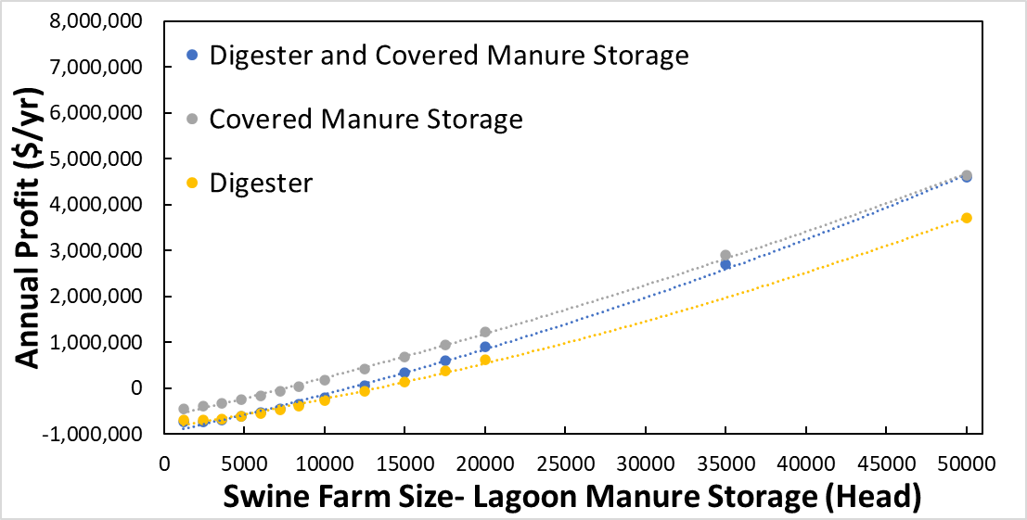
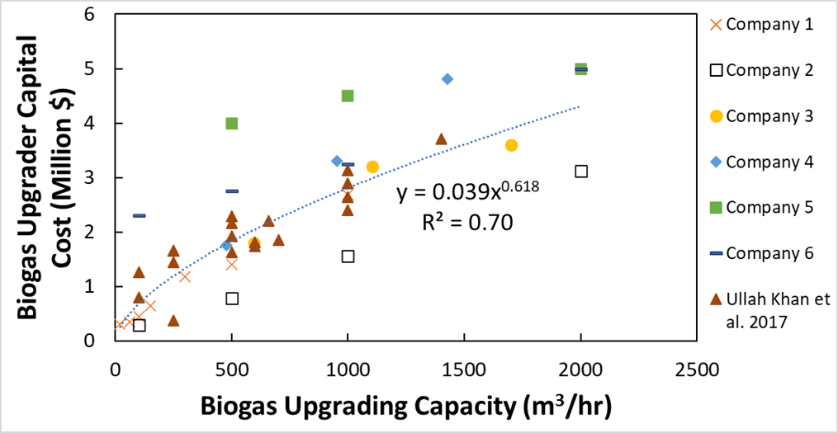
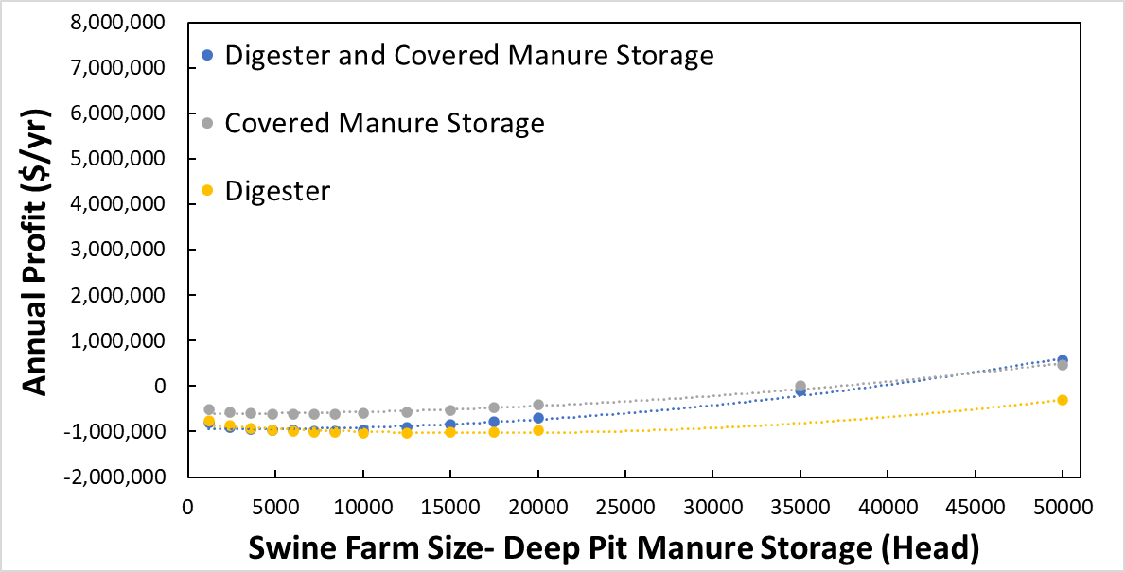
    January 2024
Farm Size Impacts Profitability of Anaerobic Digestion Renewable Natural Gas Projects
Luke C. Soko and Daniel S. Andersen
Project Rationale and Goals
Livestock manure produces 1.5% of anthropogenic greenhouse gas (710 million metric tons CO_{2e} per year)
There are 330 manure-based anaerobic digesters in the US, which reduce 6.1 million metric tons of CO_{2e} annually = removing 1.3 million cars off the road
Smithfield Foods, Tyson, and JBS committed to 30% (or more) greenhouse gas reduction by 2030
Objective: develop a calculator that helps farmers assess the profitability of potential anerobic digester and renewable natural gas projects
Alternate Scenario
Dairy Manure Storage Emptied 1x Per Year
Less manure application increases baseline methane emissions
CMS $/yr > 0 at 730 head
Methods
Sources of Revenue
Natural gas sales
  $0.127 per m³ methane
  (2% to 5% of total revenue)
  Renewable Identification Number (RIN) credits
    $1 per m³ methane
    (18% to 35% revenue)
    Low Carbon Fuel Standard (LCFS) credits
      $167 per metric ton CO_{2e} abated
      Dependent on fuel’s carbon intensity (CI) score
      (60% to 80% revenue)
                Sources of Cost
                Impermeable cover cost modeled from 24 different projects from Roos et al. (1999)
                Biogas upgrader cost modeled using estimates from 6 different companies and data from Ullah Khan et al. (2017)
                Brokerage fees range from 20% to 10% of credit value depending on farm size. Does not exceed $200,000/yr
                Deep pits require additional manure storage estimated at $0.066/L storage plus $18,000 per 1200 head
                Natural gas injection site estimated capital cost of $1,000,000
                Digester cost calculated by Washington State University “Anaerobic Digester System Enterprise Budget Calculator” Astill and Shumway (2016)
                Carbon Intensity (CI) Scoring and Digester Efficiency
                CI scores calculated by “Tier 1 Simplified CI Calculator for Biomethane from Anaerobic Digestion of Dairy and Swine Manure”- California Air Resources Board or CARB (2018)
                CI scores (g CO_{2e} / MJ)
Digester Efficiency (% of BMP Achieved in Digester in Ames, IA)
Discussion and Conclusion
Deep Pit Downfalls
Construction costs at deep pit facility and new manure storage reduce project profitability
Less baseline emissions in the deep pit scenario results in a worse CI score and subsequently less LCFS credits
LCFS and RIN Price Volatility
Below graph demonstrates how annual profit would change as the LCFS and RIN prices change from Q1 2018 to Q1 2023
Range of $500,000/yr caused by LCFS and RIN volatility
Conclusion
Digester efficiency of DCMS requires more research regarding the breakdown of volatile solids prior to digestion
Existing manure management and storage play large role in CI score and project profitability
Revenue relies heavily on carbon credits (~95% of total revenue)
66 potentially profitable dairy farms in Iowa (38% of dairy farms)
50 potentially profitable swine farms in Iowa (0.7% of swine farms)
Frequency of emptying manure storage plays critical role in methane production, CI score, and break-even herd size
CMS more profitable than DCMS for smaller farm sizes
Assuming a 5-year life, 8% interest, and that biogas is produced in Iowa and upgraded to renewable compressed natural gas (RCNG) and injected into the natural gas grid…
Break-Even Farm Size
Profit
Digester Cost
Biogas Upgrader Cost
AgSTAR Data and Trends. (2022). Retrieved from https://www.epa.gov/agstar/agstar-data-and-trends#:~:text=In%20the%20United%20States%2C%20there,to%20these%20biogas%20recovery%20system.
Astill, G. M., & Shumway, C. R. (2016). Profits from pollutants: Economic feasibility of integrated anaerobic digester and nutrient management systems. Journal of Environmental Management, 184, 353–362. https://doi.org/10.1016/j.jenvman.2016.10.012
Bauer, F. & Hulteberg, CP. 2013. Biogas upgrading – review of commercial technologies. SGC Rapport 2013:270. Svenskt Gasteknist Center AB, Malmo.
California Air Resources Board. (2023a). LCFS Life Cycle Analysis Models and Documentation | California Air Resources Board. https://ww2.arb.ca.gov/resources/documents/lcfs-life-cycle-analysis-models-and-documentation
EPA. (2022). Greenhouse Gas Emissions from a Typical Passenger Vehicle. Retrieved from https://www.epa.gov/greenvehicles/greenhouse-gas-emissions-typical-passenger-vehicle#:~:text=typical%20passenger%20vehicle%3F-,A%20typical%20passenger%20vehicle%20emits%20about%204.6%20metric%20tons%20of,8%2C887%20grams%20of%20CO2.
EPA. (2022b). RIN Trades and Price Information. Retrieved September 23, 2022, from https://www.epa.gov/fuels-registration-reporting-and-compliance-help/rin-trades-and-price-information#:~:text=December%2031%2C%202019-,D3%20RIN%20Price%20%E2%80%93%20Min,Price%3A%20%240.05%20%26%20Max.
EPA. (2022c). Livestock Anaerobic Digester Database. EPA. https://www.epa.gov/agstar/livestock-anaerobic-digester-database
Key facts and findings. FAO. (2022). Retrieved October 4, 2022, from https://www.fao.org/news/story/en/item/197623/icode/
Roos, K.F., M.A. Moser, & A.G. Martin. 1999. Agstar Charter Program: Experience with five floating lagoon covers. Available at: https://citeseerx.ist.psu.edu/viewdoc/download?doi=10.1.1.591.3396&rep=rep1&type=pdf
Ullah Khan, I., Hafiz Dzarfan Othman, M., Hashim, H., Matsuura, T., Ismail, A. F., Rezaei-DashtArzhandi, M., & Wan Azelee, I. (2017). Biogas as a renewable energy fuel – A review of biogas upgrading, utilisation and storage. In Energy Conversion and Management (Vol. 150, pp. 277–294). Elsevier Ltd. https://doi.org/10.1016/j.enconman.2017.08.035
U.S. Energy Information Administration. 2022. Natural Gas: Iowa Natural Gas Industrial Price. https://www.eia.gov/dnav/ng/hist/n3035ia3m.htm

