Slide 1
Piggybacking on the Sun: Examining the Efficiency and Economic Viability of Solar-based Microgrid Systems in Iowa
Alexandra Jean
Elmin Rahic
Luke Soko
Connor Thorpe
Thanks to Dr. Anne Kimber and her group
DataFEWSion 2024 Symposium

Slide 2
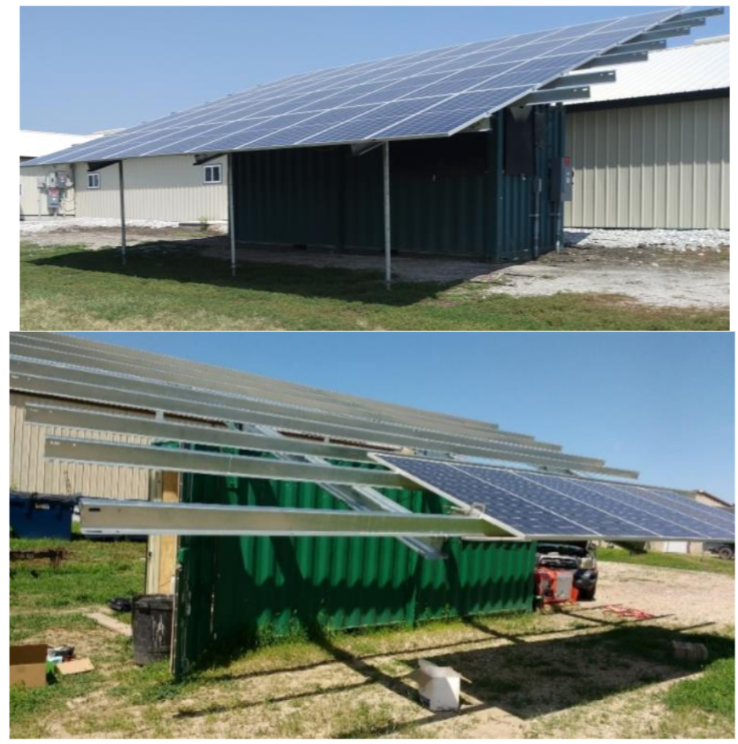
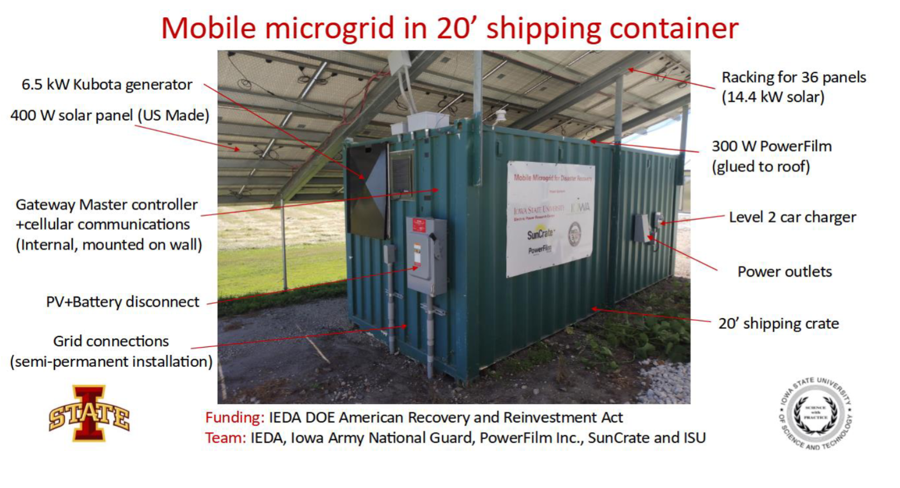
Introduction
Mobile microgrid for disaster recovery (established by Anne Kimber and group)
Powers 500-head hog barn at ISU facility (Ag 450 Farm)
Tesla Gateway sends data on energy generated and required every day for collection
How efficient is the current microgrid system based on the solar radiation data?
Anne Kimber and her group
DataFEWSion 2024 Symposium

Slide 3
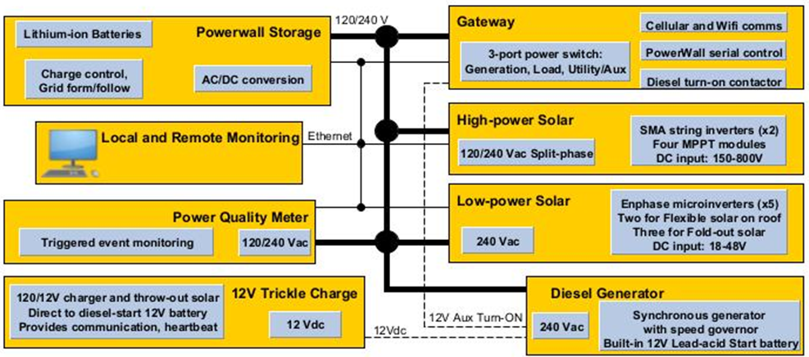
Components & Operating Principles
Major Components:
400 W high-power solar panels (x36)
5-220 W low-power solar panels (x7)
7 kW diesel generator (currently not in use)
5 kW, 13.5 kWh, Tesla Powerwall battery (x6)
Tesla Gateway (master controller)
Directs power to load, Powerwall,
or grid.
Pulls power from grid based on
Powerwall charge.
Anne Kimber and her group
DataFEWSion 2024 Symposium

Slide 4
Outline
Mobile Microgrid System Data
Cumulative Solar Radiation
Energy Generation and MMS Efficiency
Modeling MMS Energy Generation
Economic Evaluation
DataFEWSion 2024 Symposium

Slide 5
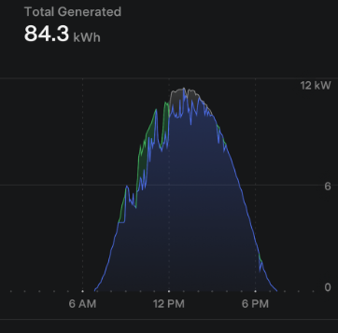
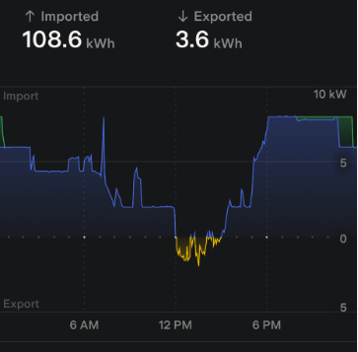
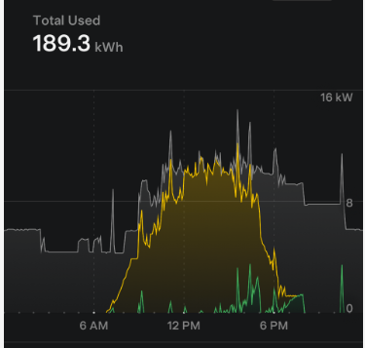
Mobile Microgrid System Data
Solar Pannel
Electric Grid
Hog Barn Demand
DataFEWSion 2024 Symposium

Slide 6
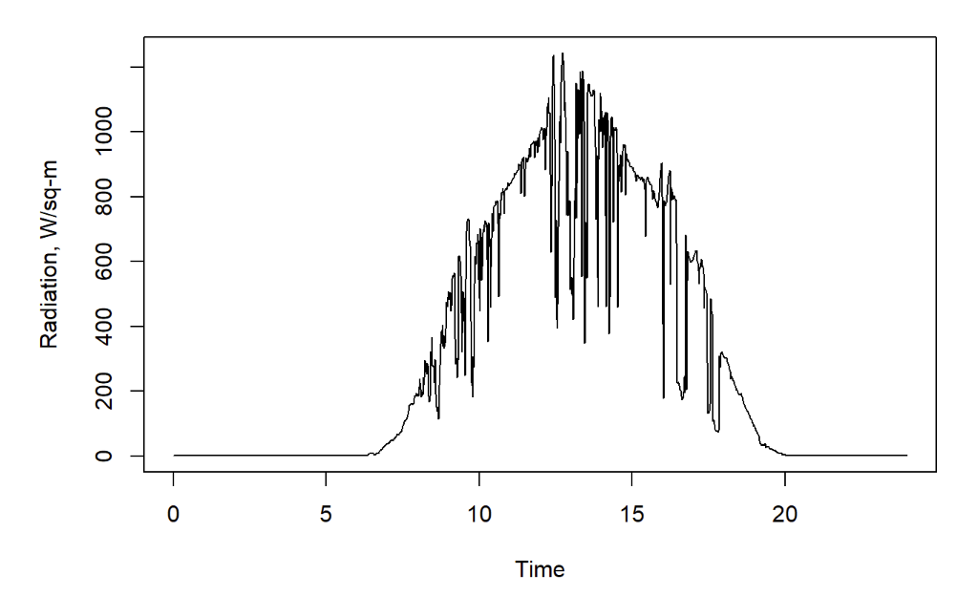
Cumulative Solar Radiation
DataFEWSion 2024 Symposium

Slide 7
Energy Generation and MMS Efficiency
Projected Energy Generation
Total array area: 72 m²
Rated Efficiency: 20%
$$ProjectedGeneration=CumulativeRadiation∗72∗0.2$$
𝑃𝑟𝑜𝑗𝑒𝑐𝑡𝑒𝑑𝐺𝑒𝑛𝑒𝑟𝑎𝑡𝑖𝑜𝑛=𝐶𝑢𝑚𝑢𝑙𝑎𝑡𝑖𝑣𝑒𝑅𝑎𝑑𝑖𝑎𝑡𝑖𝑜𝑛∗72∗0.2
Practical Energy Generation
$$MeasuredEffeciency=\frac{Measured Generation}{Projected Generation}$$
𝑀𝑒𝑎𝑠𝑢𝑟𝑒𝑑𝐸𝑓𝑓𝑒𝑐𝑖𝑒𝑛𝑐𝑦=(𝑀𝑒𝑎𝑠𝑢𝑟𝑒𝑑 𝐺𝑒𝑛𝑒𝑟𝑎𝑡𝑖𝑜𝑛)/(𝑃𝑟𝑜𝑗𝑒𝑐𝑡𝑒𝑑 𝐺𝑒𝑛𝑒𝑟𝑎𝑡𝑖𝑜𝑛)
Average Efficiency: 17%
DataFEWSion 2024 Symposium

Slide 8
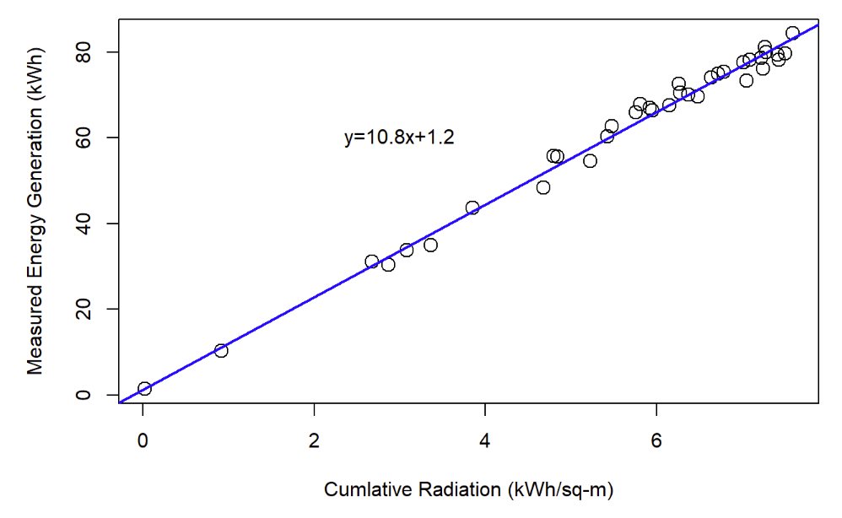
Modeling MMS Energy Generation
DataFEWSion 2024 Symposium

Slide 9
Economics
$130,000 capital expense for SunCrate MMG
Battery system is lithium-ion phosphate with a 10-year or 3000 cycle warranty
Solar inverters 10-year warranty
Solar panels 20-year warranty
$19,300/year over 10 years at 8% interest
DataFEWSion 2024 Symposium

Slide 10
Options to Pay Off Project
Electricity Value
  Reduced electric bill
  Sell electricity back to grid
  Emergency microgrid and electricity usage
Carbon credits
Grants and tax credits

Slide 11
Electricity Value
Reduced electric bill
  4.89 kWh/m²/day
  72 m² panel area and 17% efficiency yields 60 kWh/day
  $0.14/kWh… $8.40/day or $3070/year
Sell electricity back to utility
  Utility takes big cut, maybe sell for $4.20/day or $1530/year
Emergency electricity
  FEMA (Federal Emergency Management Agency) Schedule Equipment Rate
    7000 kW solar microgrid usage - $800/hour
      14.4 kW- $1.64/hour or $40/day
    16 kW (unspecified) generator $190/day
    How long is the emergency?

Slide 12
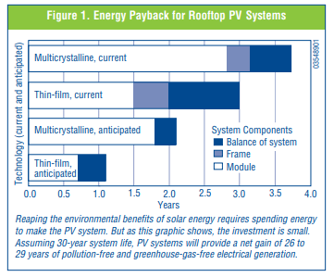
Carbon Offset and Credits
Can’t use LCFS and RIN carbon credit markets
  eRINs “electric” RIN – can’t use this either- must be “biomass derived”
    6.5 kWh/RIN at $1.50/RIN = $9.75/day
    Must sell electricity: $4.20/day + $9.75/day = $13.95/day or $5100/yr
Private party carbon markets- Amazon, Google, Delta
Carbon Offset
  1 to 4 years to offset CO_{2e} from solar panel production
  0.9 tons CO_{2e}/pig-space/year (1080 tons CO_{2e}/yr)
  Carbon neutral pork or carbon neutral electricity?

Slide 13
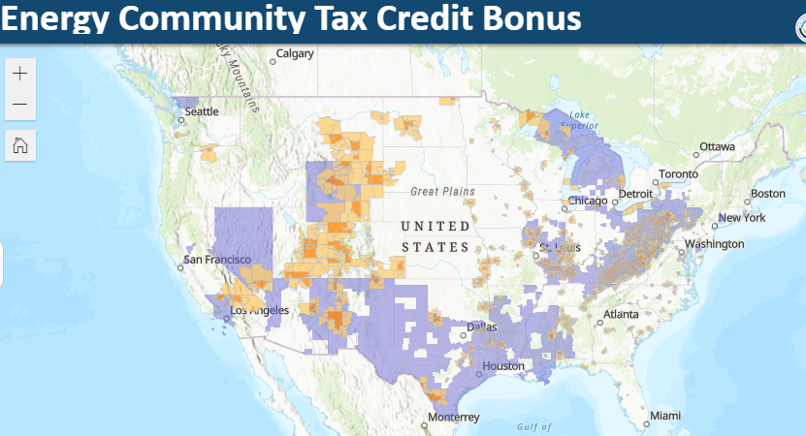
Tax Credits and Grants
2022 Inflation Reduction Act- Investment Tax Credit (ITC)
  Up to 50% off capital expense
    6% or 30% capital expense tax credit (depends on wages for labor)
    Additional 10% Domestic Content (U.S. made materials)
    Additional 10% “Energy Community” (Traditionally fossil fuel region)
REAP (Rural Energy for America Program)
  $1.055 billion in available funds as of March 2023
  Grants up to $1,000,000
  Low interest loans
Future work explores private carbon credits

