Slide 1

DataFEWSion Symposium 2024
Student Collaboration Project
Food Systems
Júlia Brittes Tuthill
Logan Johnson
Nicole Kling
Angelos Lagoudakis

Slide 2

Harvesting Harmony:
A Data-Driven Inquiry into Food Inequity and Climate Impacts in Iowa

Slide 3


Slide 4
Roadmap
Introduction to Interdisciplinary Collaboration
Objectives
Data Sources
Data Visualization
Future Steps

Slide 5
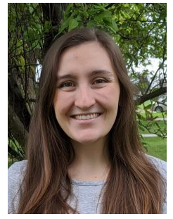
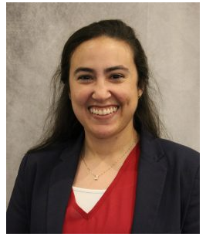
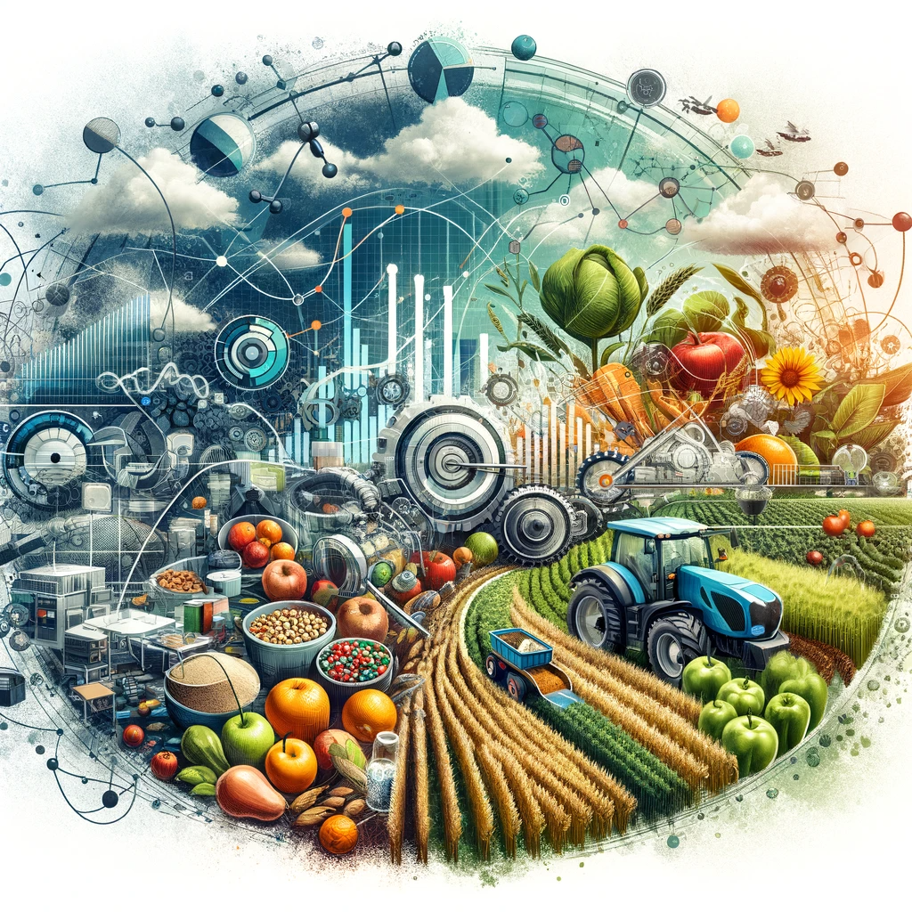
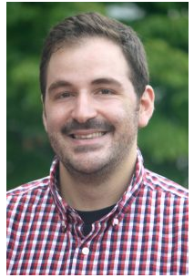

Interdisciplinary Collaboration – Chapter One
Ag Production
Nutrition
Nicole
Nutritional Sciences
Júlia
Ag & Bio Engineering
Food Economics
Ag Production
Angelos
Economics
Logan
Animal Science

Slide 6
Interdisciplinary Collaboration – Food Systems Exploration
Climate Opinions
Ag Production
Local Food Security
Food Access
Household Characteristics
Notes:
-Using Directed Acyclic Graphs, we will show you some of the explorations of the food systems that took place in our discussions during the last few months.
1st) We tried to find any potential connection between ag production and local food security
2nd) Food Access could be a mediator in that relationship
3rd) In turn, household characteristics can be a confounder in the relationship between Food Access And Local Food Security, as the literature has shown (Alcott et al. 2019).
4th) Finally, Climate Opinions can be a collider.
As it is easily understandable, food systems are quite complicated, and their exploration requires a wide variety of data. Nicole will explain next the objectives of our project given those challenges.

Slide 7
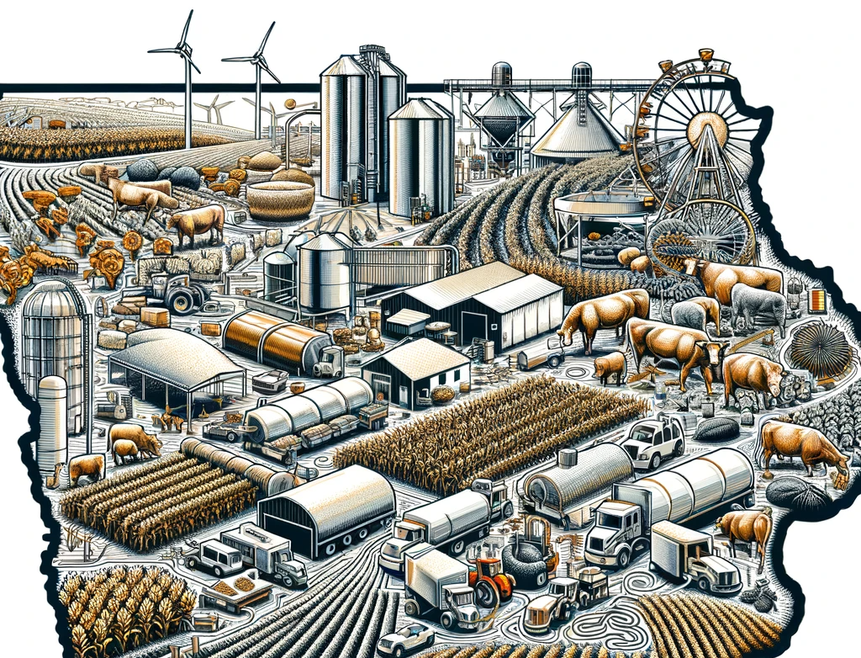
Objectives
Visualize and analyze Iowa's food systems
Integrate various data sources
Identify gaps and trends in the data
Notes:
dashboard aims to provide a clear, data-driven view of how agricultural practices, specifically livestock production, intersect with food security challenges in Iowa. The insights gained could be pivotal for strategic planning in agriculture and food policy
To gather and integrate data on livestock production (hogs and cattle) and food insecurity in Iowa.
To use statistical and data analysis techniques to identify trends, patterns, or correlations of the Iowa food production system with basic demographic, socioeconomic, and other descriptive statistics of Iowa's population, and state and federal funding of SNAP and other food/agricultural funding for people/farmers.
To create an interactive dashboard that visually represents these trends making the data easily accessible and understandable.

Slide 8
Data Sources - Now
Population Distribution
  US Census: 2000, 2010, & 2020
Crop and Livestock Production
  USDA NASS: 1968-2022
Food Access Statistics
  USDA NASS, USDA ERS, Food Access Research Atlas: 2018
Climate Opinions
  Yale Climate Opinion Survey: 2014-2023

Slide 9
Data Sources – Desired for Future
More detailed population information
  Demographics, Socioeconomic status, and other affiliations
Federal SNAP funding allocation and participation rates
Other relevant agricultural production data
  Location of ethanol plants, etc.
Specific Point Data
  Local food production systems
  Food banks, farmers markets
  Other relevant agricultural or food access data

Slide 10
Brief Glimpse at our Shiny Application
This is a rough outline of what we might produce in a final form.
Ideally would include more background information, the other data sources, and other interactive elements for the user.

Slide 11
Future Steps
Finalize our data visualization
Incorporate more data
Share our work

Slide 12
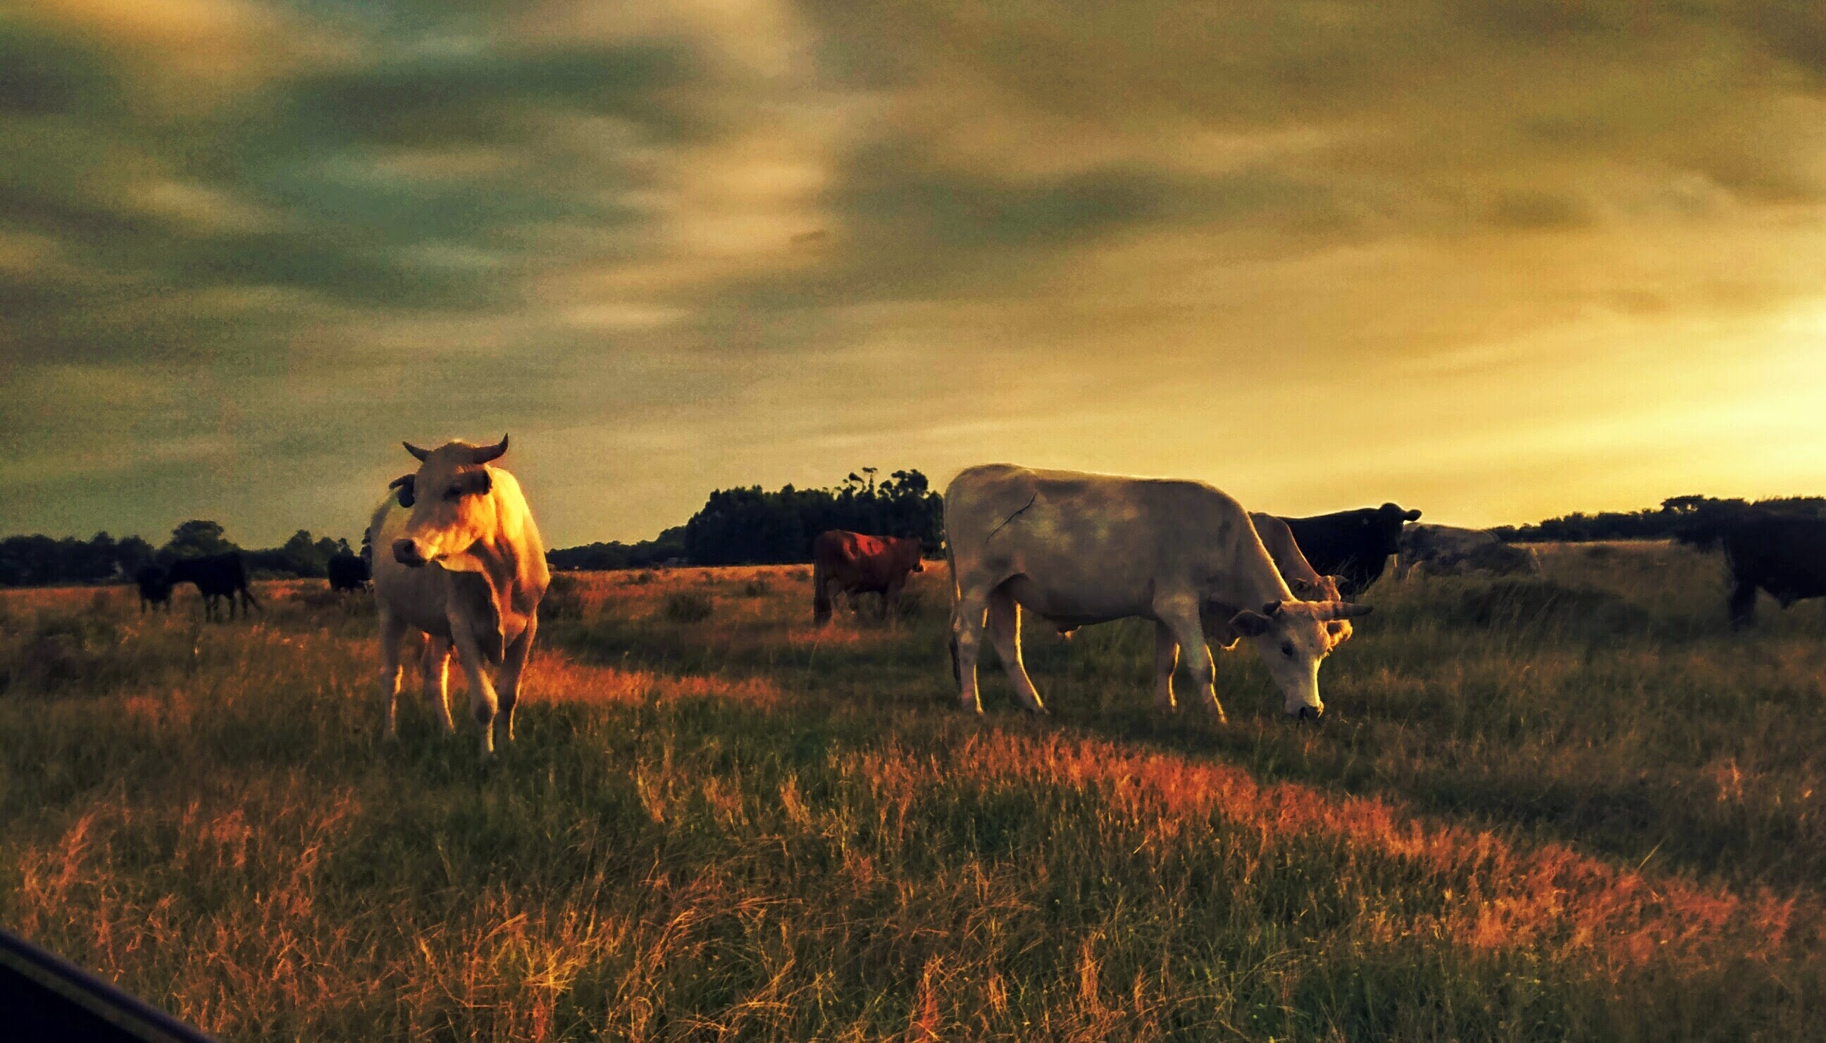
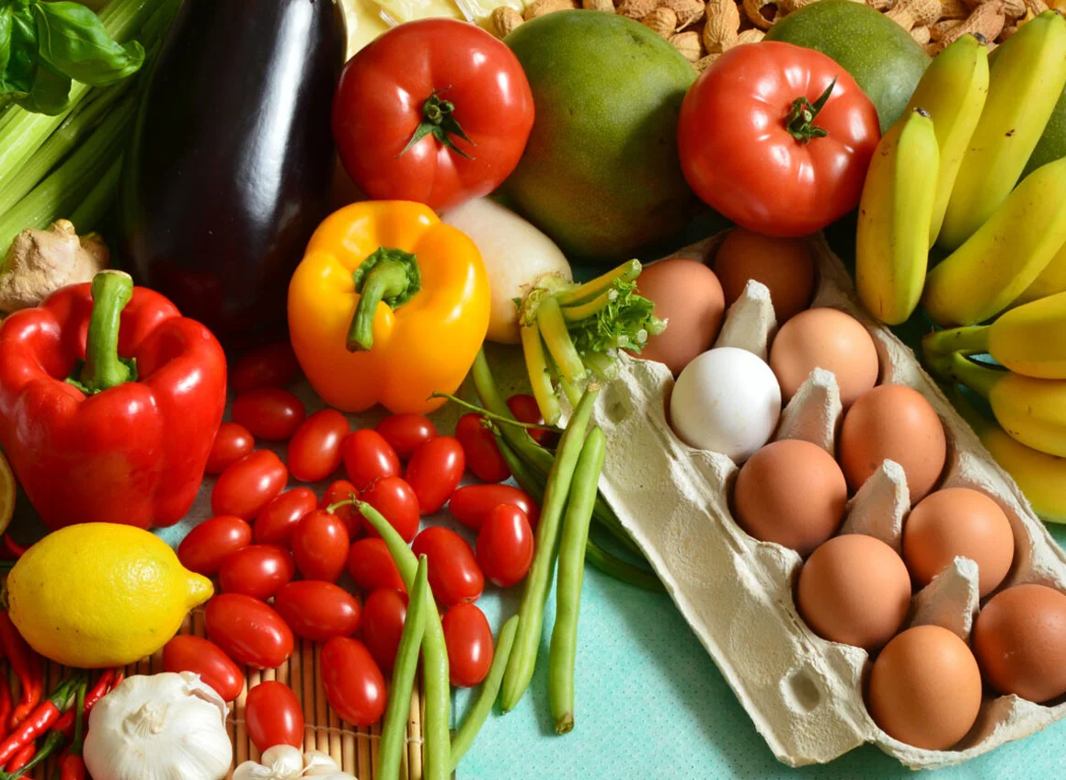
Thank you!

