Slide 1
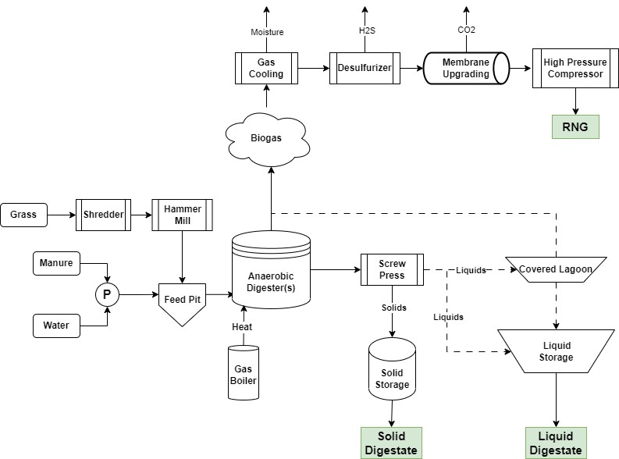
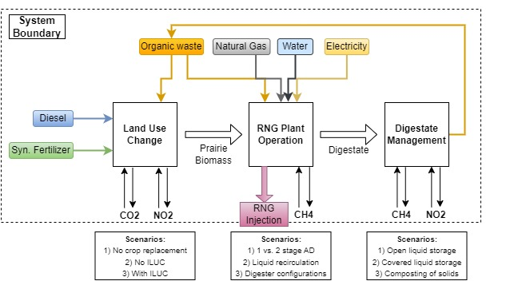
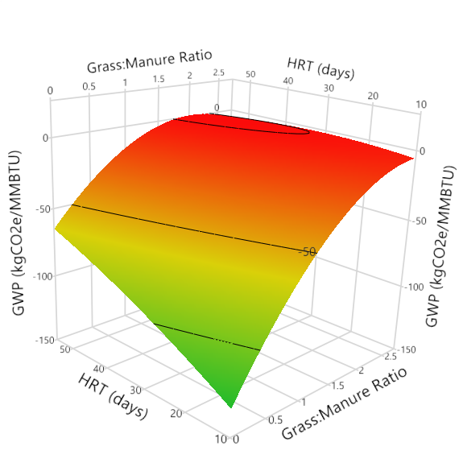
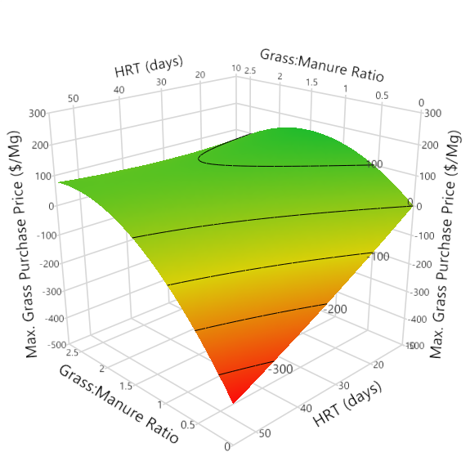
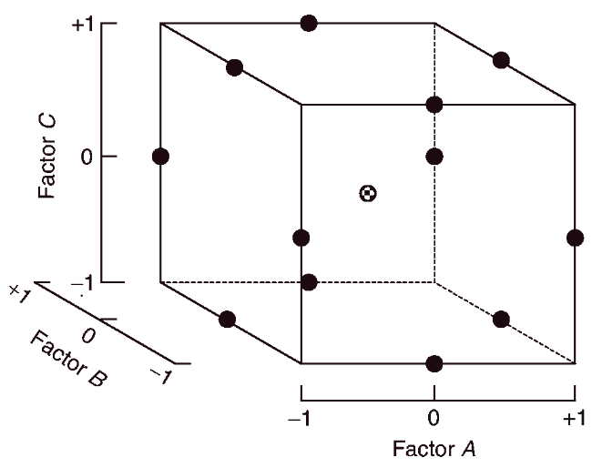
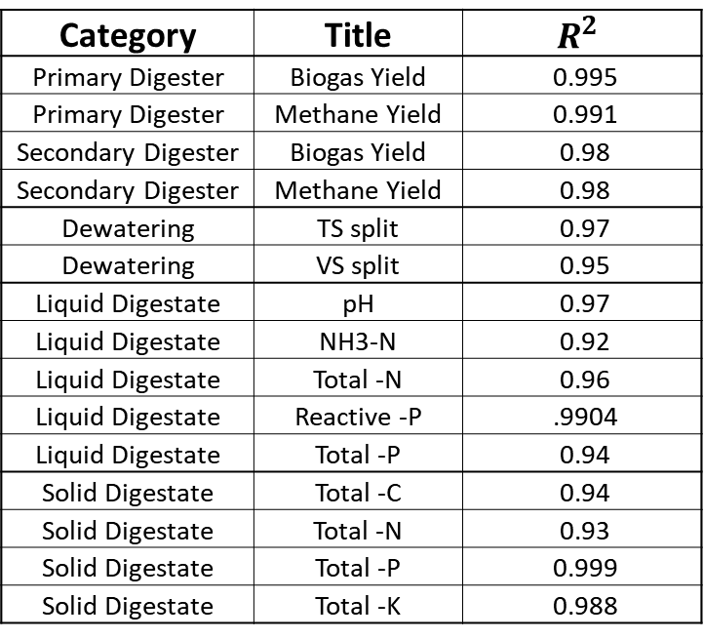
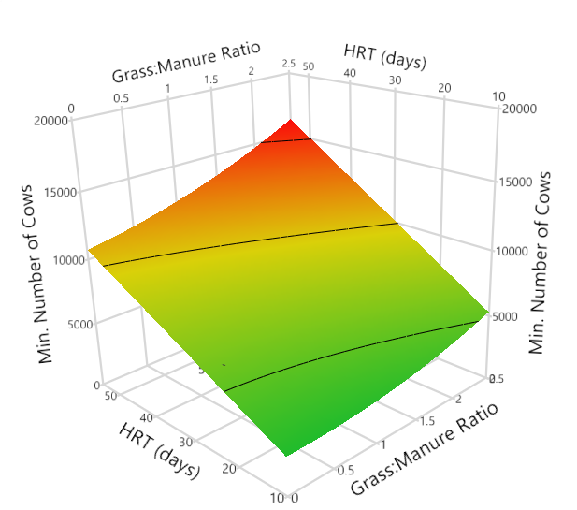
Can Anaerobic Digestion Fuel Regenerative Agriculture?
${Elmin Rahic}^{1}$, ${Nicholas Cassady}^{2}$, ${Zhiyou Wen}^{3}$
Dept. Agricultural and Biosystems Engineering$^{1}$, Dept. Biochemistry, Biophysics, and Molecular Biology$^{2}$,
Dept. Food Science and Human Nutrition$^{3}$, Iowa State University
Introduction
Results: Techno-economic Analysis
Results: Life-cycle Assessment
Background
Current agricultural practices have resulted in significant ecological and environmental harm.
To incentivize farmers to implement conservation practices, they must provide some economic return.
Objective
Evaluate whether anaerobic digestion (AD) can be used to provide a financial incentive to farmers to replace portions of existing cropland with prairie. We call this system “Grass2Gas.”
Evaluate the economic and environmental sustainability of this system.
Materials and Methods
Experimental Modeling
Anaerobic digestion outputs are modeled using response surface methodology.
All conditions are evaluated in semi-continuous reactors under mesophilic conditions (37°C). Reactors are fed a mixture of beef manure and prairie.
Three liquid digestate recirculation rates will be evaluated: 0%, 50%, and 100%.
Modeling Residual Gas Production during Liquid Digestate Storage
Liquid digestate samples (during steady state periods) are evaluated for gas production and nutrient concentration during storage.
Each condition is being measured in batch and in triplicate.
The global warming potential (GWP) of a Grass2Gas system depends heavily on:
Quantity of grass.
Digestate management.
Within the boundaries tested, RNG can be produced anywhere between -120 to 10 kgCO2e/MMBTU.
RNG selling price set at D3 RIN value ($2.58/RIN).
Digester configuration significantly affects RNG economics for a Grass2Gas system.
Shorter retention time was generally more favorable.
Can you have a Grass2Gas system that is both environmentally and economically sustainable?
RNG production can still be carbon negative, but this depends on the digestate management system.
Demonstrates a need for more field data on digestate emissions.
Can RNG provide farmers with a financial incentive to grow prairie?
RNG can be profitable with prairie feedstock costs up to $150/Mg.
Approximately $500 - $700/acre in revenue to farmers.
Retention time
Organic Load
*AD parameters set for maximum allowable purchasing price of prairie feedstock.
Grass:Manure ratio
Remaining Work
Techno-economic Analysis (TEA)
Investigating different AD parameters for 1 vs. 2 stage AD systems to evaluate which scenarios/scales are profitable.
Process model and TEA performed using the BioSTEAM library in Python.
Life Cycle Analysis (LCA)
Spreadsheet-based process model looking at global warming and eutrophication potential.
Goal: Compare LCA and TEA results to better understand economic and environmental outcomes for all scenarios.
Will this result in the expansion of CAFOs?
AD can integrate a variety of feedstocks. Incorporation of grasses is not synonymous with CAFO facilities.
Process model assumes manure is purchased off-site (community digester).
Continuing data collection on liquid recirculation and higher grass ratios.
Integrating different land use change scenarios into the LCA process model.
Comparison of LCA results with the GREET model.
LinkedIn
Grant Number: 2020-68012-31824

