Slide 1
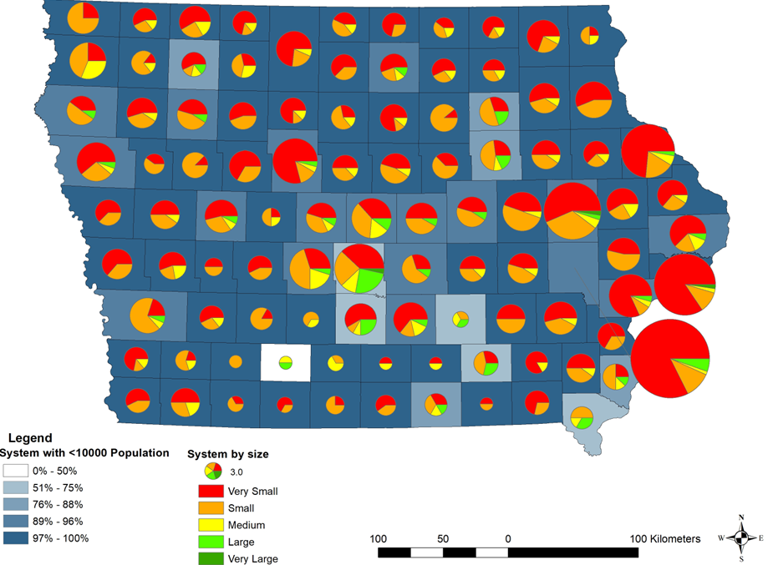
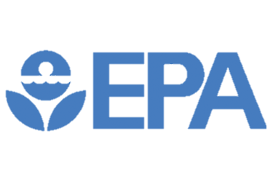
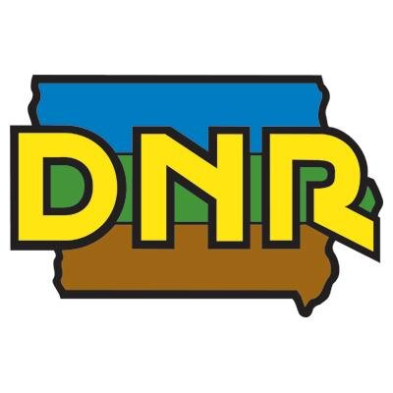
Civil, Construction and Environmental Engineering
DataFEWSion Symposium
Emmanuel Padmore Mantey, Lu Liu*, Chris Rehmann
Disparities in potential nitrate exposures within Iowa public water systems
Background and Introduction
Key Results
Conclusions
Iowa faces health risks from elevated nitrate levels in drinking water linked to agricultural activities.
Cancer cases emerge at nitrate levels as low as 5 mg/L, half the limit set by the Federal Safe Drinking Water Act (10 mg/L).
Vulnerable communities, including those with low income, people of color, and children, often face challenges addressing nitrate-related issues.
Limited research exists on nitrate pollution specific to Iowa’s water systems, and less is known about the disparities in nitrate exposure among different sociodemographic groups in the state.
Iowa Public Water Systems
A rising trend in average nitrate concentration in Iowa’s PWSs.
2.19% of the PWSs are ‘high-risk’ systems in Regions 3, 4, 5, and 6.
Lack of nitrate removal processes in many small communities contributes to sustained elevated levels.
Low-income, elderly, children, and people of color are statistically more exposed to elevated nitrate in Iowa.
‘Hotspots’ (high nitrate PWSs) identified and correlated with socially vulnerable groups.
Most community water systems in Iowa fall under the “Very small” to “Medium” category, with few counties having one water system
Small system (serving <10,000 people)
Average Nitrate Concentration
Average = 6.74 mg/L
Average = 6.36 mg/L
18 systems above 5mg/L 9 systems consistently above 5 mg/L
Objectives
16 systems above 5mg/L 10 systems consistently above 5 mg/L
Implications
Investigate long-term nitrate levels in the Iowa’s Public Water Systems (PWSs).
Evaluate the risk of PWSs (consistently > 5mg/L) by analyzing trends in nitrate levels.
Assess potential sociodemographic disparities in potential nitrate exposure.
Iowa Department of Public Health regions
We aim to inform decision-makers about the urgent need for low-cost nitrate remediation technologies.
We seek to prompt more robust public health initiatives through frequent monitoring.
Risks in potential nitrate exposure
Disparities for low-income communities
Methods
Acknowledgments
Analyzed average annual nitrate concentrations in 871 Iowa PWSs between 2012 and 2022 (Data source: Iowa Department of Natural Resources).
Associated sociodemographic information (race, gender, age, level of income, etc.) for each PWS (Data source: Enforcement and Compliance History Online (ECHO)).
Applied statistical methods to analyze trends and disparities in potential nitrate exposure.
The authors would like to acknowledge the Environmental Protection Agency for funding and Iowa Department of Natural Resources for data support.
We would also like to thank ISU undergraduate students Matthew Decker, Sarah Kothlow, Suryansh Mishra, and Jacob Dunn.
Iowa Department of Public Health regions
Low Nitrate= 95% High Nitrate=5%
Percentage (C >5 mg/L) | People 65 and Older | Children 5 and Younger | Low income | People of Color
Region 1 | 0% | 0% | 0% | 0%
Region 2 | 4% | 3% | 3% | 1%
Region 3 | 5% | 6% | 4% | 3%
Region 4 | 15% | 9% | 9% | 3%
Region 5 | 6% | 6% | 6% | 7%
Region 6 | 26% | 26% | 32% | 35%
Demographics | Percentage (C >5 mg/L)
State average | 7.40%
Low-Income | 10.10%
People 65 and Older | 9.60%
People of Color | 9.20%
Children 5 years and Younger | 8.70%
Results are significant at p < .05 using unequal variances t-test
padmore@iastate.edu
Emmanuel Padmore Mantey

