Slide 1
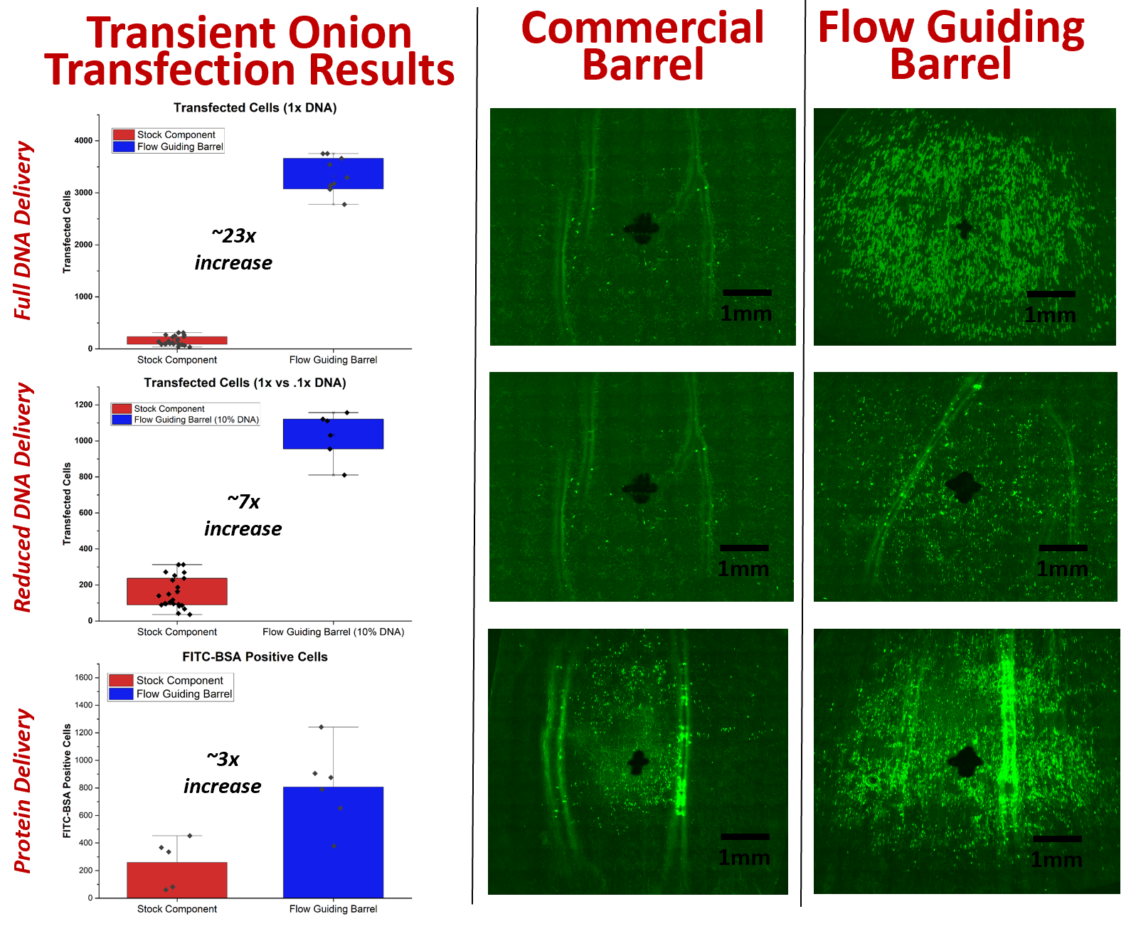
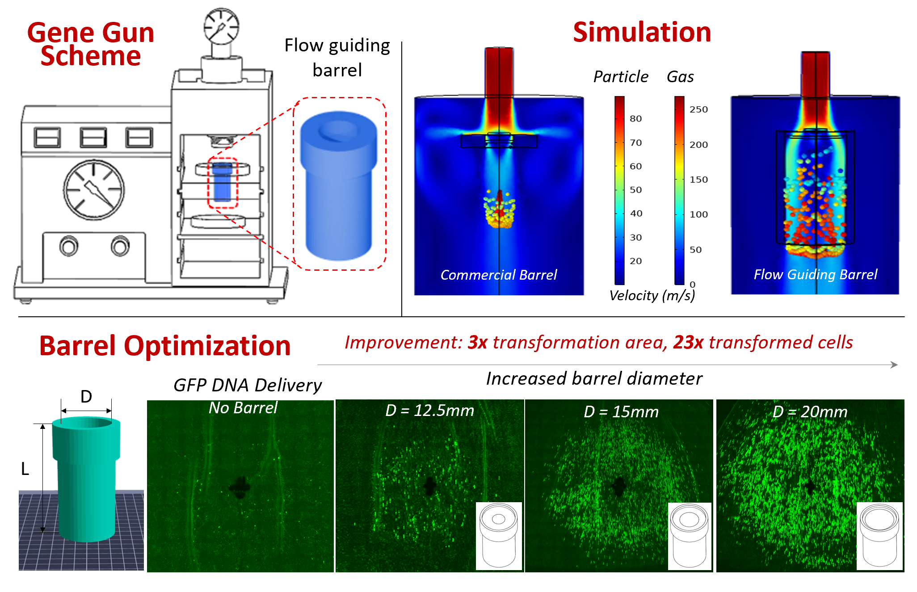
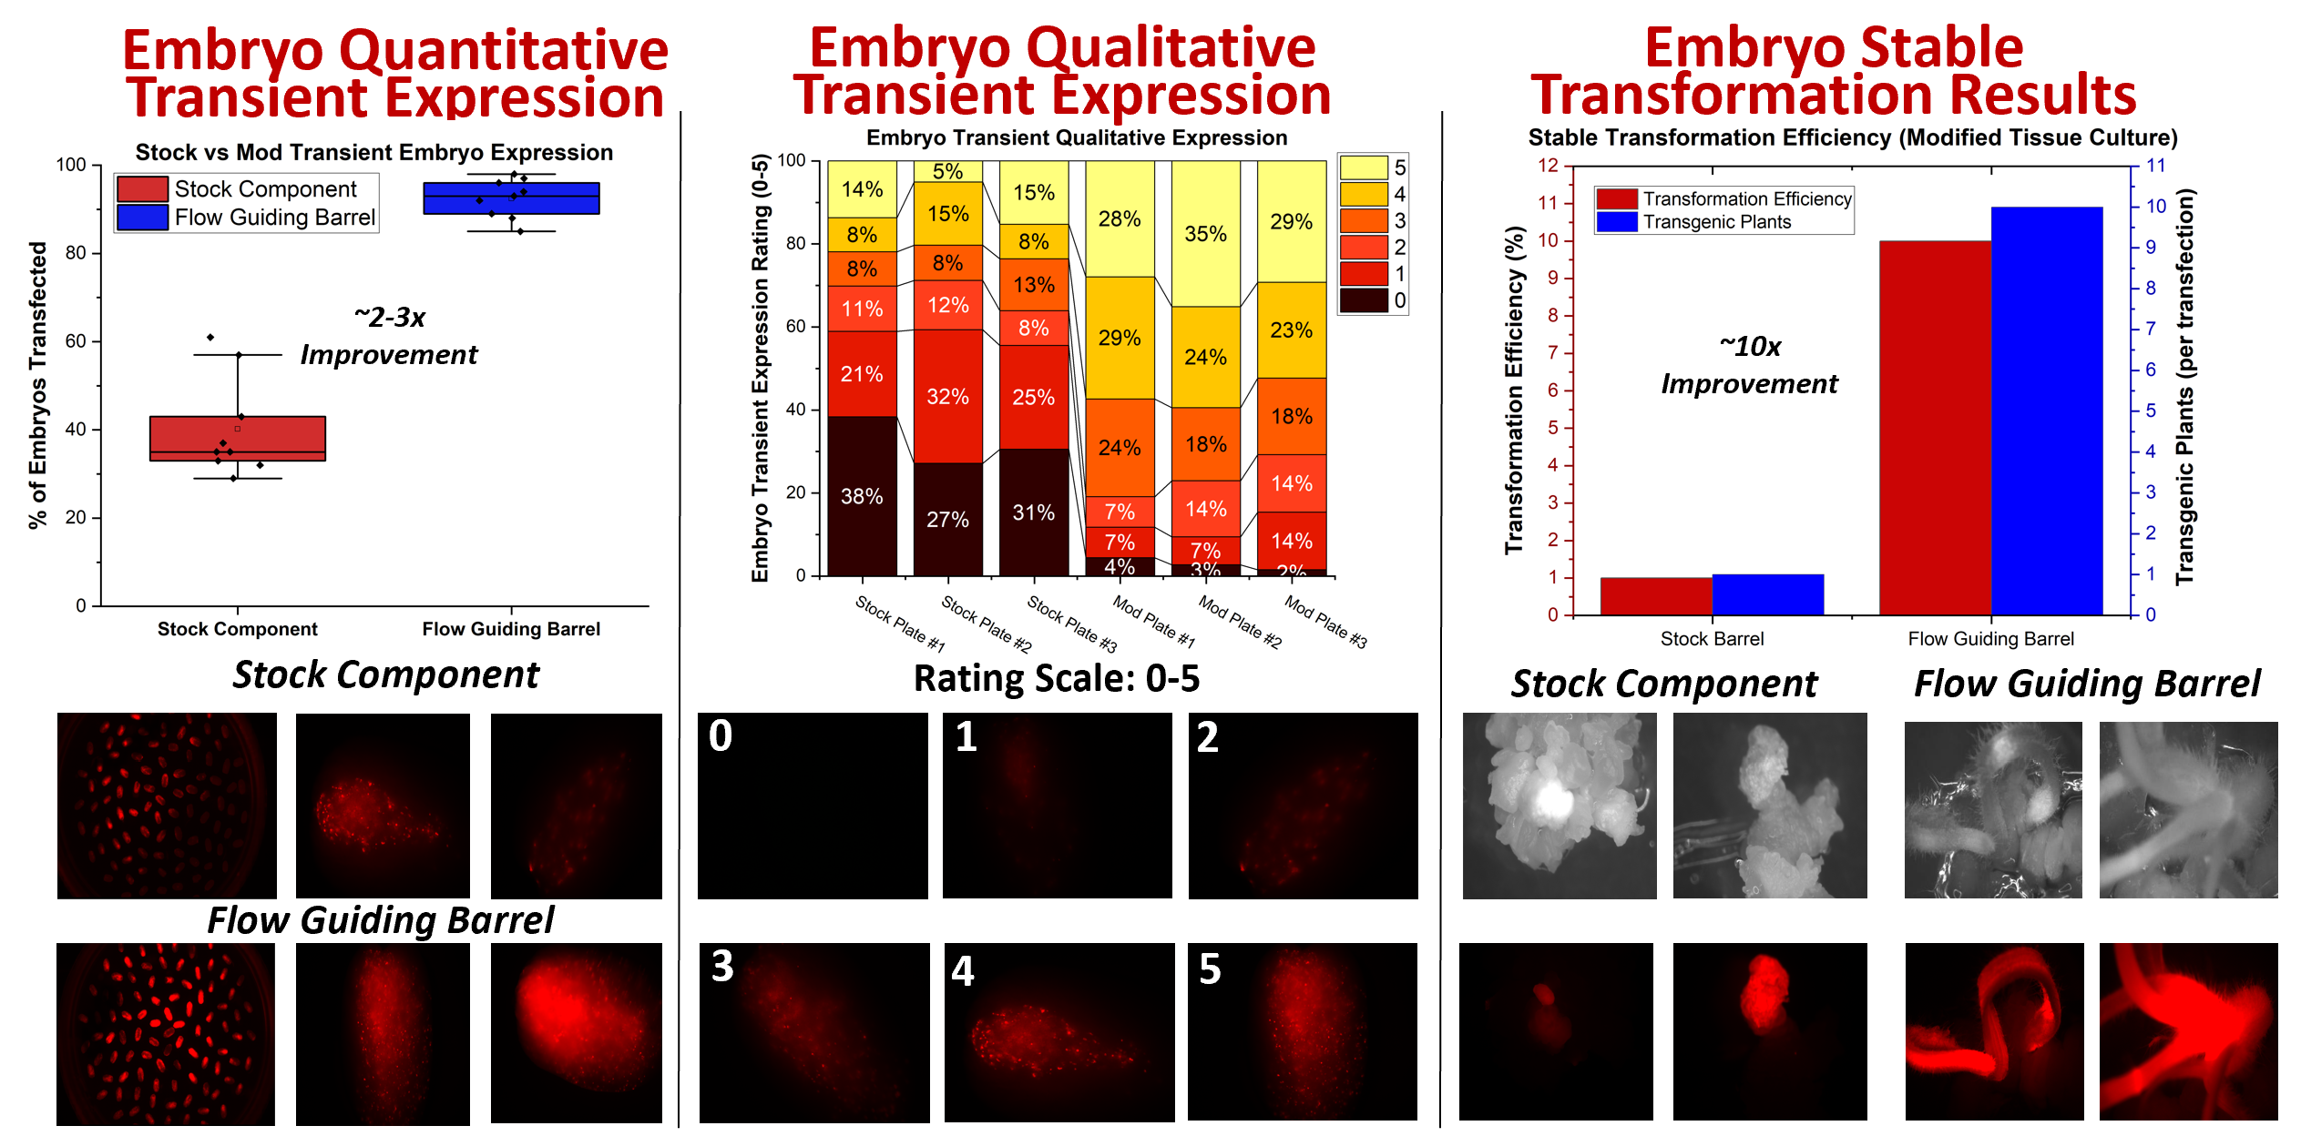
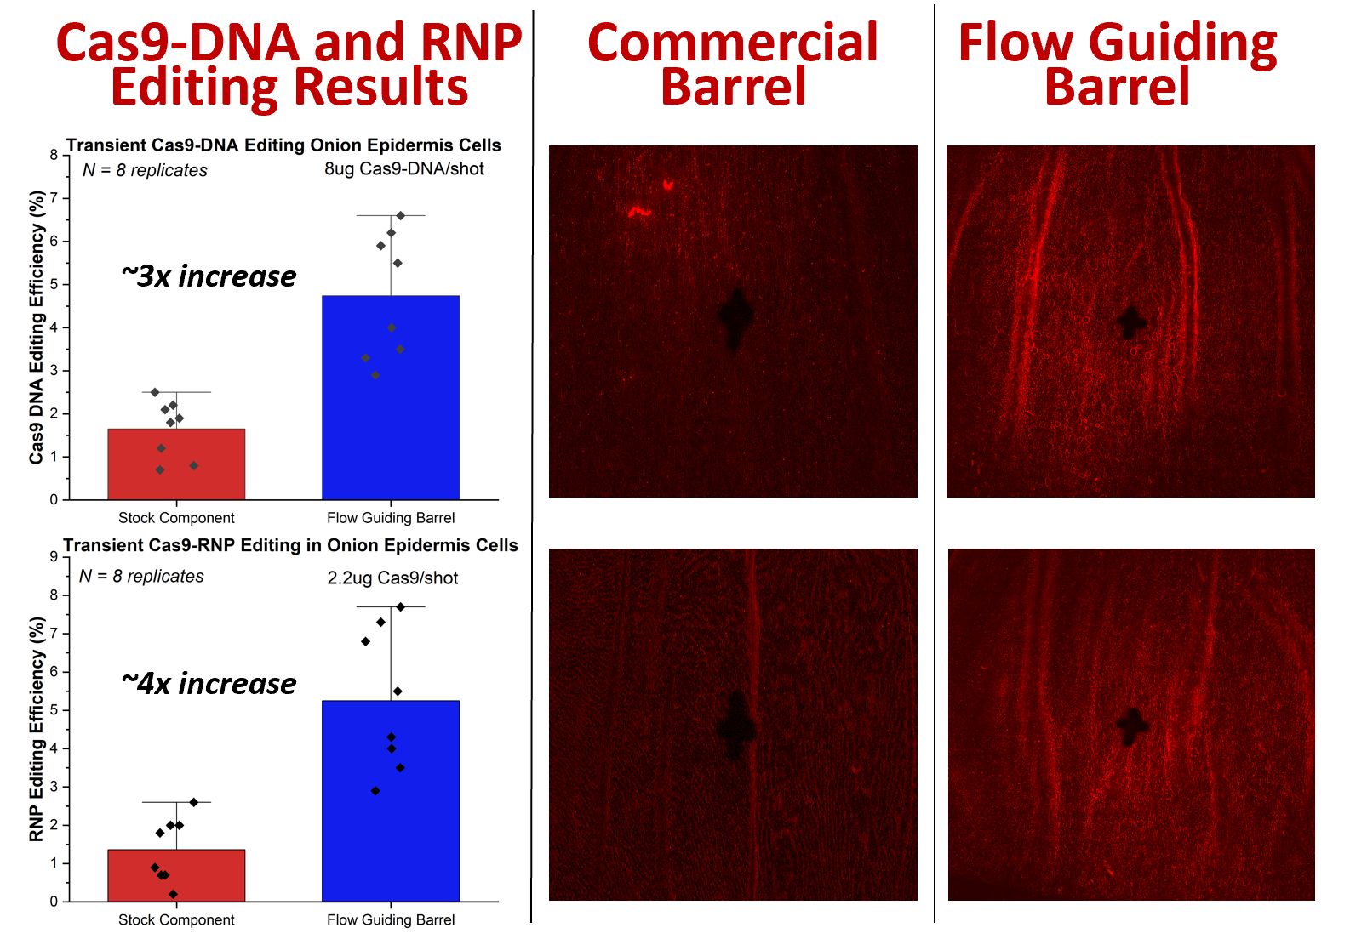
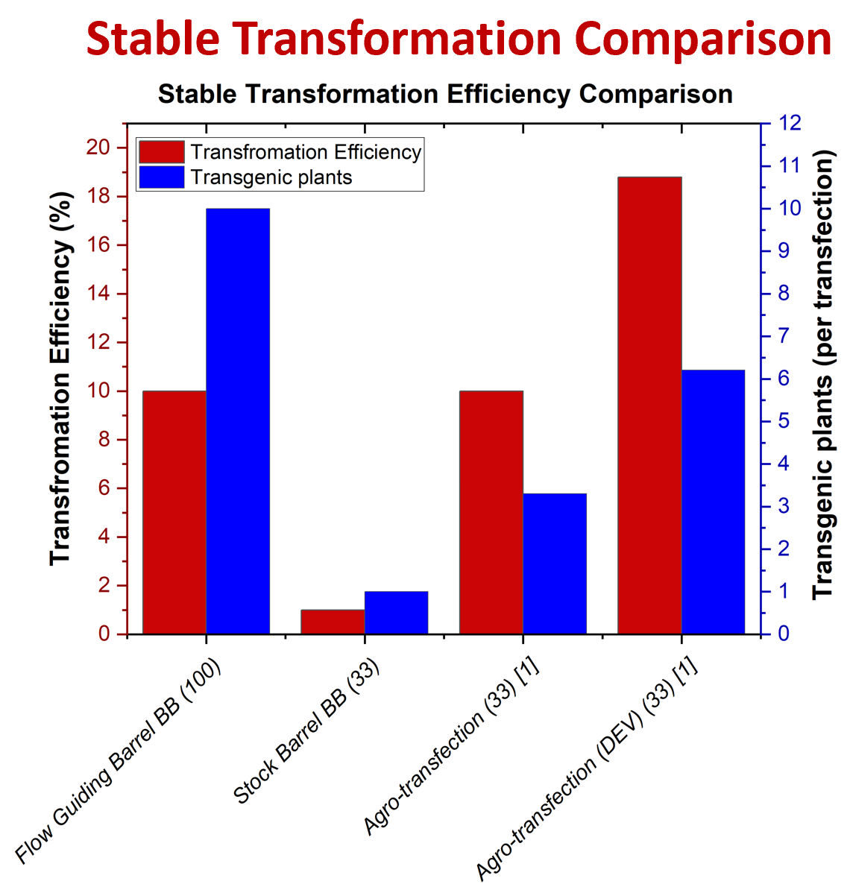
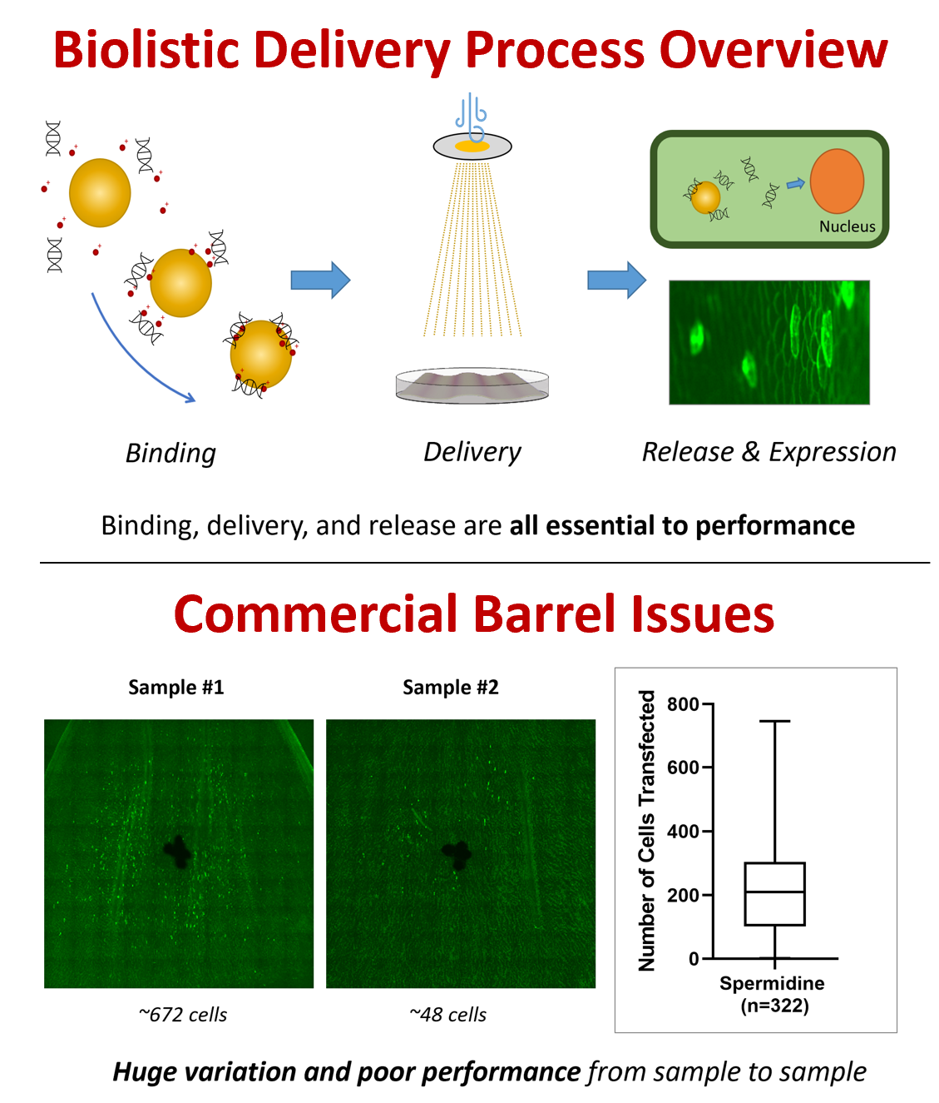
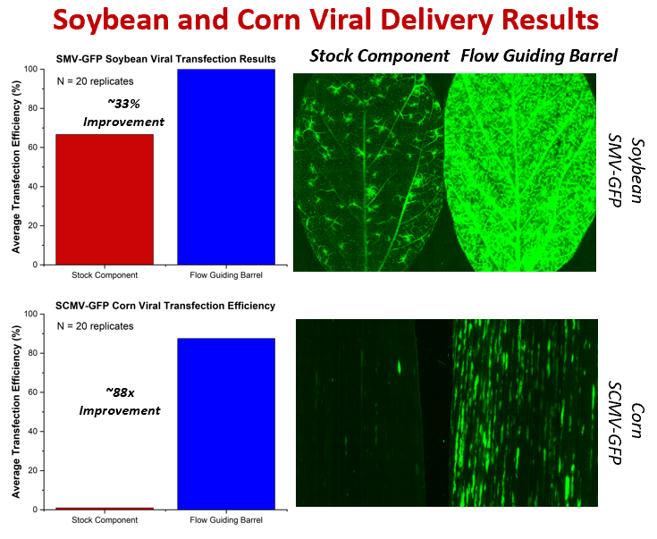
Revolutionizing Biolistic Plant Transformation: The Flow Guiding Barrel Breakthrough
Introduction: Flow Guiding Barrel Design Process
Transient Transfection in Onion Epidermis
Modified Quick Corn Tissue Culture Protocol
Biolistics is the most versatile method of plant gene delivery and editing that can deliver DNA, virus, and protein to any species
Developed a new biolistic barrel device: “Flow Guiding Barrel”
Flow Guiding Barrel improves delivery, transient expression, and stable transformation significantly by altering the flow and efficiently projecting the gold particles toward the tissue
Biolistic improvements demonstrated on onion epidermis, maize B104 embryos, juvenile corn plants, and juvenile soybean plants using plasmid-DNA, viral constructs, and protein.
Novel barrel device was designed in Solidworks and created via 3D printing and optimized for biolistic delivery on all plant species mentioned above
Flow Guiding Barrel shows 23x improvement in transient DNA transfection with 22ng GFP-DNA, 7x improvement with 2.2ng GFP-DNA, and 3x improvement with FITC-BSA protein in onion epidermis
Novel tissue culture protocol developed for biolistic transformation of corn embryos
Modified tissue culture protocol is more than 3x faster than the conventional protocol
Maize B104 Transient and Stable Transformation
Flow Guiding barrel improves transient DNA expression 2-3x to 95% efficiency with 100 embryos per biolistic bombardment
The quality of transient expression is significantly increased when using the new barrel device
Stable transformation frequency increases 10-fold with the Flow Guiding Barrel to around 10% efficiency producing 10 transgenics per experiment
Cas9-DNA and RNP Editing Results in Onion
Flow Guiding Barrel demonstrates a ~3x improvement in Cas9-DNA editing and a ~4x improvement in Cas9-RNP editing in onion epidermis analyzed with Next-generation sequencing (NGS)
Biolistic Process and Current System Drawbacks
Stable Transformation Comparison
Bind DNA, virus, or protein to a heavy metal particle and propel at the plant tissue to penetrate the cell wall and release the DNA, virus, or protein into the cell nucleus
Binding, delivery, and release of the biological reagents are all critical and essential to the overall performance
Current commercial biolistic device is extremely inconsistent and requires extensive experiments to reproduce results
Commercial device has overall very poor performance
Flow Guiding Barrel is 10x more efficient than the commercial stock barrel
The new device is on par with agro-transfection, the commercial standard for gene delivery, but produces more transgenic plants per experiment [1]
Less efficient than agro-transfection with developmental genes (DEV) but produces more transgenics per experiment [1]
Viral Transfection in Juvenile Soybean and Maize
Flow Guiding Barrel shows a 33% improvement in SMV-GFP transfection and an 88x improvement in SCMV-GFP transfection to three-week-old soybean and corn respectively
Future Work
Finish PCR analysis of stably-transformed transgenics and DNA copy number analysis comparing biolistic vs agro-transfection
Move towards protein stable transformation using the Flow Guiding Barrel after transient protein delivery was significantly improved as a proof of concept
References
Kang et al. Enhancing Maize Transformation and Targeted Mutagenesis through the Assistance of Non-integrating Wus2 Vector. Plants. (2023).
Sanford, J. C. Biolistic plant transformation. Physiol. Plant. 79, 206–209 (1990).
Martin-Ortigosa, S. & Wang, K. Proteolistics: a biolistic method for intracellular delivery of proteins. Springer doi:10.1007/s11248-014-9807-y.
Johnson-Saliba M, Jans DA. Gene therapy: optimising DNA delivery to the nucleus. Curr Drug Targets. 2001 Dec;2(4):371-99. doi: 10.2174/1389450013348245. PMID: 11732638.

