Slide 1
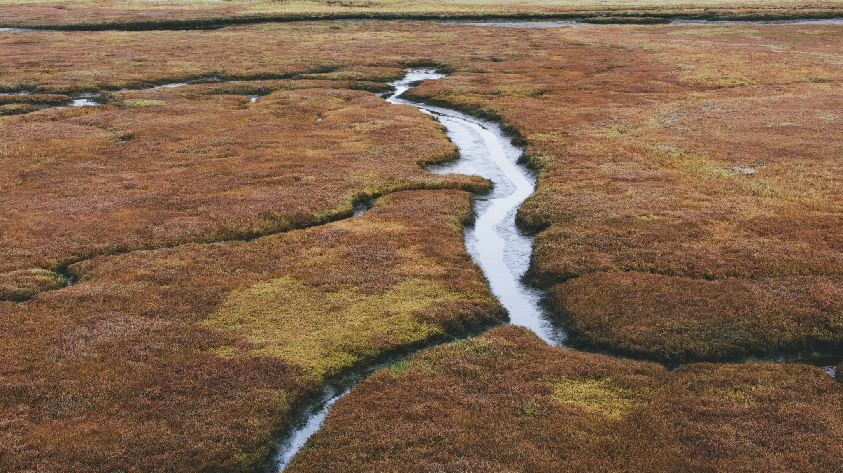
Examining the Potential of Conservation Practices to Maximize Subfield Profitability and Environmental Benefits
By: Haleigh Summers

Slide 2
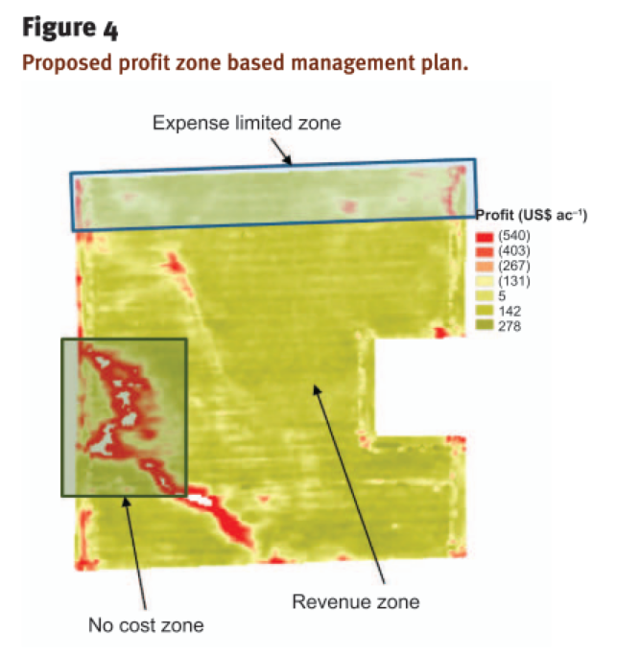
Subfield Profitability
(Muth, 2014)
Chronically Unprofitable Land:
In good years, has $0 profit for farmers
In bad years, loses farmer money
“…between 5 and 15% of fields consistently face productivity challenges” (Muth, 2014)
“… could increase overall cropland profitability by 80%.” (Brandes et al. 2016)

Slide 3
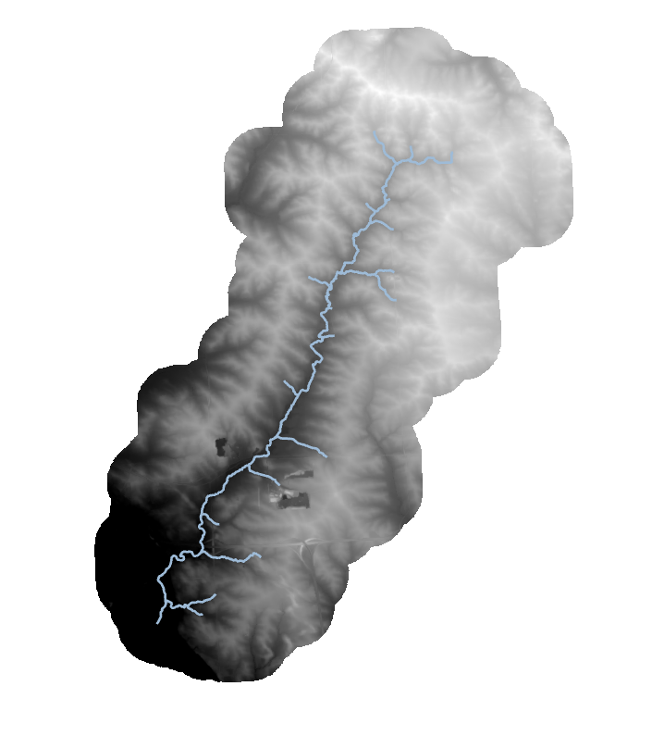
Subfield Profitability Benefits
Save farmers money
Could have conservation benefits
Wildlife or pollinator habitat
Carbon sequestration
Water quality?

Slide 4
How does the ACPF work?
The Agricultural Conservation Planning Framework (ACPF):
Based on principles of agricultural watershed management
Uses publicly available geospatial data (e.g., elevation, soils, land use)
Operationalizes planning using a GIS-based tool to identify opportunities to install best management practices (BMPs) to address soil and water quality needs.
(Tomer et al., 2013; Porter et al., 2018)
Notes:
So how does the ACPF work? The ACPF is composed of three different pieces: a conceptual framework, a publicly available, high-resolution geospatial database, and a series of GIS-based tools to identify areas of resource concern and site potential BMPs to address those concerns in in-field, edge-of-field, and downstream locations. I’ll step through each of these components to provide more information about what the ACPF is based on and how it works.
Let’s start with the first part of the ACPF: the ACPF is based on a conceptual framework that is represented in the figure on the right side of the slide. This figure has a lot of information, so I want to take a few minutes to step through this diagram. First and foremost, when we consider resource concerns, there are important management opportunities to avoid nonpoint source pollutant losses by doing things like protecting soils from erosion by no-till or conservation tillage, limiting excess nutrients by practicing the 4Rs, and building soil organic matter. In many cases, nutrient and sediment losses may need to be controlled, trapped, and/or treated, which is represented at three different scales on the left column of this diagram: in-field, below-fields or edge-of-fields, and in riparian or downstream positions. In each of these landscape positions, potential BMPs to control, trap, and/or treat vary dependent on whether they are treating water soluble nitrate, often found in subsurface tile drainage or phosphorus and sediment, often found in runoff. Those varying BMP options are included in the middle and right column. For in-field, surface runoff, the ACPF uses proximity to stream and slope steepness to assess potential runoff risk, and for riparian or downstream positions, the ACPF assesses water table depth and contributing area to recommend a functional design for riparian buffers.
Ultimately, the ACPF uses this conceptual framework to assist planners, managers, and stakeholders to identify areas of resource concern, potential suitable BMPs, and field- and watershed-level conservation scenarios.

Slide 5
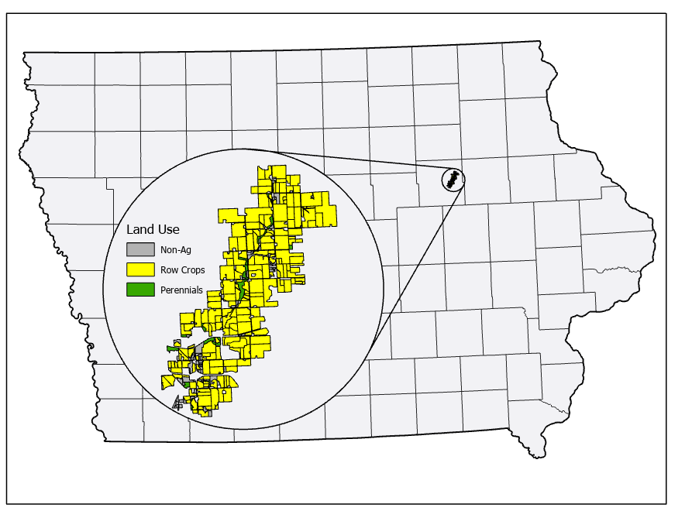
Poyner Creek HUC12 Watershed
12,600 acres
91% row crops
Prairie Strips
Wetlands
Riparian Buffers
Saturated Buffers

Slide 6
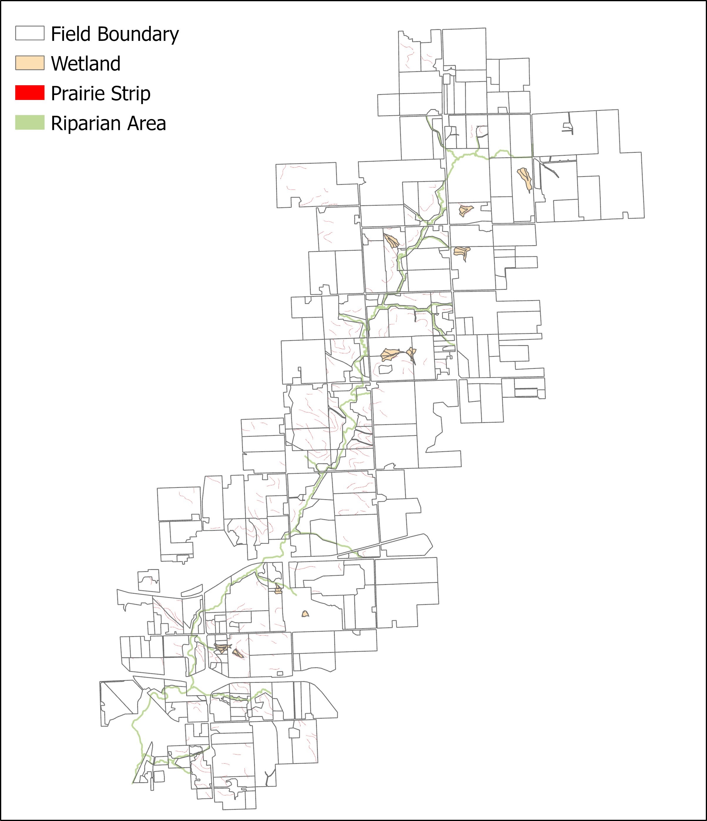
Original ACPF Results
Only practices that take land out of production
All potential practice locations

Slide 7
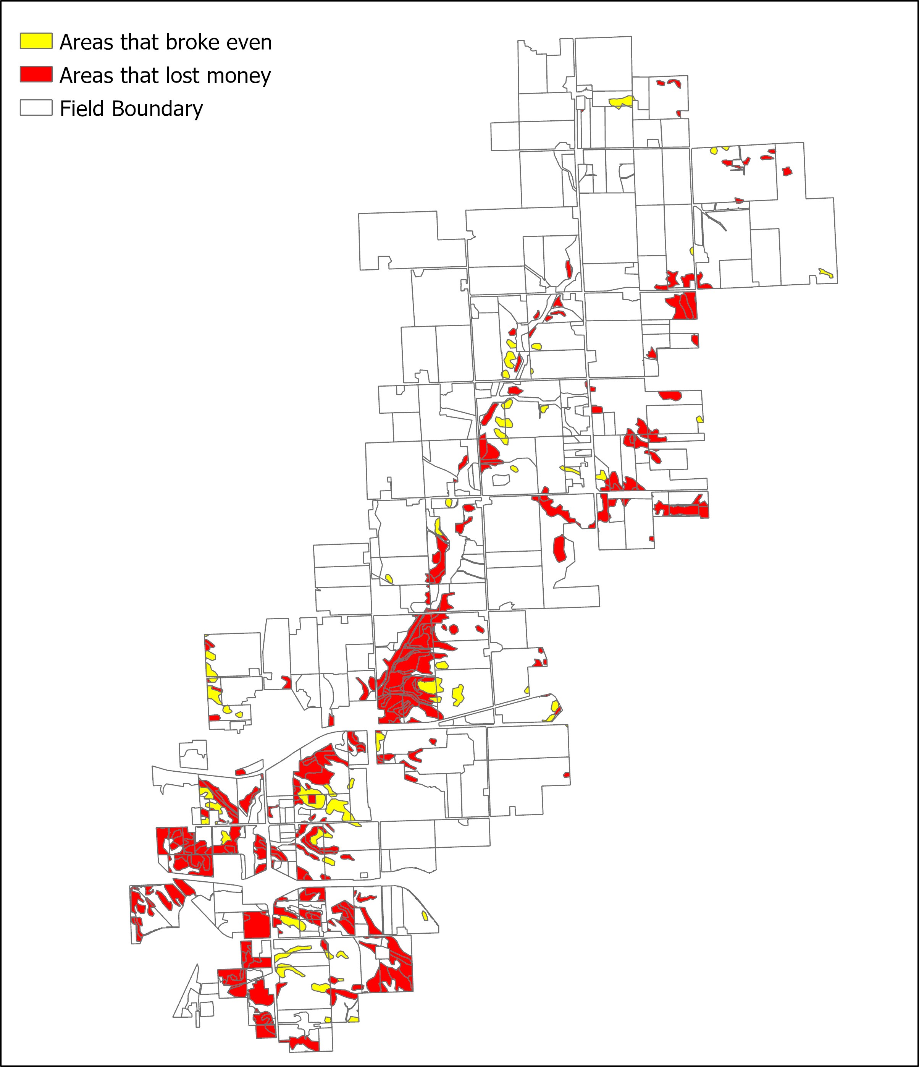
Finding Unprofitable Areas
Determine average yield needed to have $0 profit (breakeven)
Crop Budget Data from 2016-2020 ISU Ag Decision Maker
Different approaches/datasets for subfield profitability
Corn Suitability Rating (CSR)
Normal Difference Veg. Index (NDVI)
Subfield Areas Using CSR Method
Yield = (1.6 * CSR) + 80

Slide 8
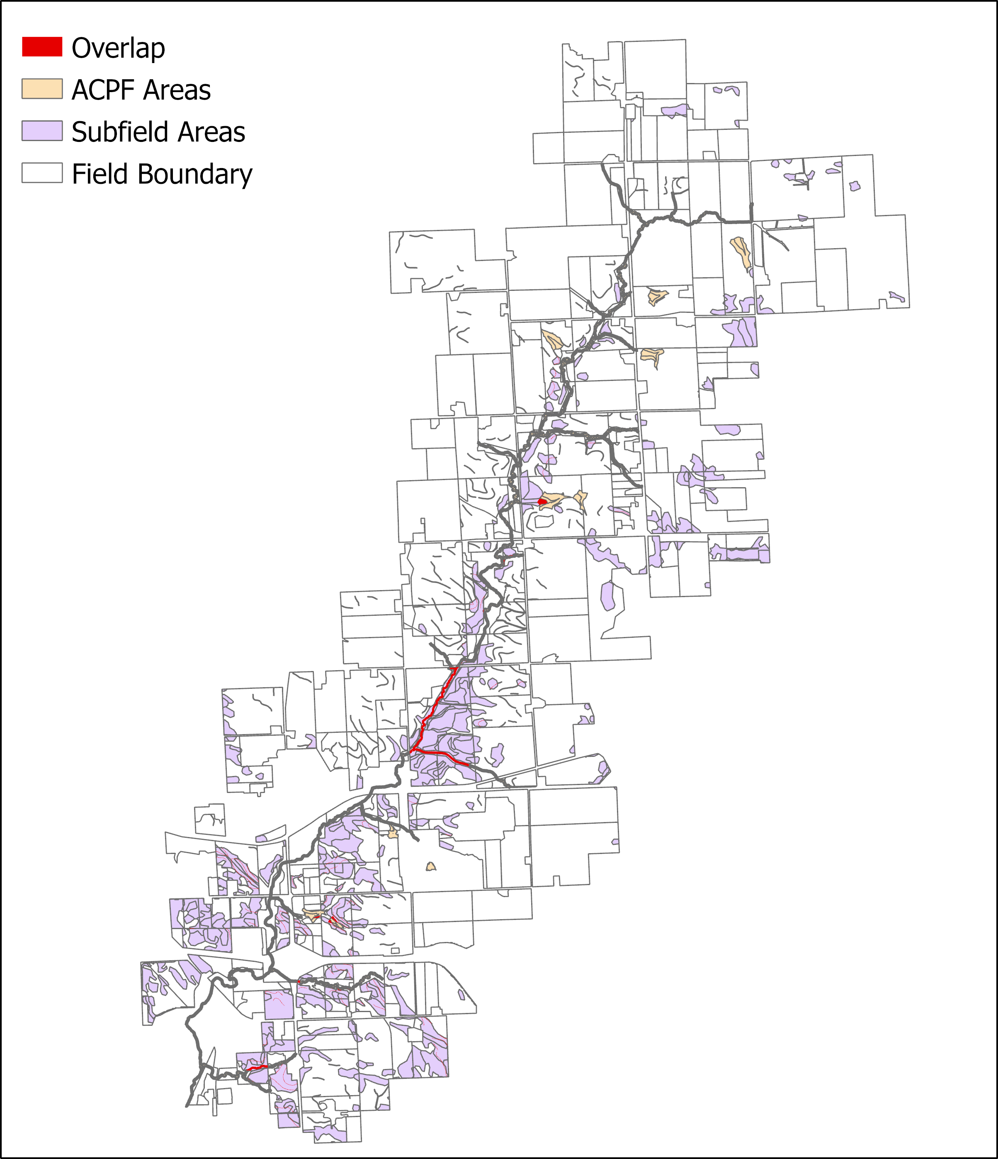
Area Conserved
ACPF:
156 ha
Subfield:
621 ha
Overlap:
15 ha

Slide 9
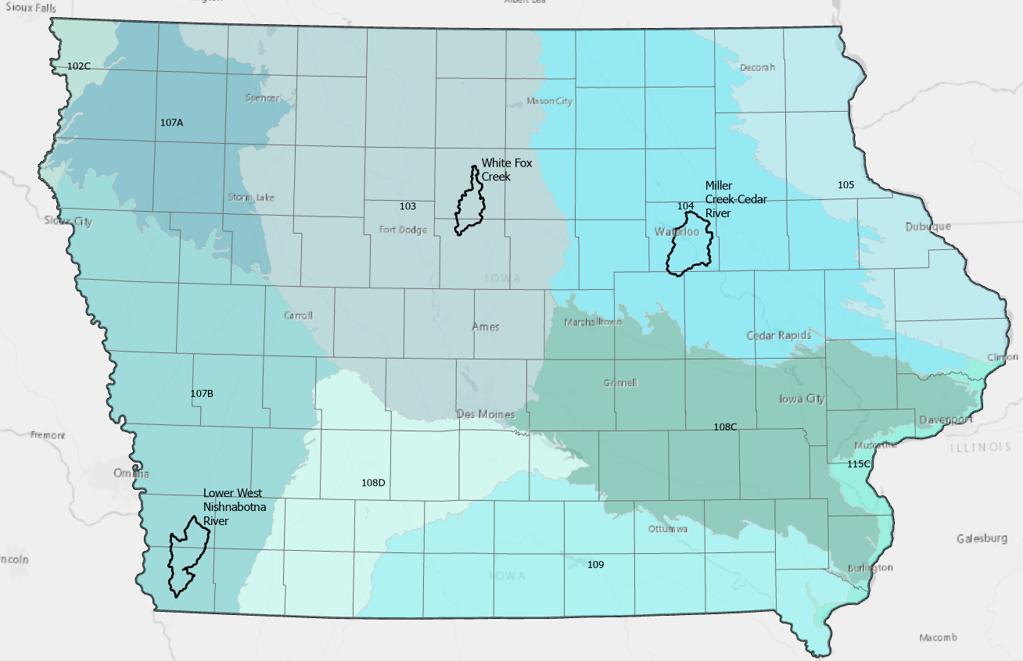
Next Steps
Identify the difference in economic or biophysical benefits
Run this analysis for multiple watersheds
Complete sensitivity analysis for how to determine subfield areas

Slide 10
Thank You!
Dr. John Tyndall
Dr. Emily Zimmerman
Dave James
Dr. Alejandro Plastina
Dr. Brian Gelder
Dr. Bradley Miller
Dr. Amy Kaleita
Meyer Bohn
Haleigh Summers
hsummers@iastate.edu
@haleigh_summers

