Slide 1


Food System Modeling at the Metropolitan Scale: Comparing Current to Localized Scenarios in the Midwest US
Tiffanie Stone*, Janette Thompson, Kurt Rosentrater
* tstone@iastate.edu
https://iowa-urbanfews.cber.iastate.edu/
This work is supported by NSF Award # 1855902 and DGE-1828942. Opinions, findings and conclusions are those of the authors and do not necessarily reflect the views of the NSF.

Slide 2
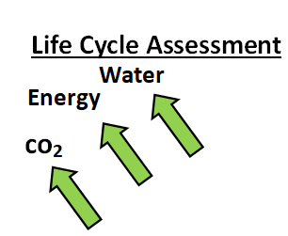
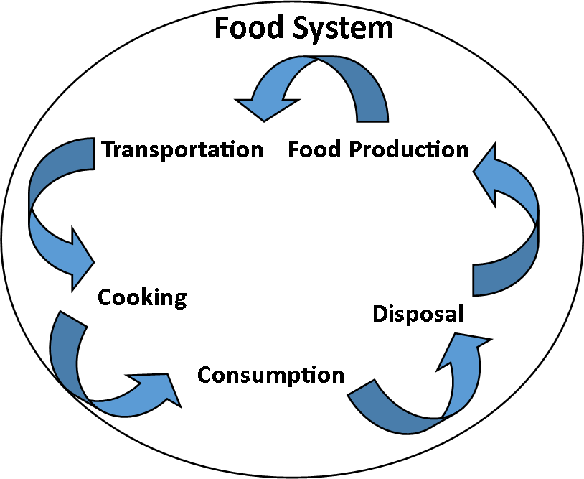
US food systems are environmentally intensive, this LCA was developed to quantify impacts
19 -29% of global GHG emissions
(Vermeulen, Campbell, & Ingram, 2012)
GWP
> 50% Urban Population
(Kulak, Graves & Chatterton, 2013)
Average Food Miles in the US ≈ 1,500
(Knight & Riggs, 2010)
produce about 25% of GWP and in the US food travels an average of 2,400 km (often Ca FOR FRESH PRODUCE)
Introduction – Methods – Results – Conclusion

Slide 3
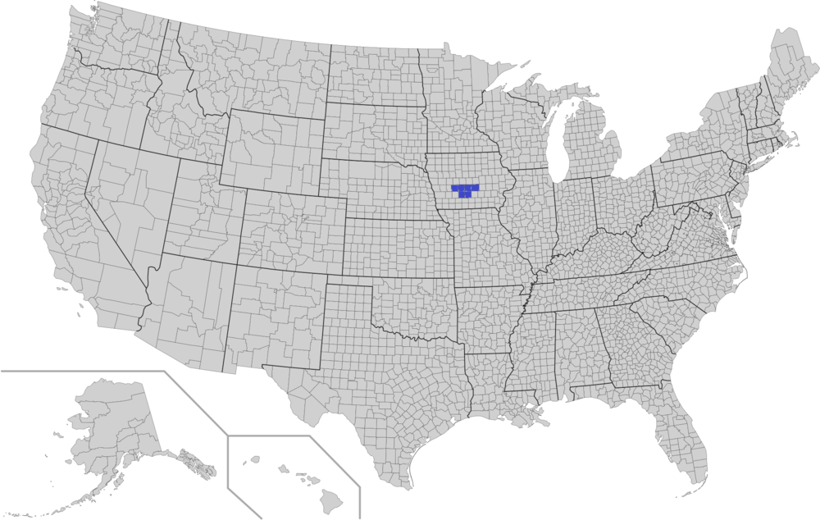
The Des Moines Metropolitan Statistical Area (Metro) is considered representative of many Metropolitan Areas in the Midwest
Population ≈ 700,000
Rainfed agriculture
Lansing, MI
Omaha, NE
Dayton, OH
Madison, WI
Introduction – Methods – Results – Conclusion

Slide 4
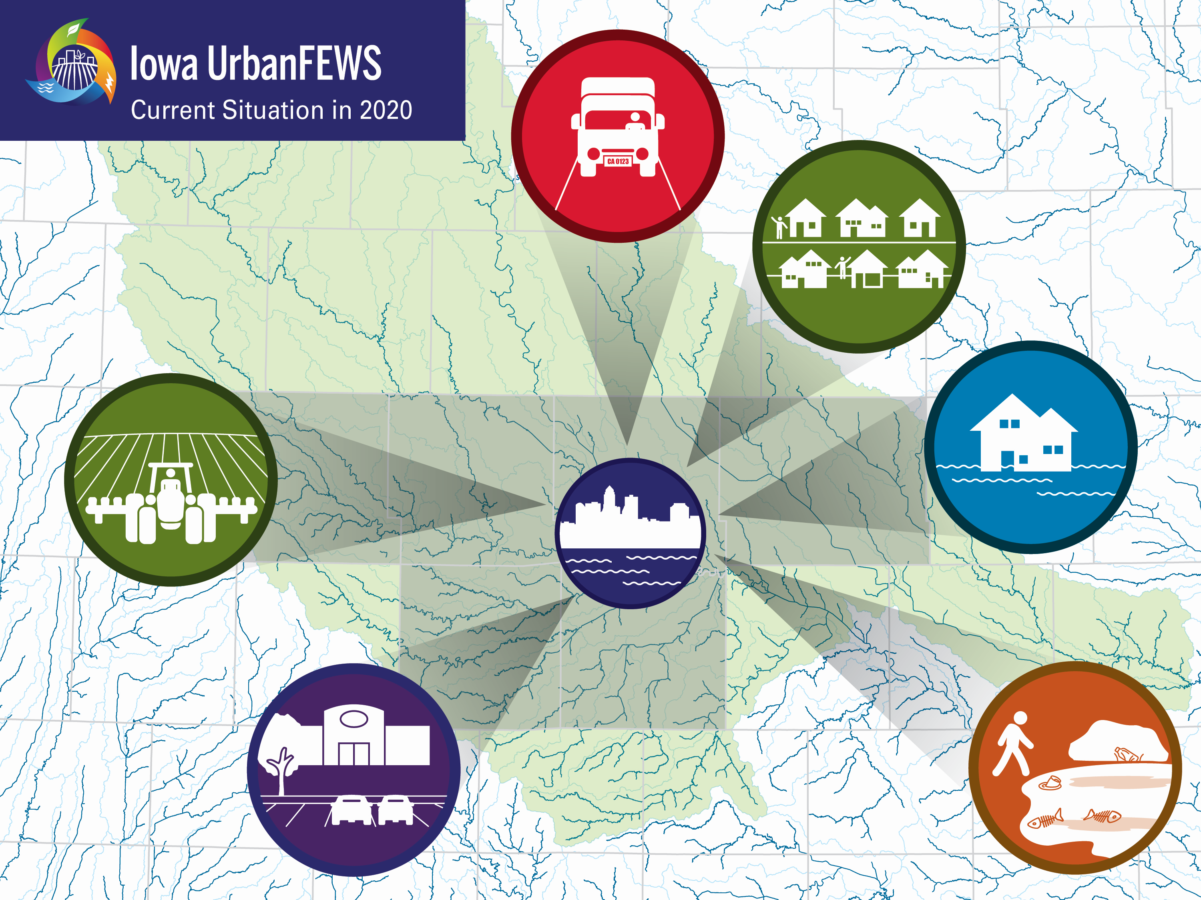
Food system modeling with LCA gives us the opportunity to ask “what if” questions: What if more food was produced locally in Iowa?
Approximately 90% of foods are imported
Predominantly corn and soybeans
Producers receive $0.143 of every food dollar
50% of fruits and vegetables are imported from California

Slide 5
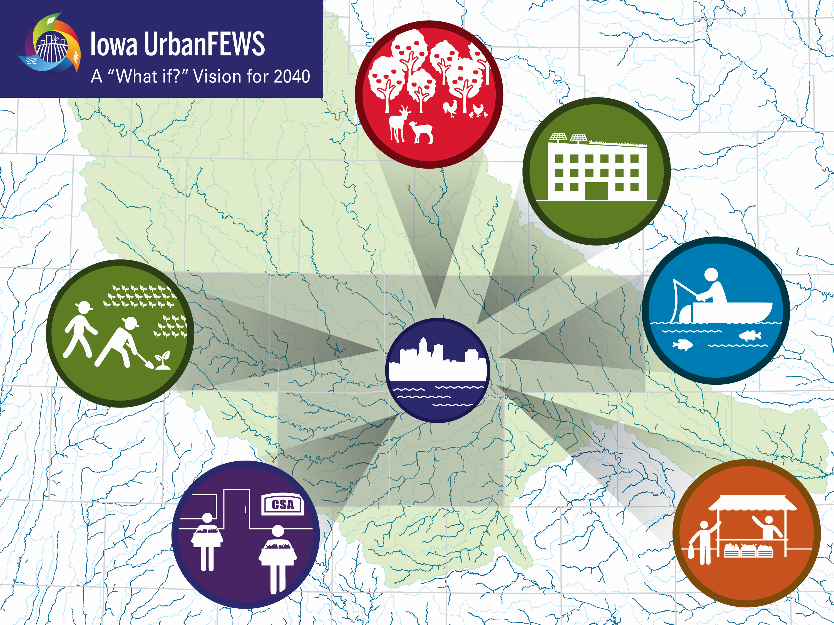
Food system modeling with LCA gives us the opportunity to ask “what if” questions: What if more food was produced locally?
Approximately 50% of food is produced within the Metro
Landscape includes more table food (for human consumption)
67.5% of local food is sold directly to consumers
Food is transported within the Metro

Slide 6
The current metropolitan-scale food system was compared to a localized scenario (where 50% of food was produced within the six-county area)
Metro Food System Scenarios | Existing level of local food production | Increasing level of local food production
Current consumption patterns | Scenario 1 – BASE Current production (Ag Census, 2017) and consumption (USDA loss adjusted food available per capita) | Scenario 2 – LOCAL Increased local production (50% of nutritional requirement produced within the metro) and current consumption
Introduction – Methods – Results – Conclusion

Slide 7

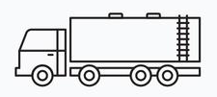
The LCA functional unit = environmental impact per kg of foods in the metro annually, system boundary = cradle to grave using CleanMetrics
Waste
By food type and system stage
Production
Mechanization
Fertilizers
Pesticides
Water Use
Consumption
Not included
Baseline: semi truck, one-way, based on state sales
Local: single unit truck, roundtrip, 160 km
Cooking
Baseline
includes 45% imported from outside Iowa, 5% local to metropolitan
Local
includes 50% local to metropolitan
By storage type (Poore & Nemecek, 2018)
By food type (Poore & Nemecek, 2018)
Wholesale/ Retail
Packaging
Transport
Introduction – Methods – Results – Conclusion

Slide 8
The foods for each diet were selected by food group based on 1) production in IA and 2) quantity consumed (>0.001 servings/day)
For Example
Fruit: 50% is tropical and cannot be produced in Iowa. We used equal weighting for all remaining fruits at 100%
Grains: over 50% of consumption was wheat, we included corn based on quantity consumed to better match current diet
We used equal weighting for both grains at 53.6%
Introduction – Methods – Results – Conclusion

Slide 9
Defining the local scenario meant building reasonable assumptions across the food system (production scale and transport distance varied greatly)
Food System Stage | BASE | LOCAL
Production | California vegetable producer scale (average) = 59 acres | Iowa vegetable producer scale (average) = 8 acres
Processing | 37 % of fruits and vegetables are processed | None available for fruits and vegetables
Packaging | 96.6 % of food is packaged | 67.5 % is sold with limited packaging
Transport | National distance modeled (average) = 1,740 km | Metropolitan distance modeled = 160 km
Wholesale/Retail | 96.6 % sold through wholesale/retail | 67.5 % sold direct-to-consumer
Waste | Average food waste = 33 % | Average local food waste = 22 %
Introduction – Methods – Results – Conclusion

Slide 10
A sensitivity analysis was conducted to understand how much key variables influence LCA results
+ 20%
Consumption by food group
+ 20%
- 20%
Transportation
+ 20%
- 20%
Food Waste
- 20%
Introduction – Methods – Results – Conclusion

Slide 11
The local scenario produced fewer environmental outputs compared to the baseline scenario
Introduction – Methods – Results – Conclusion

Slide 12
The difference between baseline and local scenarios were smallest for protein and largest for fruit and vegetable food groups
Introduction – Methods – Results – Conclusion

Slide 13
For fruits and vegetables in the local scenario GWP was reduced by approximately 50%, energy input by 65%, and water use by 95% - however, these groups have the smallest initial emissions
Introduction – Methods – Results – Conclusion

Slide 14
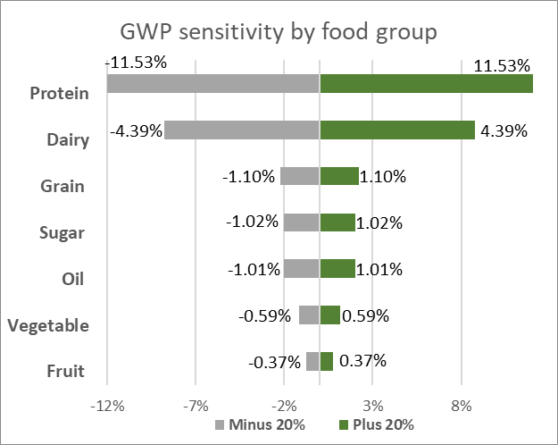
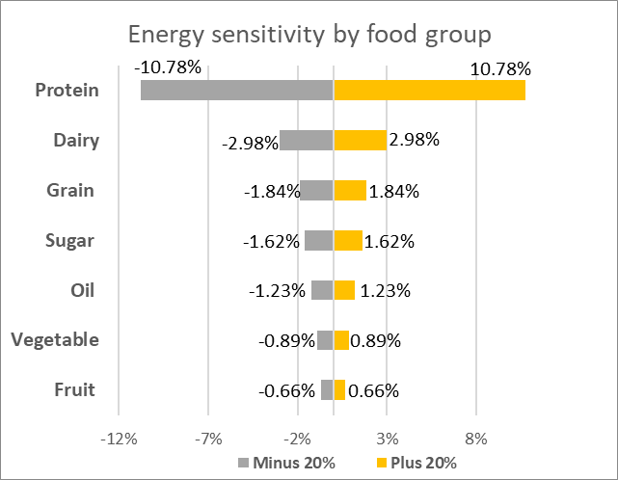
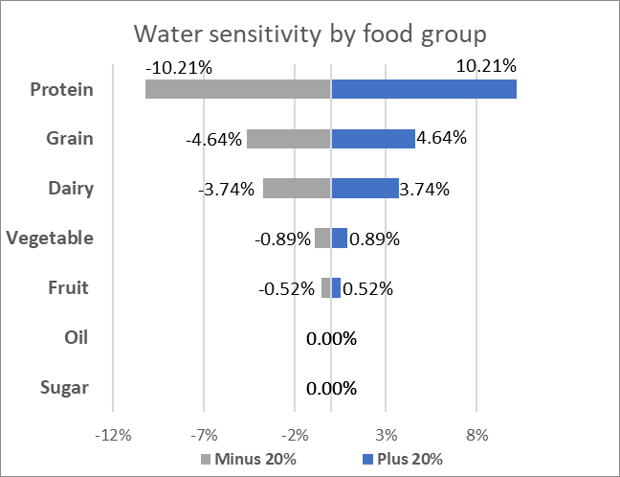
The most sensitive variable tested was consumption by food group, reducing protein and dairy would reduce environmental impacts most
Introduction – Methods – Results – Conclusion

Slide 15
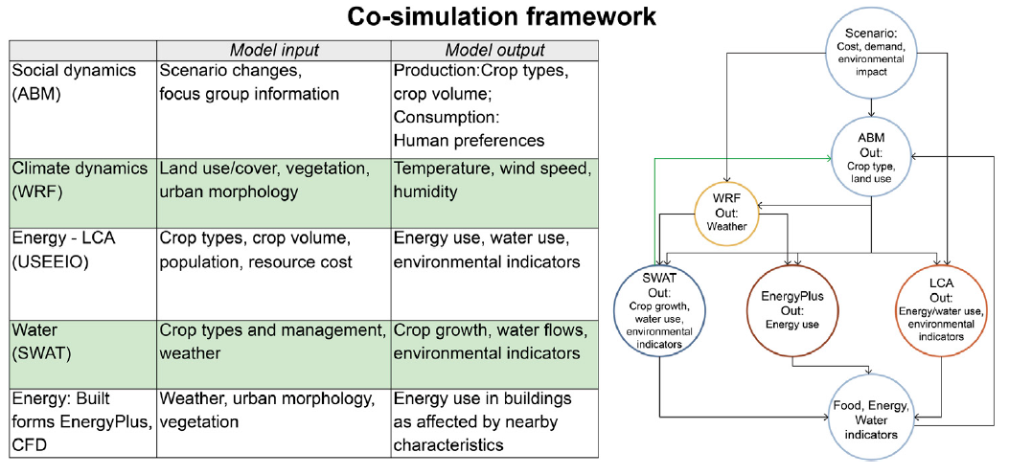
Future work will co-simulate metropolitan scale food system emissions to identify tradeoffs and inform decision-makers using USEEIO to model energy use
Introduction – Methods – Results – Conclusion

Slide 16
The current metropolitan-scale food system was compared to a localized scenario (where 50% of food was produced within the six-county area)
DSM-MSA Food System Scenarios | Existing level of local food production | Increasing level of local food production
Current consumption patterns | Scenario 1 – BASE Current production (Ag Census, 2017) and consumption (USDA loss adjusted food available per capita) | Scenario 2 – LOCAL Increasing local production (50%) and current consumption patterns (USDA loss adjusted food available per capita)
Healthy consumption patterns based on dietary guidelines | Scenario 3 – DIET Current production (Ag Census, 2017). and healthier consumption (USDA-HSS, 2015) | Scenario 4 – LOCALDIET Increasing local production (50%) and healthier consumption (USDA-HSS, 2015)
Introduction – Methods – Results – Conclusion

Slide 17
The baseline scenario models current production and consumption
Scenario 1 | Existing level of local food production
Current consumption patterns | BASE - Current Production: Ag Census, 2017 - Current Consumption: USDA loss adjusted food available per capita

Slide 18
FOOD SYSTEM MODELING GIVES US THE OPPORTUNITY TO ASK, “WHAT IF” QUESTIONS. What if food was produced locally?
Scenario 2 | Increased level of local food production
Current consumption patterns | LOCAL - 50% of nutritional requirements produced in the DSM-MSA - Current Consumption: USDA loss adjusted food available per capita

Slide 19
FOOD SYSTEM MODELING GIVES US THE OPPORTUNITY TO ASK, “WHAT IF” QUESTIONS. What if food was produced locally?
Scenario 3 | Existing level of local food production
Consumption based on dietary recommendations | DIET - Current Production: Ag Census, 2017 - Current Consumption: USDA loss adjusted food available per capita

Slide 20
FOOD SYSTEM MODELING GIVES US THE OPPORTUNITY TO ASK, “WHAT IF” QUESTIONS. What if food was produced locally?
Scenario 4 | Increasing level of local food production
Consumption based on dietary recommendations | LOCALDIET 50% of nutritional requirements produced in the DSM-MSA Dietary Guidelines followed in DSM-MSA (USDA-HSS, 2015)

