Slide 1
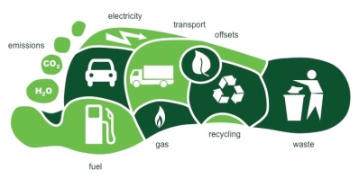
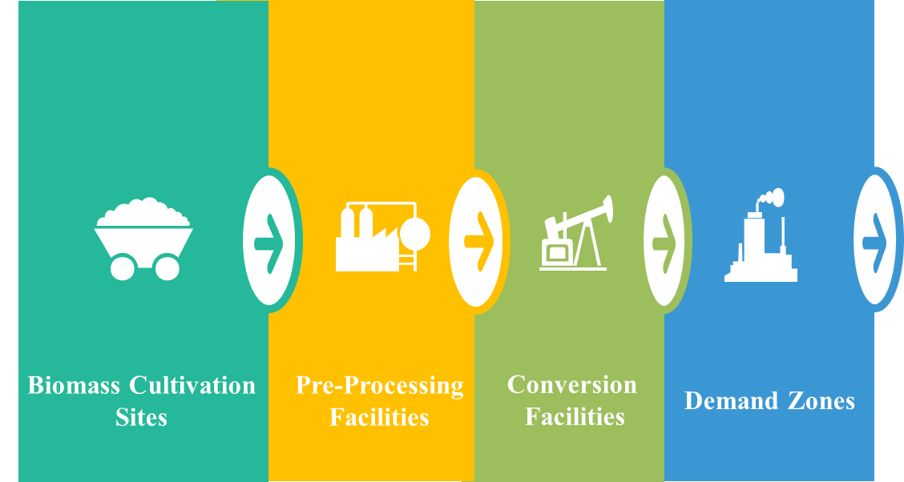
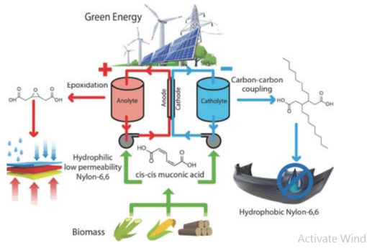
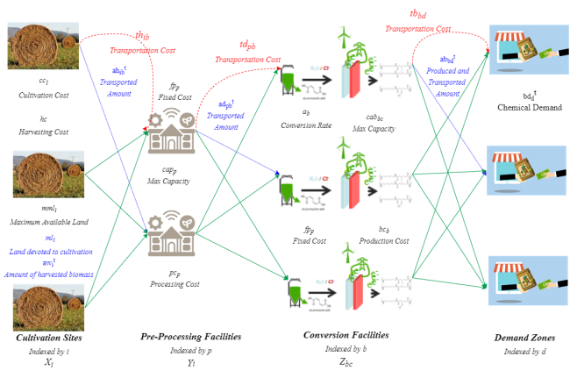
Industrial and Manufacturing Systems Engineering
Supply Chain Design for Chemicals from Biomass
Constraints
Motahareh Kashanian and Dr. Sarah M. Ryan
BACKGROUND & MOTIVATION
PROBLEM SETTING
MODEL
CO2 Emission
Supply Chain Network Design
Defining Decision Variables
Promoting Economic Sustainability Through Supply Chain Optimization:
Positive continuous variables
Area of land devoted to biomass cultivation in cultivation site i (ha)
Amount of biomass harvested at time stage t in cultivation site i (ton)
Amount of harvested biomass transported from cultivation site i to pre-processing facility p at time stage t (ton)
Amount of densified biomass transported from preprocessing facility p to conversion facility b at time stage t (ton)
Amount of chemicals produced in conversion facility b at time stage t and transported to demand zone d (kg)
Determining the strategic investment decisions on location and scale of facilities
Determining the operational decisions on collecting and transporting feedstock to the fermenters, MA from the fermenters to the EFRs, and chemicals to markets
CO2 emissions are causing climate change.
The chemical industry will need to switch to renewable energy.
Electrochemistry has shown promise for producing chemicals from biomass.
Binary variables
1 if a cultivation site is selected in location i; Else 0
1 if a preprocessing facility is built in location p; Else 0
1 if a conversion facility with capacity c is built in location b; Else 0
Objective: Minimize Total Annual Costs
Total Annual Cost = (annualized) Fixed facilities cost + biomass production cost + preprocessing cost + chemical production cost + transportation cost
Constraints
Cultivation sites
(if built in location i), respect limit on available land
Limit on yield in each time stage
Conservation of (bio)mass
Inventory balance at each time stage, accounting for deterioration
Preprocessing facilities
Respect capacity limits
Inventory balance at each time stage
Distributed electrochemical manufacturing of novel monomers from biomass for the production of performance-advantaged polyamides.
Conversion facilities
Generalized conservation of flow considering conversion rates for biomass to chemicals
Respect capacity limits
Demand zones
Satisfy demands for final products

