Slide 1
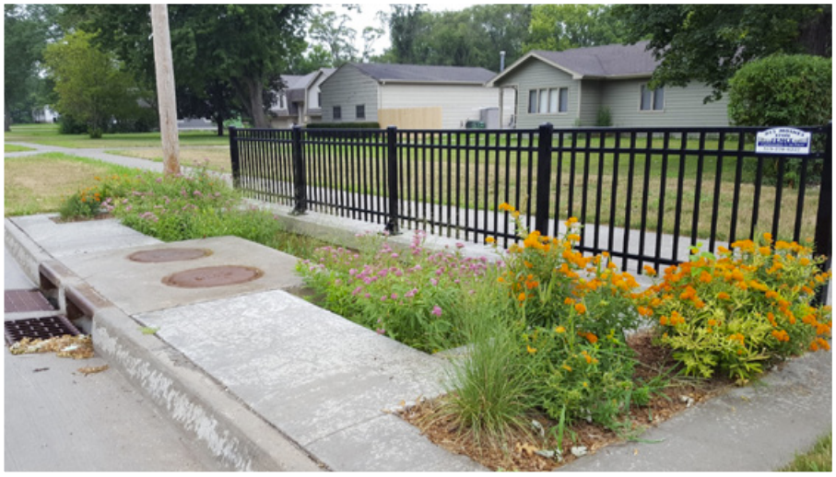
Stormwater management: opportunities and challenges
Loulou Dickey
Chris Rehmann, Kaoru Ikuma, Michael Perez
DataFEWSion Graduate Traineeship
Innovations at the Nexus of Food-Water-Energy Systems

Slide 2
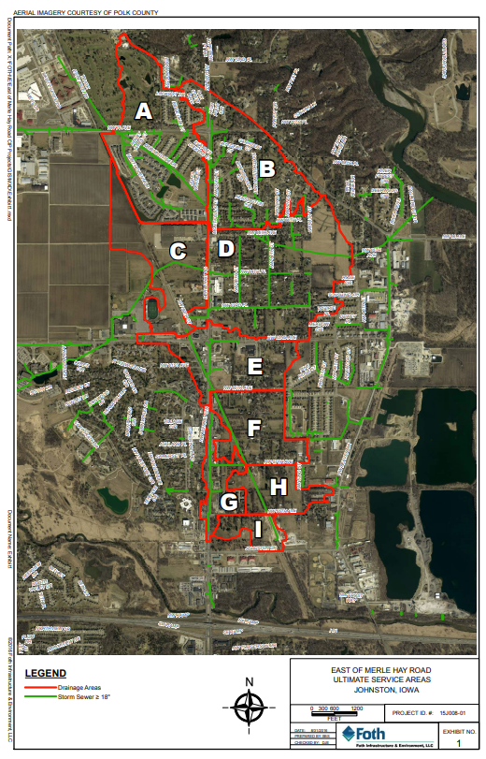
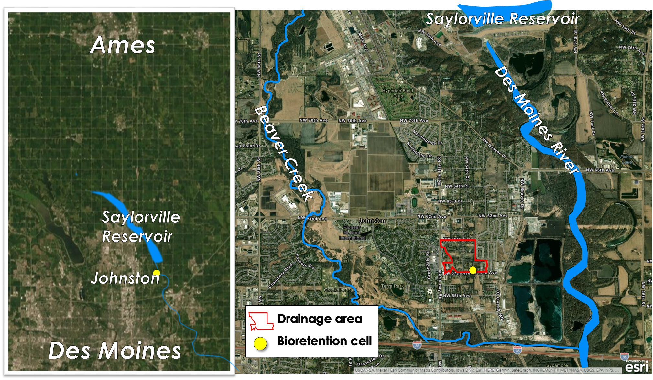
The bioretention cell we study is part of an effort to manage stormwater in Johnston’s Merle Hay neighborhood
Source: Foth Engineering
Notes:
Explain location of BRC in relation to Ames, DSM, river, and Beaver creek
Show drainage area as a part of the larger project submitted for Water Resource SRF funding by City of Johnston in partnership with Polk County Soil & Water Conservation District, & IDALS
Drainage area F out of 9 total areas in the Merle Hay neighborhood

Slide 3
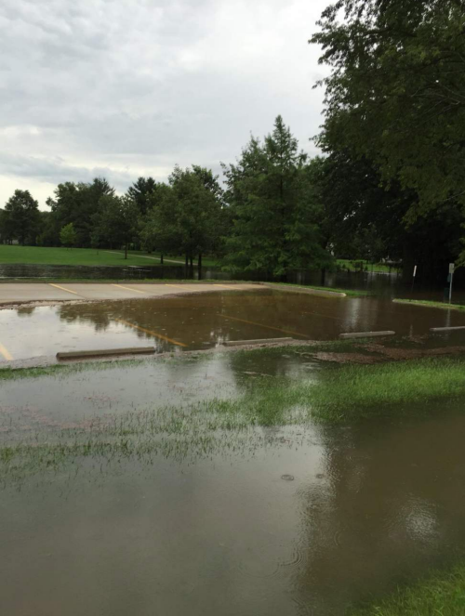
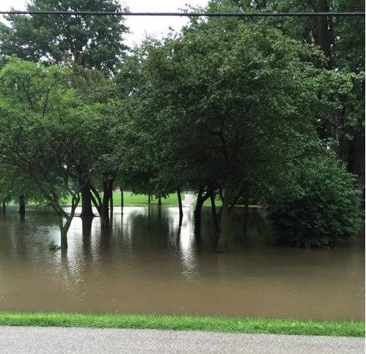
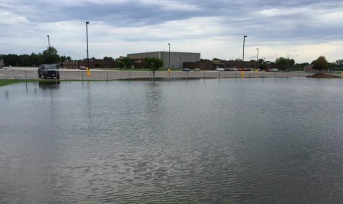
As the city’s oldest neighborhood, the Merle Hay area lacked adequate stormwater conveyance infrastructure
Source: Foth Engineering
Notes:
When the project began, this area was unsewered with no storm sewer system and private septic systems for wastewater. As more impervious surfaces were constructed and the city, issues with flash flooding and water quality became more frequent. To remedy these issues, Johnston proposed a large scale project to construct sanitary sewers and implement a comprehensive stormwater management plan. A major obstacle in the stormwater management plan was a downstream 72 inch trunk sewer, which was already experiencing strained capacity even before adding additional water by connecting these areas to the storm sewer network. This led the project managers to consider the use of green infrastructure solutions, which they termed the “green street” approach.

Slide 4
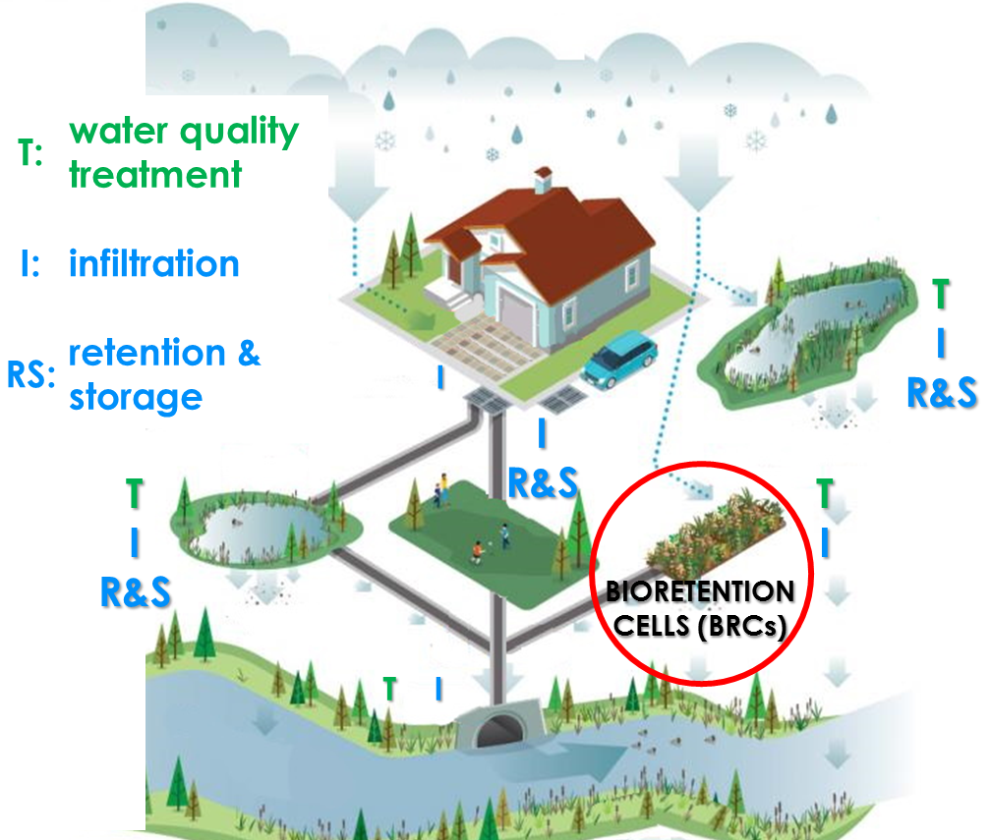
The Green Street approach could address both stormwater runoff quantity and quality
Source: Global Info Resource
Notes:
BRCS are compromised of an engineered soil media vegetated with native plants where water is routed and allowed to infiltrate through the cell media.
BRCS address runoff quantity by providing volumetric storage and reducing peak flow rates during storm events. They address water quality by facilitating physical, biological, and geochemical processes to reduce pollutants and excess nutrients like nitrate and phosphorus.

Slide 5
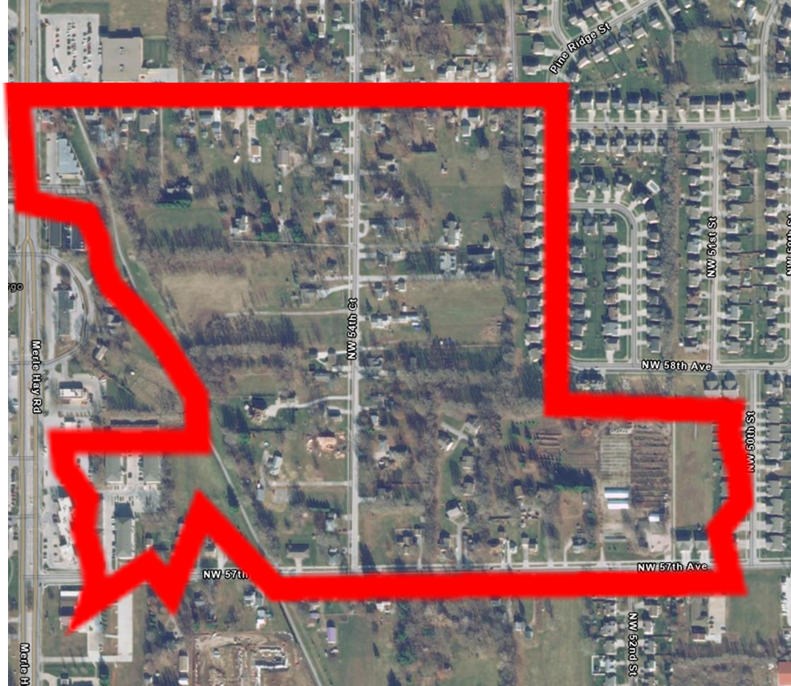
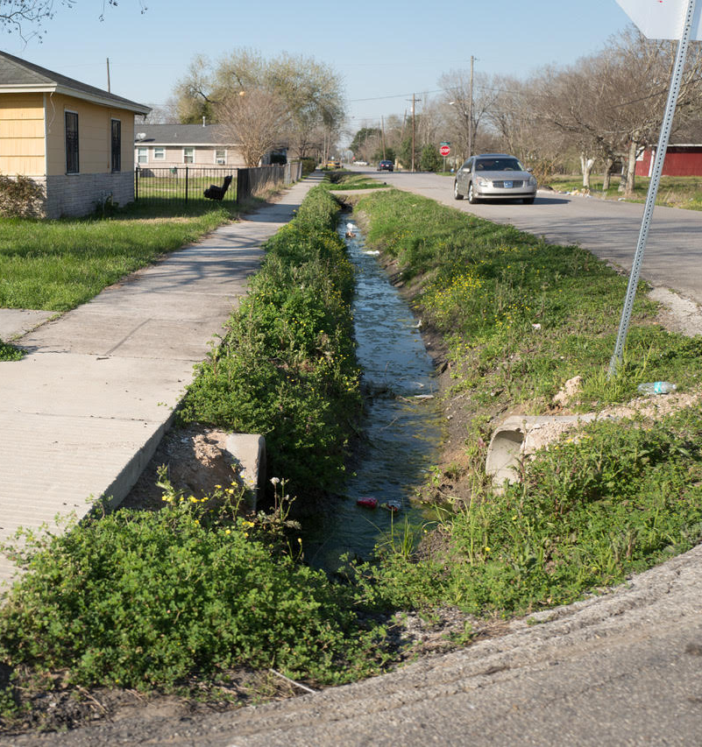
Conditions in the 57th Street drainage area were ideal for bioretention and infiltration
HSG: A
DRAINAGE DITCHES
Notes:
The area is in close proximity to the DSM river – with relatively sandy soils all in hydrologic soil group A which corresponds to very well drained. Additionally, though there was no conventional storm sewer network, in the previous decades the area had relied on drainage ditches that would allow water to infiltrate to groundwater. Since the ditch system had worked fairly well in some areas, it was inferred that infiltration practices would be a good fit. Bioretention cells were selected along with a suite of additional practices to maximize quantity and quality benefits.

Slide 6
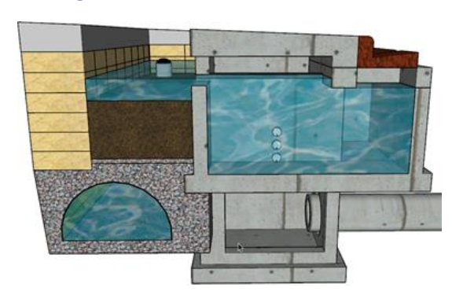
The BRCs were designed to facilitate exfiltration to the surrounding soil
Q_{inflow}
Q_{exfiltration}
Source: Foth Engineering

Slide 7
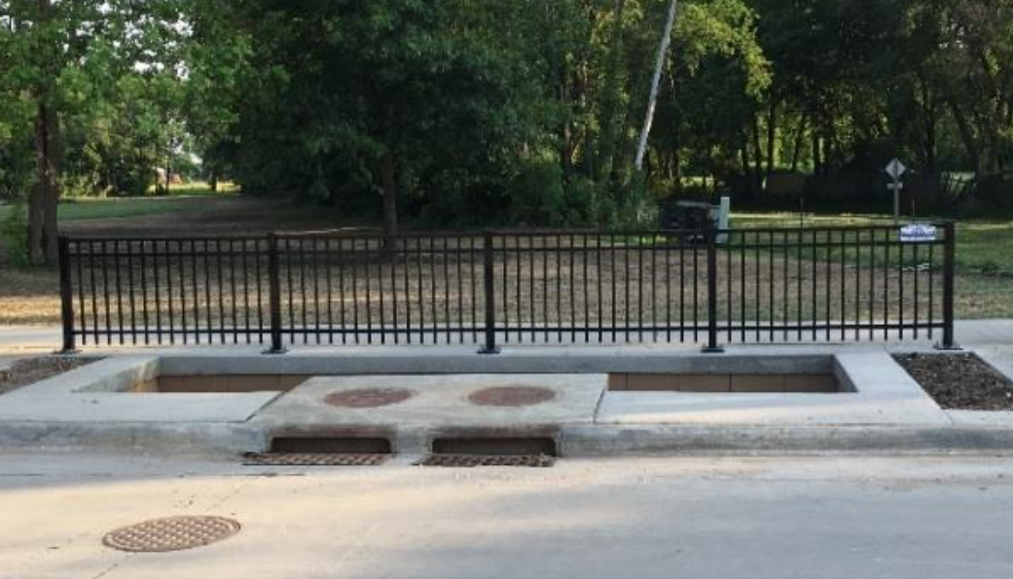
The Johnston design includes an intake structure, which is uncommon in BRCs
Q_{inflow}
Source: Foth Engineering

Slide 8
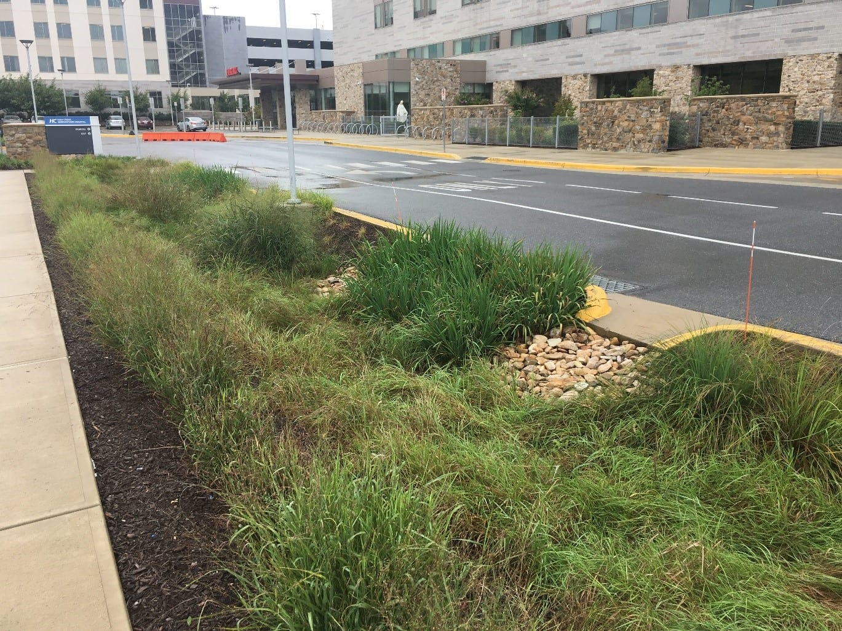
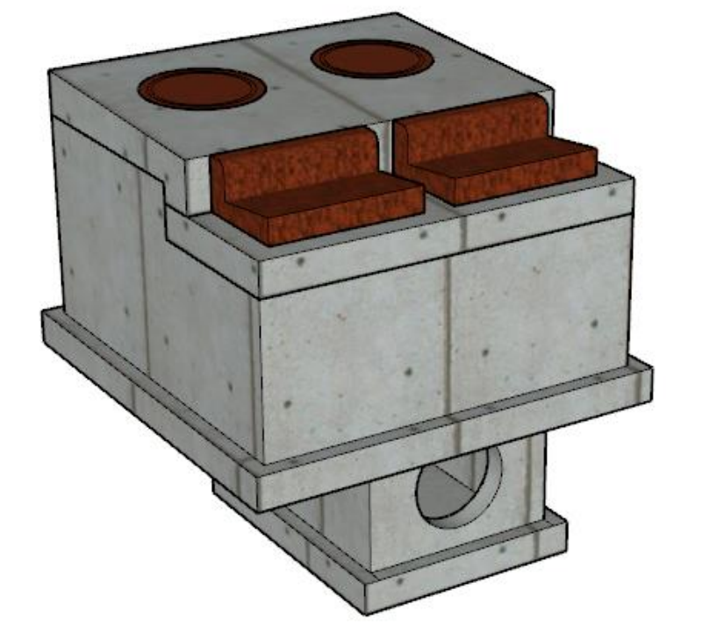
This design is unique because most BRCs receive inflow from curb cuts or shallow channels
JOHNSTON DESIGN
Q_{inflow}
Q_{inflow}
TYPICAL DESIGN
Source: Foth Engineering
Source: Ecological Landscape Alliance

Slide 9
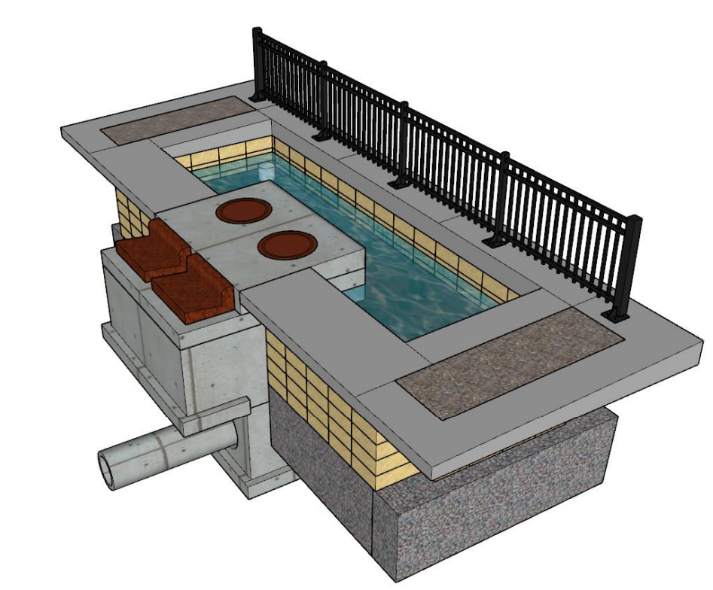
The concrete structure diverts stormwater inflow from the street
Q_{inflow}
Source: Foth Engineering

Slide 10
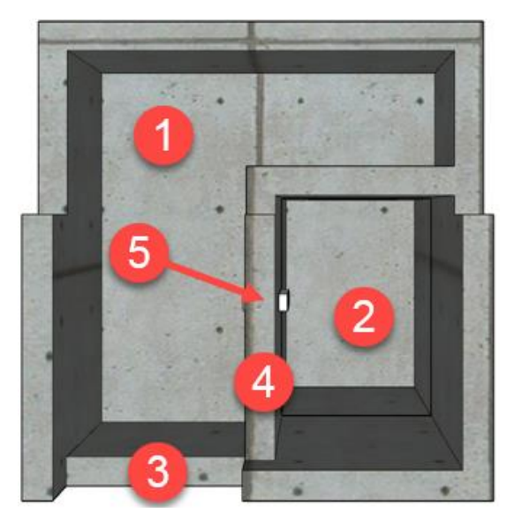
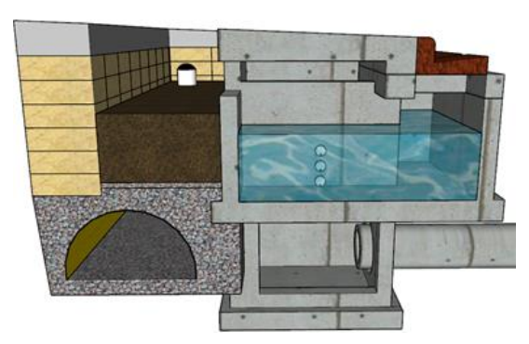
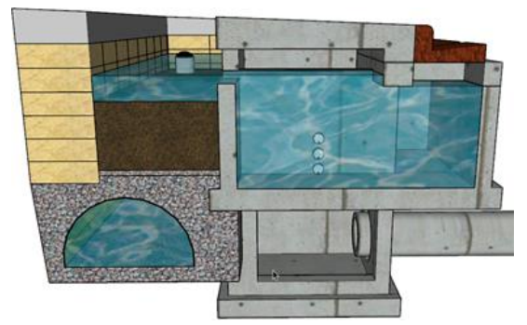
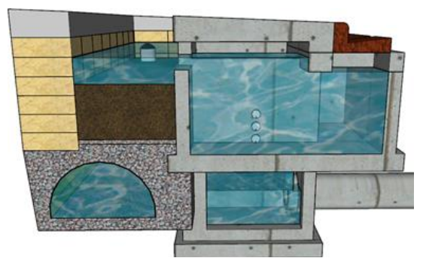
The intake structure has two internal weirs – weir 1 to cell media, weir 2 to storm sewer
Q_{inflow}
1. INTAKE STRUCTURE FILLS
1
2
Q_{sewer}
2
Q_{cell}
1
2. WATER FLOWS OVER WEIR 1
3. WATER FLOWS OVER WEIR 2
1
2
1
2
Source: Foth Engineering

Slide 11
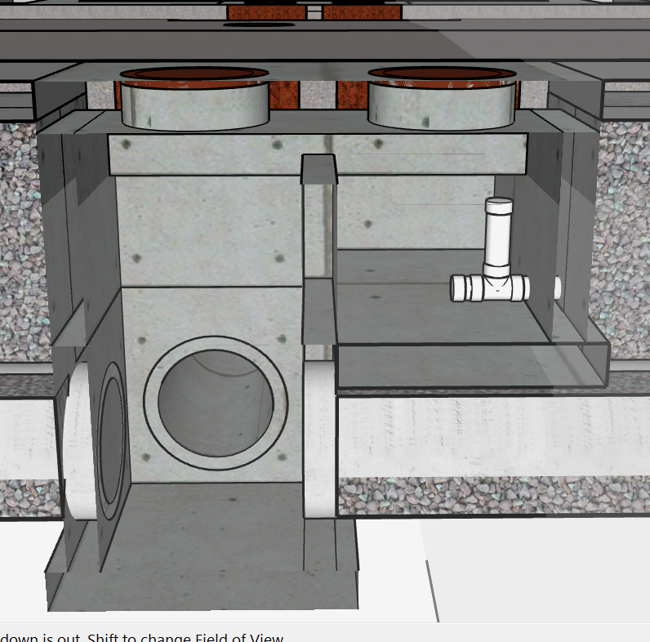
A small standpipe drain prevents standing water in the structure
Source: Foth Engineering

Slide 12
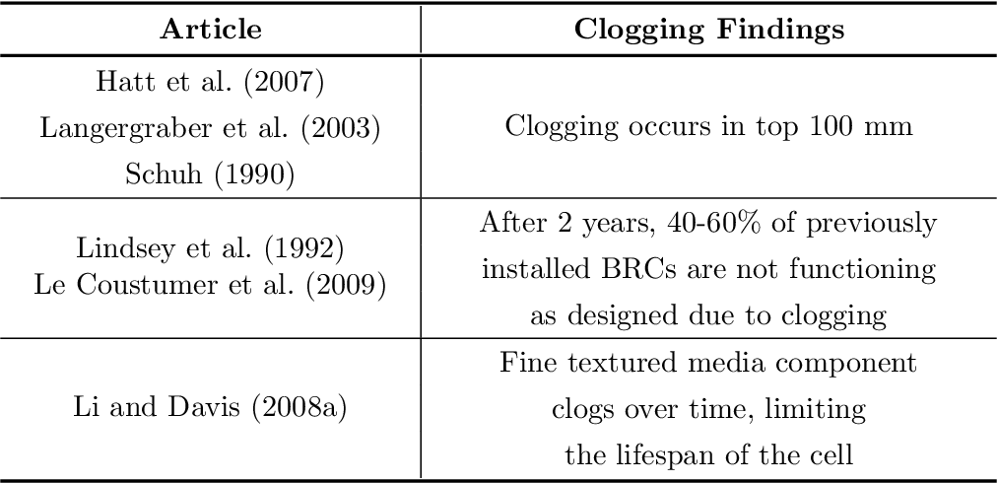
This design may help to prevent or delay a major problem in BRCs - “clogging” of the cell media by fine sediments
PRIMARY SETTLING?
Source: Foth Engineering
Source: Douglas, H. (2017). Spatial Relationships of Suspended Solids and Phosphorus in Bioretention Cells.
Notes:
Clogging is a common problem in bioretention systems which occurs when fine sediments settle on the surface of the soil media. These particles reduce infiltration rates which prevents water from receiving treatment and reduces the cell’s storage capacity.
A 2017 review by Douglas found numerous publications about clogging in BRCS – several studies found clogging can impede functionality after as little as 2 years. Additional studies found reduced practice lifespan and increased maintenance costs due to clogging.

Slide 13
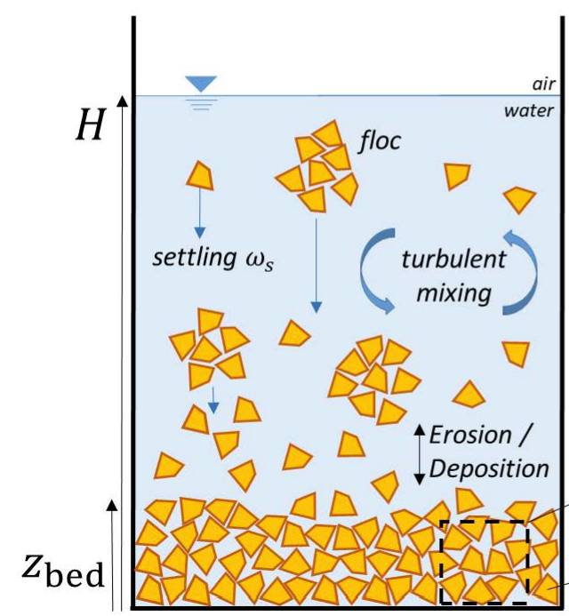
Our hypothesis is that the intake structure functions as a primary settling chamber
Settling velocity
$$\frac{\left.g D_{p}^{3}(ρ_{p}−ρ\right)}{18μ}$$
Source: Foth Engineering
Source: University of Granada
Notes:
Because the Johnston cells have the unique intake structure, we hypothesized that primary settling will occur before the runoff reaches the cell media. This would reduce the sediment load and possibly prevent or delay clogging on the media surface. The effect would be the most beneficial if the time it takes for runoff sediment particles to settle is less than the time it takes for the runoff to exit the intake structure. In theory, the maximum benefit would occur during the early phase of a storm event when the structure is filling and no outflow is observed. Additionally, because the early phase of the storm corresponds to a flushing effect on the surrounding roadway, a majority of the sediments may actually be captured in the structure.

Slide 14
To investigate our theory we’re sampling for TSS and monitoring flow at the BRC
INFLOW SAMPLE
CELL OUTFLOW SAMPLE
STORM SEWER OUTFLOW SAMPLE
Source: Foth Engineering

Slide 15
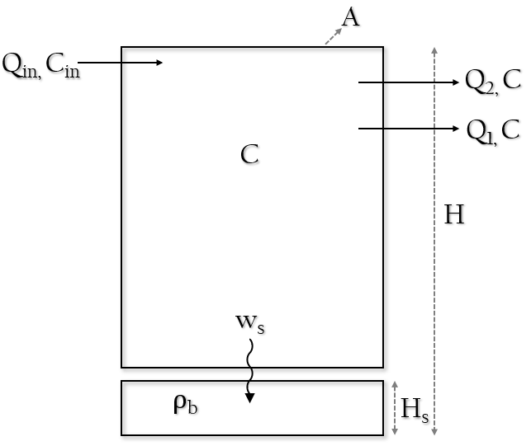
We created a 2-dimensional model of the intake structure
Conservation of water volume
$$A\frac{d}{dt}\left(H−H_{s}\right)=Q_{in}−Q_{out}$$
Conservation of water volume
𝐴 𝑑/𝑑𝑡 (𝐻−𝐻_𝑠 )=𝑄_𝑖𝑛−𝑄_𝑜𝑢𝑡
Conservation of sediment mass
$$A\frac{d}{dt}\left[C\left(H−H_{s}\right)\right]=QC_{in}−Q_{out}C−w_{s}AC$$
$$A\frac{d}{dt}\left(ρ_{b}H_{s}\right)=w_{s}AC$$
Conservation of sediment mass
𝐴 𝑑/𝑑𝑡 [𝐶(𝐻−𝐻_𝑠 )]=𝑄𝐶_𝑖𝑛−𝑄_𝑜𝑢𝑡 𝐶−𝑤_𝑠 𝐴𝐶
𝐴 𝑑/𝑑𝑡 (𝜌_𝑏 𝐻_𝑠 )=𝑤_𝑠 𝐴𝐶
Concentration in the water column
$$\frac{dC}{dt}= \left[\frac{1}{H− H_{s}}\right]\left(\frac{Q_{in}\left(C_{in}−C\right)}{A}− w_{s}C\right)$$
Concentration in the water column
𝑑𝐶/𝑑𝑡= [1/(𝐻− 𝐻_𝑠 )]((𝑄_𝑖𝑛 (𝐶_𝑖𝑛−𝐶))/𝐴− 𝑤_𝑠 𝐶)

Slide 16
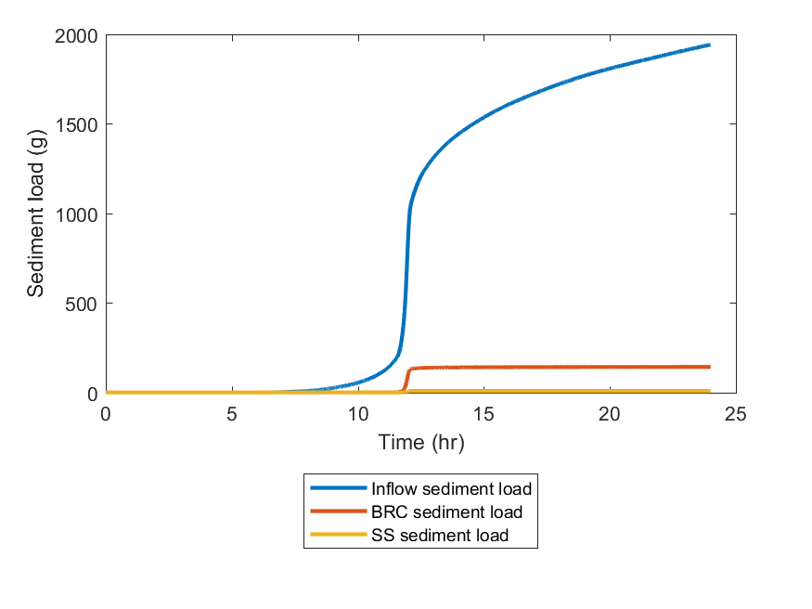
Model simulations indicate the intake structure can capture up to 80% of incoming sediments
 | Inflow sediment load
 | BRC sediment load
 | Storm sewer sediment load
Time (hr)
Notes:
We created a simple model in Matlab and ran a simulated storm event, using assumptions about inflow concentration and particle size. Time is on the x-axis with sediment mass load on the y-axis. Total inflow sediment entering from the roadway is shown in blue. The sediment load that flow overs the first weird and enters the BRC cell media is shown in orange. Overflow to the storm sewer through the second weir is shown in yellow. The difference between the total sediment load and the sum of the load to the cell and storm sewer is the sediment that is captured in the intake structure. Our preliminary model shows up to 80% of the sediments captured in the intake structure.

Slide 17
Preliminary data shows the outflow TSS concentration is typically lower than inflow
Notes:
Preliminary data collected at our study site supports our hypothesis – here you see a storm event that occurred in May of last year. Time is on the x-axis and the total suspended solids concentration is on the y-axis. The inflow concentration over the storm event is show in blue, and the outflow concentration through the internal standpipe is shown in red. The tail on the outflow after the end of the storm indicates the slow drainage that occurs as the structure empties. The outflow concentration is typically lower than the inflow and is often under the recommended limit of 75 mg/L.

Slide 18
Total N was well below 10 mg/L, while total P consistently exceeded the recommended limit of 0.1 mg/L
Notes:
We also monitored nutrient concentrations to decide if would expand our study to look at additional water quality parameters. Nitrate concentrations were low throughout the summer, with all monthly averages well below the EPA drinking water standard of 10 mg/L. Phosphorus concentrations were more concerning, with all months averaging concentrations exceeding the 0.1 mg/l recommended limit for stormwater. This reinforced our interest in sediment dynamics, as phosphorus is often sediment bound. We also decided not to focus on nitrate since concentrations entering the system were consistently low.

Slide 19
A major challenge was relatively dry summer weather this year
Source: KCRG

Slide 20
Another challenge is the size of the intake structure
362 gallons to fill up to weir 1
Source: Foth Engineering

Slide 21
Next, we will investigate the optimal design...
At steady state
$$C= \frac{Q_{in}C_{in}}{Q_{in}+Aw_{s}}$$
C ~ $\frac{1}{A}$
Notes:
We want to optimize the intake structures for maximum sediment capture – which gives a low sediment concentration in the outflow. When considering a simplified version of the system at steady state we can reduce the outflow concentration to the equation show here, which depends on the inflow concentration, flowrate, the cross sectional area of the structure, and the settling velocity. Since we cannot control the incoming flow concentration, the flowrate, or the settling velocity we can further simply the equation to show that the outflow concentration scales inverse to the cross sectional area. This is important because it shows the height of the structure is not influential on the outflow sediment concentration. Our future work will focus on how the intake structure can be further optimized for the best water quality results.

Slide 22
And the economics of the system
Design
Construction
Materials
Performance
Maintenance
Notes:
Finally, we’d like to perform a life cycle assessment to see whether the unique intake structure can help reduce overall costs in BRCS. The intake structure is more complex and requires more design, materials, and construction activities which increase the cost from a traditional curb cut bioretention system. However, these systems may save on cost and improve overall performance. Our goal is to account for all of the lifecycle components to compare the two designs.
Intake structure approx. $35,000 to construct
US Army Corp of Engineers estimates BRC cost approx. $16/sq ft – in Johnston that would give cost around $1920, but may not be comparing apples to apples here

Slide 23
Thank you!
Loulou Dickey, Graduate Researcher
Iowa State University
lcdickey@iastate.edu
(319) 671-0338

Slide 24
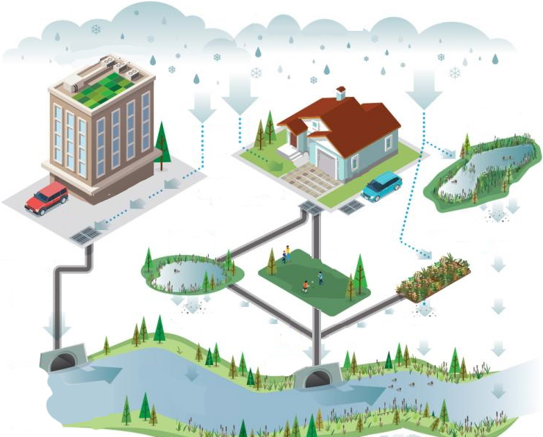
GREEN ROOFS
STORMWATER WETLANDS
PERMEABLE PAVERS
STORAGE PONDS
GREEN SPACES
BIORETENTION CELLS (BRCs)
FLOODPLAIN & RIPARIAN RESTORATION
Stormwater management
Image source: Global Info Resource

Slide 25
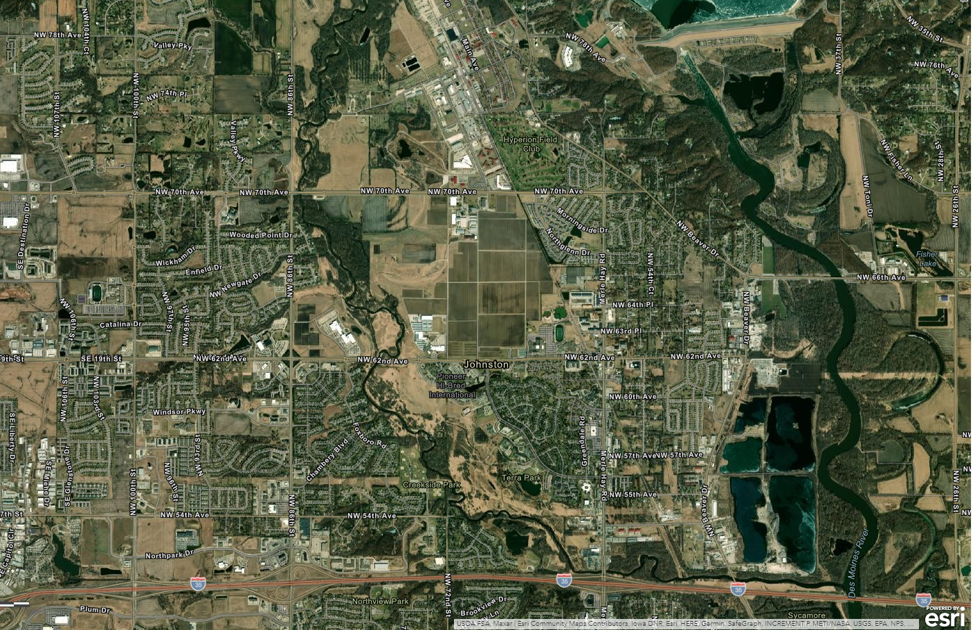
Saylorville Reservoir
Ames
Des Moines River
Beaver Creek
Saylorville Reservoir
Johnston
Drainage area
Des Moines
Bioretention cell

Slide 26
Saylorville Reservoir
xx
Ames
Des Moines River
Johnston
Des Moines
26
Image source: Xxxxxxxx

Slide 27
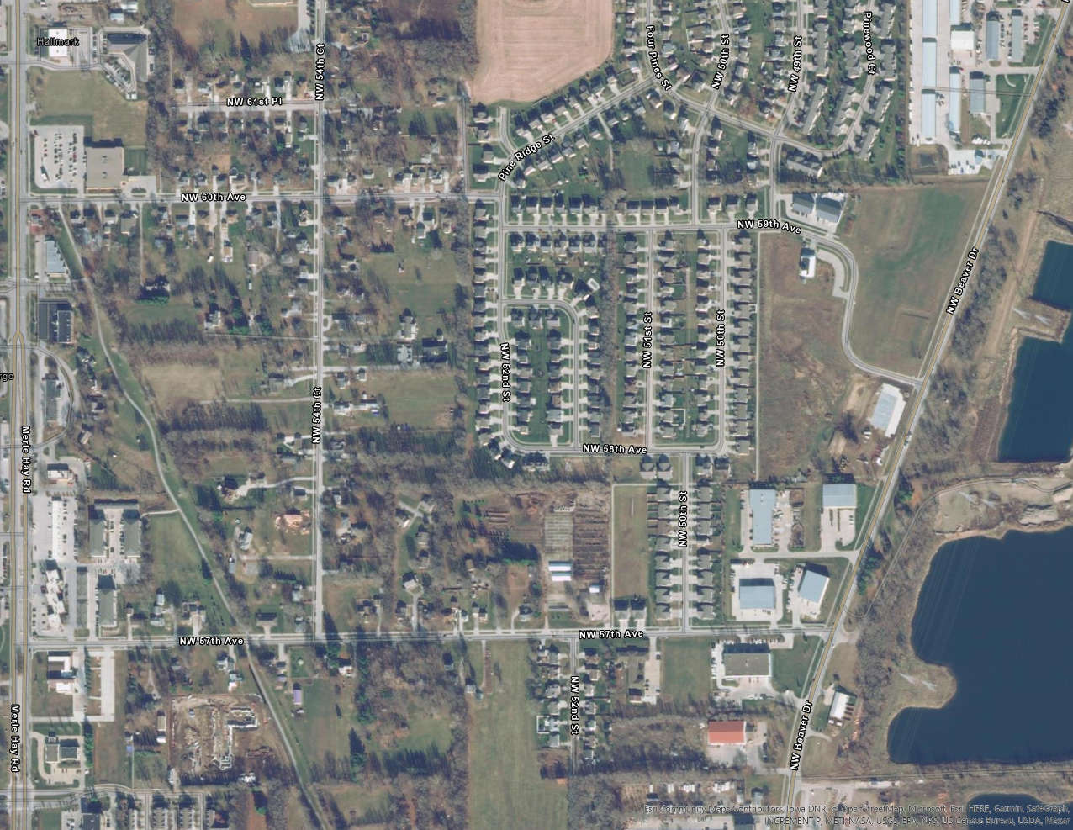

Slide 28
2.032
0.6096
1.0922
1.6764
1.0668
0.9398

