Slide 1
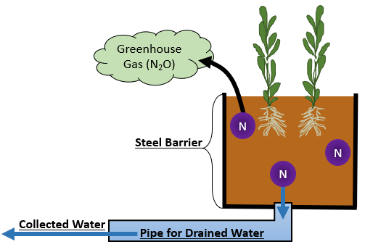
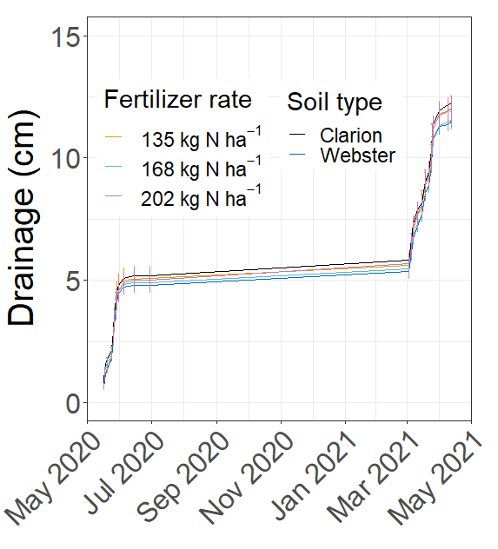
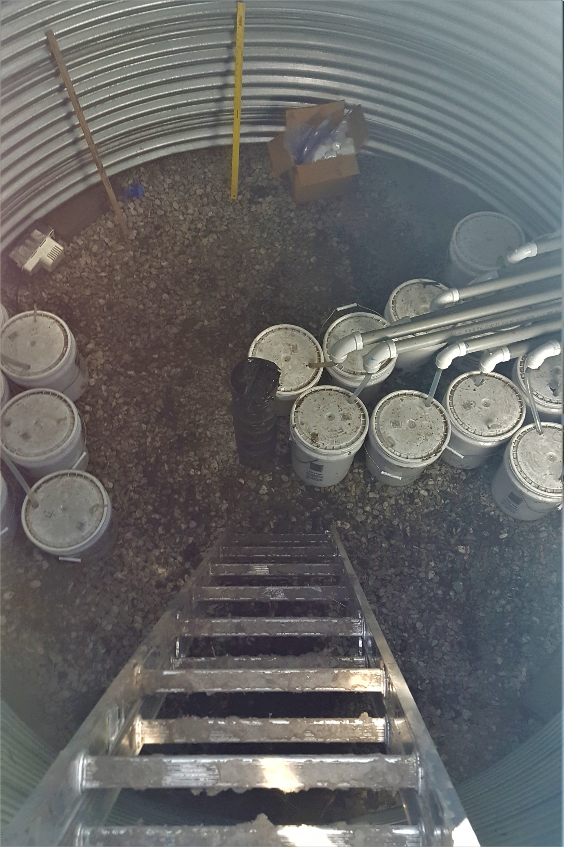
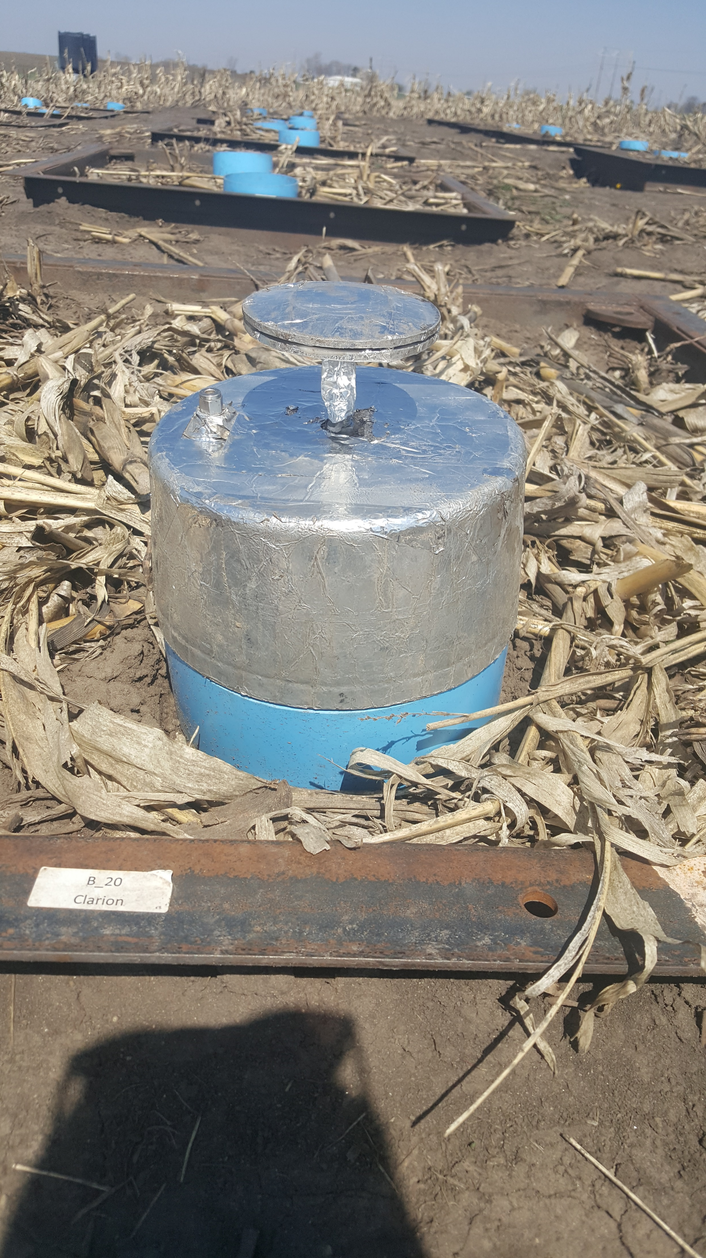
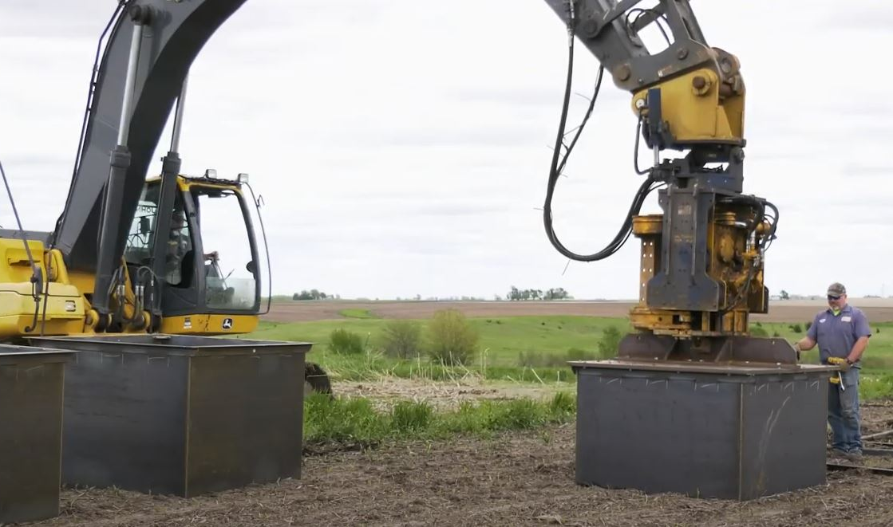
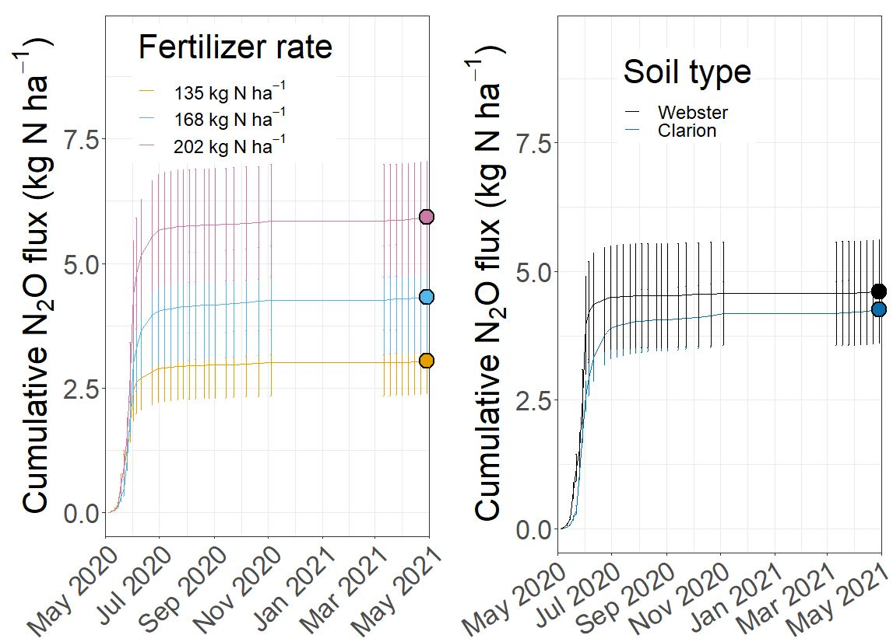
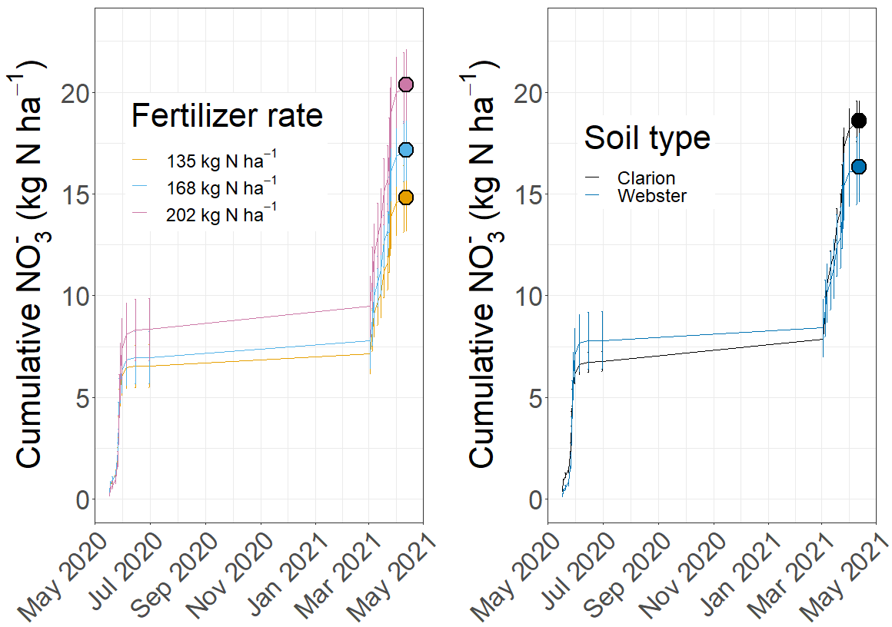
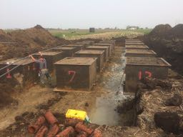
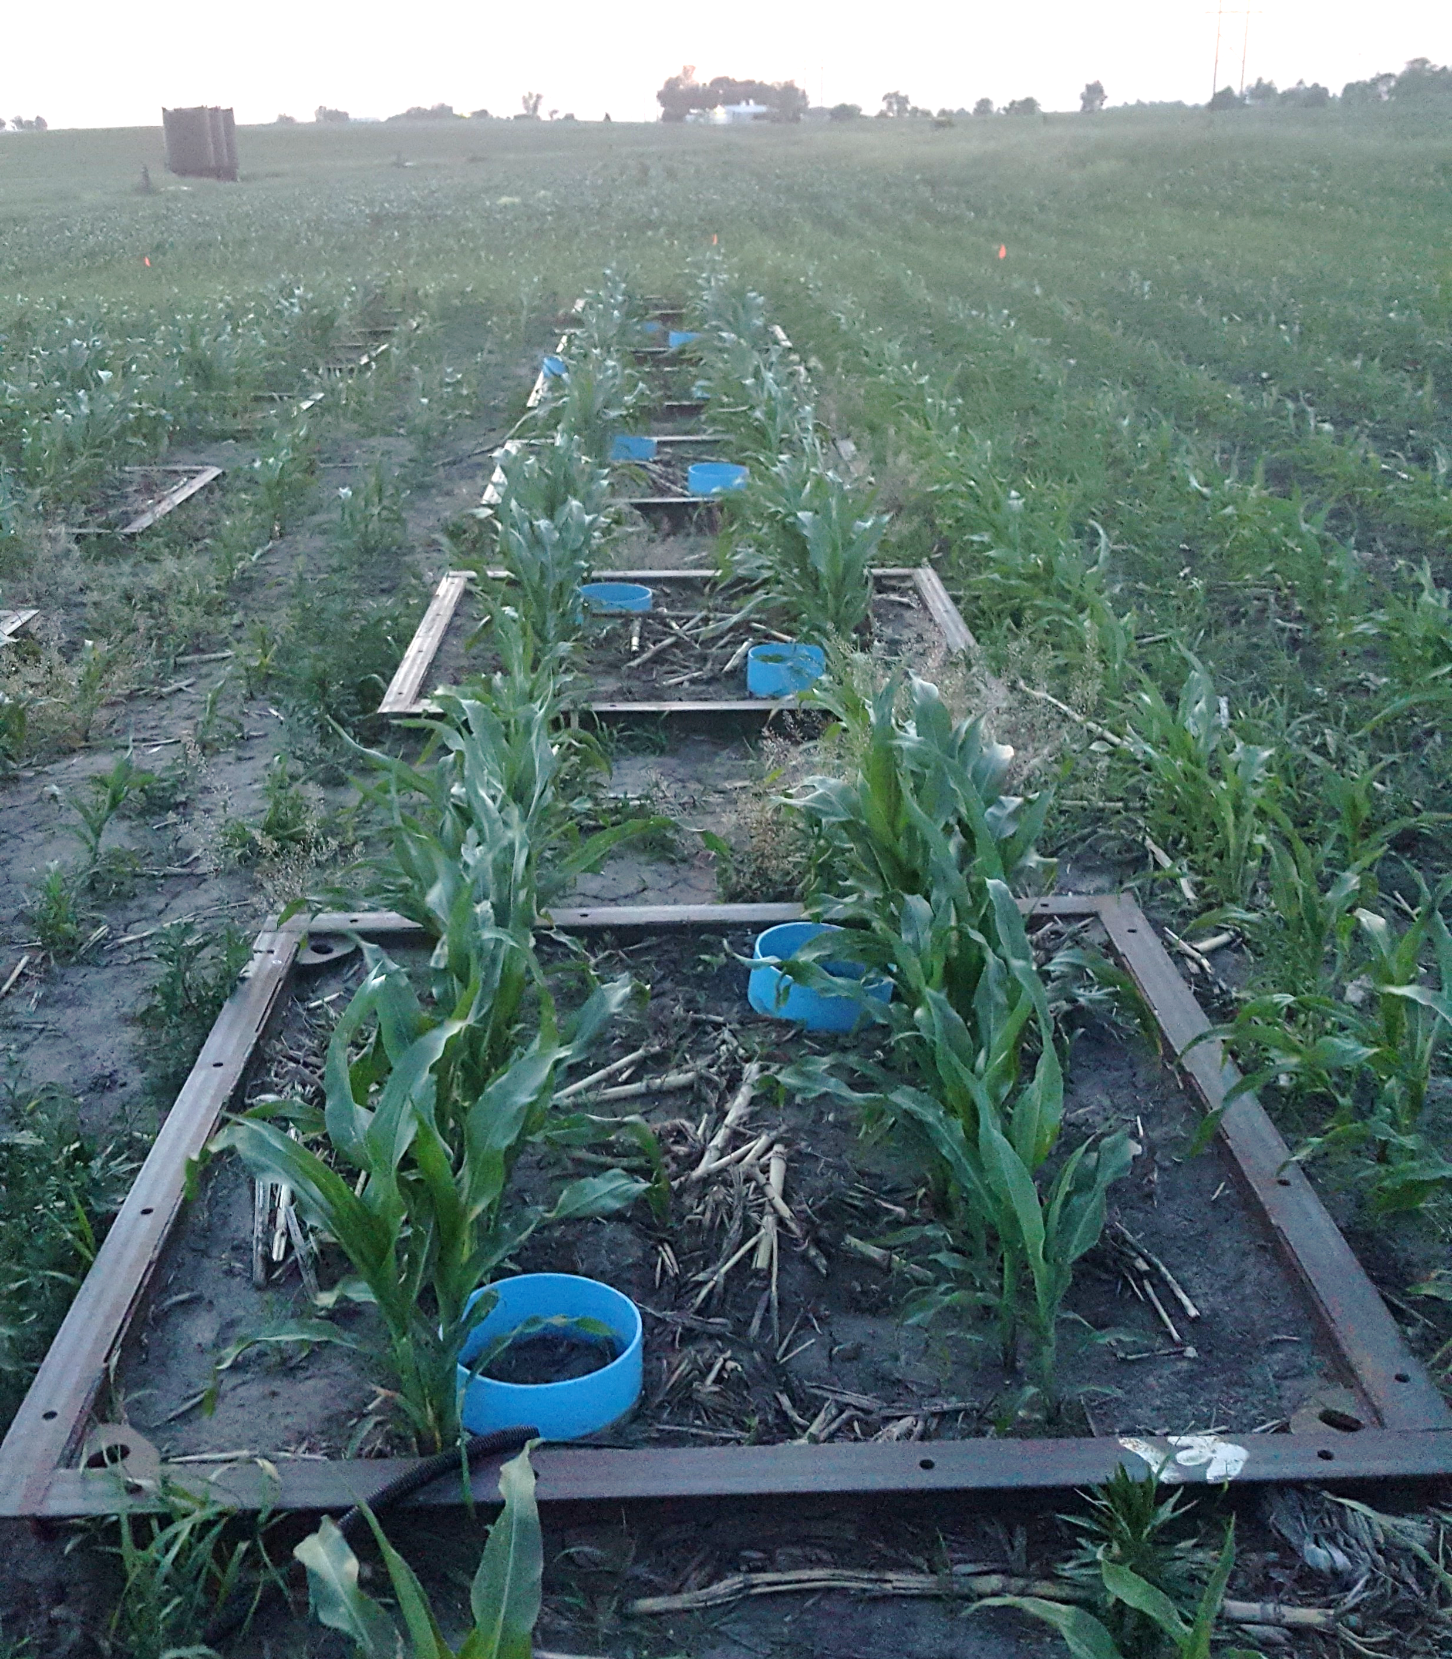
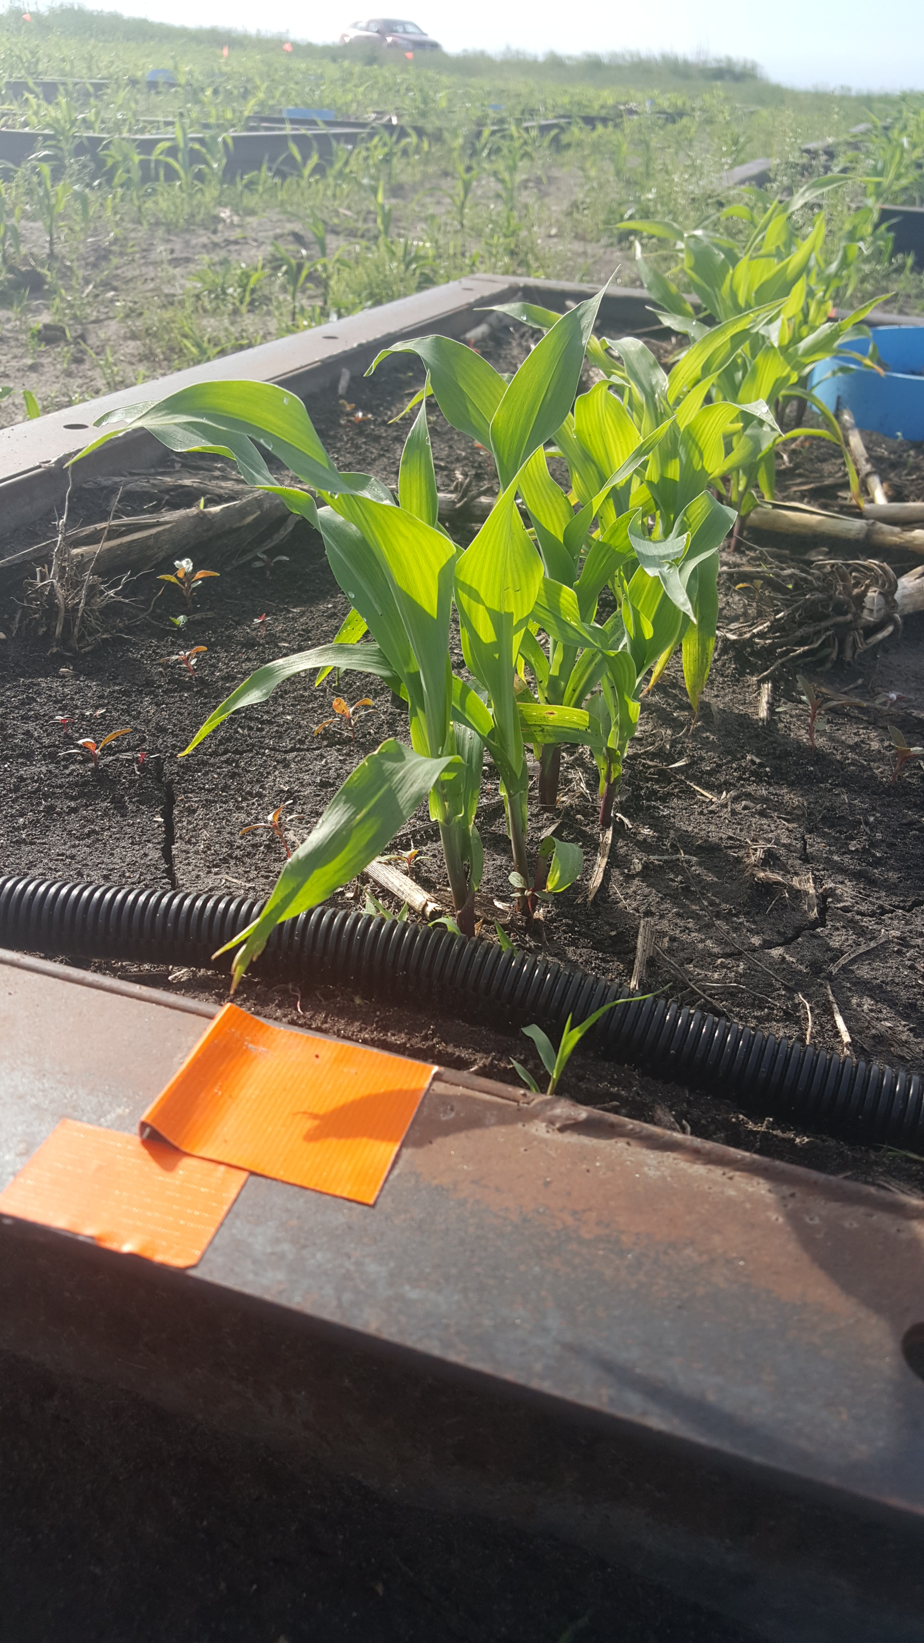
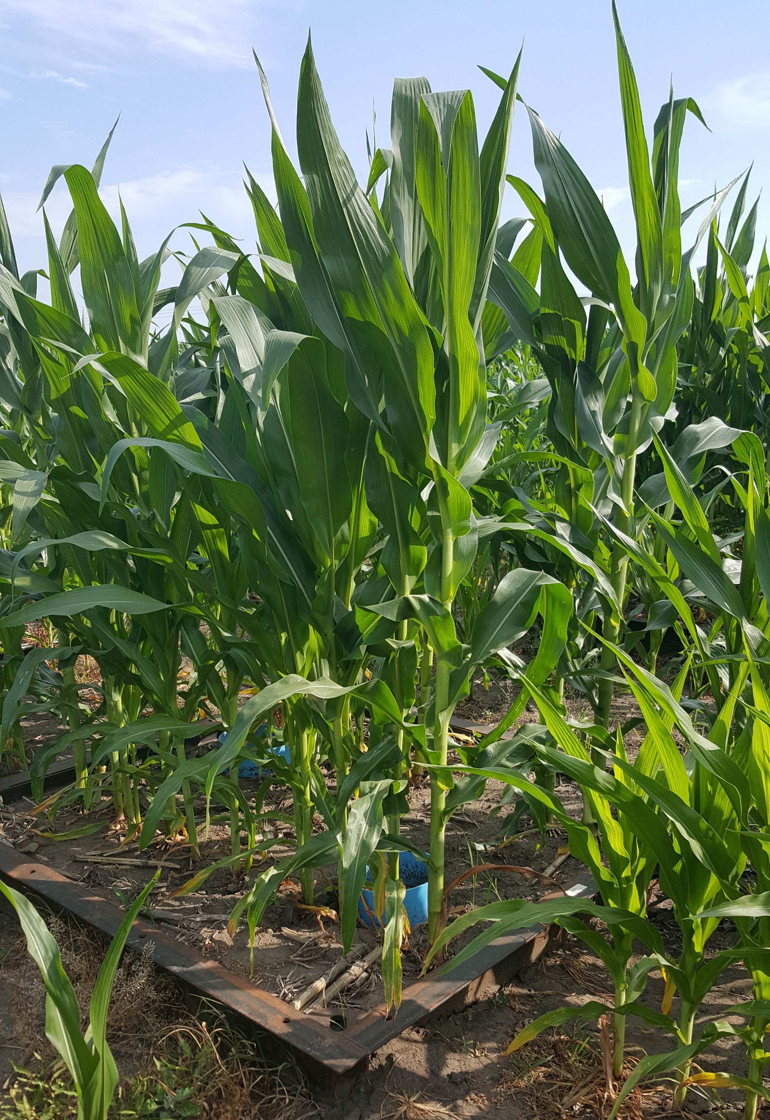
Iowa State University
American Geophysical Union Fall 2021 Meeting
12/16/2021
Holly Loper, Carlos Tenesaca, Carl Pederson, Matthew J. Helmers, William G. Crumpton, Dean Lemke, Steven J. Hall
Soil Block Mesocosms: A New Approach for Quantifying Nitrate Leaching and Nitrous Oxide Emissions from Maize Cropping Systems
Introduction
Measurements of Environmental Nitrogen Losses
Detecting the effects of agricultural management on environmental nitrogen losses is often challenged by varying drainage volume and composition among field plots.
We aimed to overcome this using novel replicable experimental soil units or “soil block mesocosms” made of defined volumes of undisturbed soil.
Nitrous oxide emissions and surface soil moisture were measured either one or two times a week when soils were not frozen.
Drainage water was collected following individual rain events for nitrate analysis.
Variation in cumulative drainage amount among treatments was not significant indicating the soil blocks had relatively similar hydrological properties. (Fig. 1)
Fig. 1
Construction
Each “soil block mesocosm” consists of intact 1.5 x 1.5 x 1.2-m soil monoliths enclosed by steel on the sides and bottom fitted individually with a pipe complete collection of drainage water.
Block harvest was done through vibrated insertion of steel box walls into undisturbed soil and insertion of a steel floor underneath secured by seamless welds.
Fig. 2
Fig. 3
Two soil types from central Iowa and were planted to maize under field conditions with one of three fertilizer application rates (135, 168, and 202 kg N/ha).
We observed higher cumulative nitrous oxide emissions (3.0 ± 0.7, 4.3 ± 1.1, and 5.9 ± 1.1 kg N/ha) with increasing N fertilizer rate (Fig. 2).
We observed higher cumulative nitrate leaching (14.8 ± 1.6, 17.1 ± 1.5, and 20.4 ± 1.7 kg NO3-N/ha) with increasing N fertilizer rate (Fig. 3).
Conclusion
The soil block mesocosm approach enabled detecting changes in nitrate leaching and nitrous oxide emissions with relatively small incremental changes in fertilizer rates, which was often not previously achievable with traditional field plots.
To see a video of soil block mesocosm construction and learn about other exciting aspects of this project scan this QR code
What to know more about this project? Contact Holly Loper on LinkedIn at linkedin.com/in/holly-loper-60a08413b or scan this QR code
Notes:
For nitrate graph: 1200x800 with 36-point font in R
For nitrous oxide graph:

