Slide 1
Impacts of soils input data On Maize BIOMASS AND YIELD Simulations
Meyer Bohn
January, 11 2022
DataFEWSIOn symposium 2022

Slide 2
Background
Process-based agroecosystem models are necessary for:
Predicting and monitoring biogeochemical cycling
On farm management decision making
Improving production
Maintain soil quality
Minimizing environmental risk
(Lehmann and Kleber, 2015)
Notes:
Agroecosystem process models are important achieving multiple productivity and environmental goals.
Predicting and monitoring biogeochemical cycling: Carbon, Nutrients, Water, Energy, GHG emissions
On farm management decision-making to optimize/improve production
This is particularly important for high production areas like the Midwest
research goals are multiple, that is, develop cultivars and improve management to increase crop production
while maintaining soil quality and minimizing environmental risks.

Slide 3
Problem
Agroecosystem models are sensitive to soils input data ^{(Brilli et al., 2017)}
Modified from legacyofwisdom.blogspot.com

Slide 4
Research Questions
What are the impacts of different soils spatial model inputs on maize simulations?
Digital Soil Mapping vs. SSURGO
To what degree does “within-field” soil spatial variability influence agroecosystem model simulations of maize biomass and yield?

Slide 5
Case STUDY
Sustainable Advanced Bioeconomy Research (SABR) farm near Ames, IA
Agricultural Production Systems sIMulator (APSIM)
Simulate Maize aboveground biomass and yield for 2018

Slide 6
Agricultural Production Systems simulator (APSIM)
Calibrated and validated on Central Iowa (Des Moines Lobe) soils: Nicollet, Webster, Clarion, and Canisteo
Independent validation uncertainty:
Biomass RMSE:
1.46 Mg ha⁻¹ | 146 g m⁻²
Yield RMSE:
0.65 Mg ha⁻¹ | 650 g m⁻² | 23.2 bu ac⁻¹
(Archontoulis et al., 2014)

Slide 7
APSIM Soils Inputs
Point-based synthetic profiles from SSURGO
Soil water physical parameters used if available
Pedotransfer functions (Saxton and Rawls, 2006) used to fill gaps
Use sand, clay, and organic matter in equations
Holzworth et al., (2018)
LL = 15 bar Lower Limit; DUL = Drainage Upper Limit or “field capacity”; SAT = Saturated Water Content

Slide 8
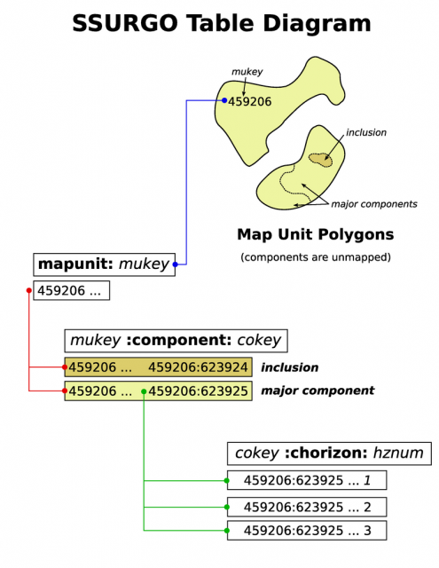
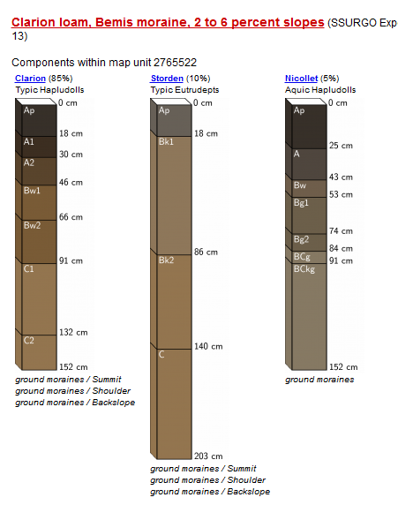
Objective 1
Evaluate the impact of spatial and tabular variations of SSURGO as soil input data for APSIM simulations.
Spatial data = soil map unit delineations
Tabular data = map unit components, horizons, and soil properties associated with them
https://casoilresource.lawr.ucdavis.edu/soilweb-apps/

Slide 9
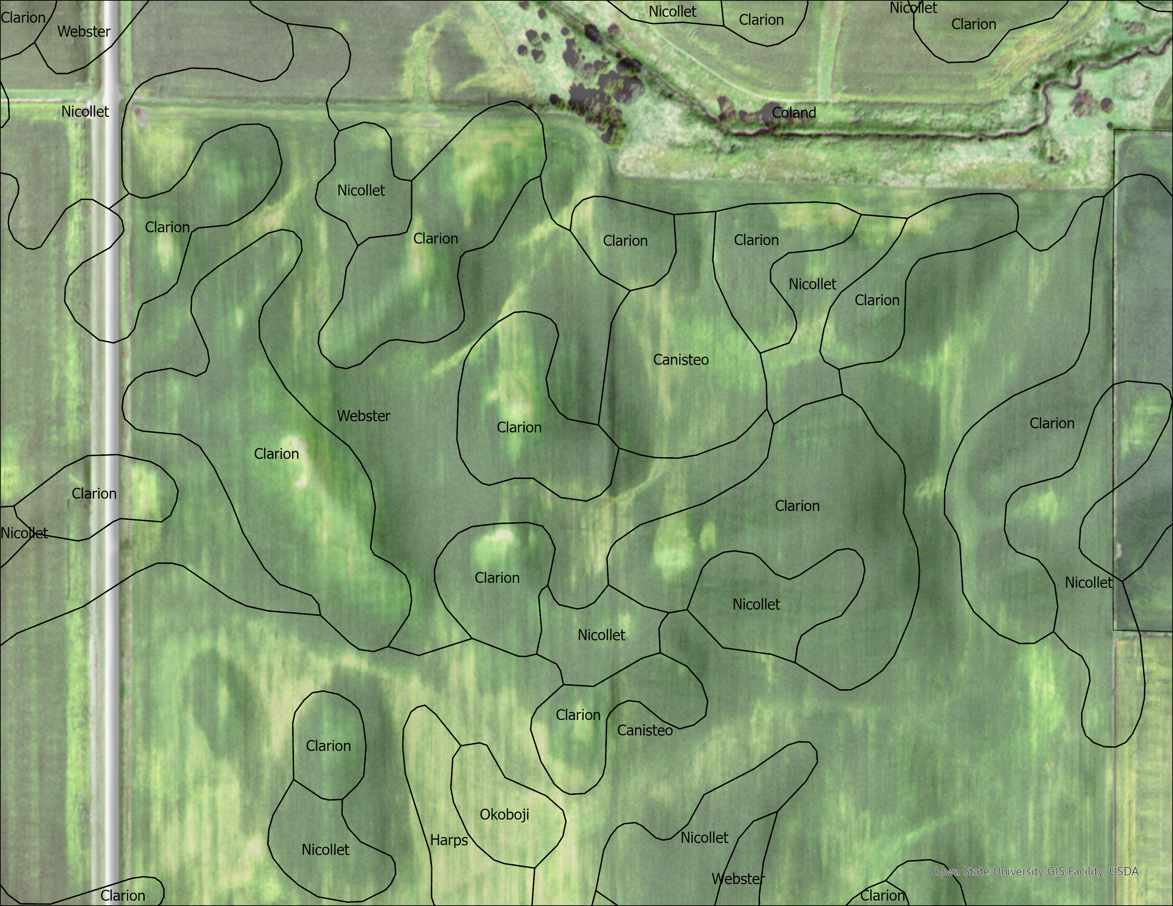
SSURGO
Commonly used for APSIM inputs
Not intended for “within-field” scale applications
Sources of uncertainty:
Prediction
Soil map unit delineations and mapping scale
Map unit composition
Temporal
Avg. Soil survey in IA > 30 yrs ^{(Dermody,} ^{personal} ^{comm.)}
Measurement
Tabular data
(Soil Survey Staff, Soil Survey Geographic (SSURGO) fy2018; National Agriculture Imagery Program, Farm Service Agency, 2019) ESRI ArcGIS Pro v 2.9 (2021)

Slide 10
SABR Farm ssURGO EXperiment
2018 Growing season
6 unique soil map units – 12 synthetic soil profiles
Treatments
Default APSIM selection – Clarion (Field)
Dominant component (SMU)
Minor component (SMU)
Component Weighted (SMU)
Spatially weighted mean of dominant component (Field)
Spatially weighted and component weighted mean (Field)
(Soil Survey Staff, Soil Survey Geographic (SSURGO) fy2018

Slide 11
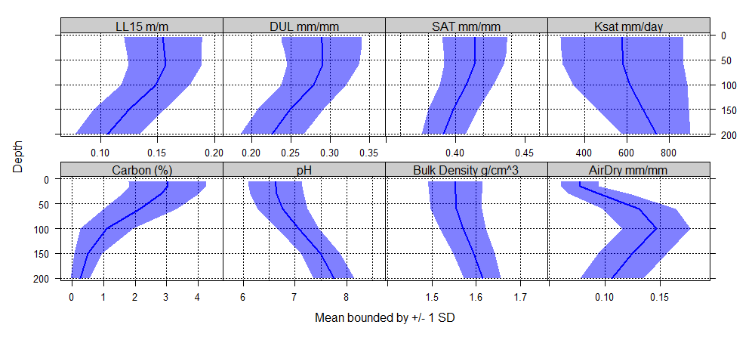
Distributions of Soil Input Variables
Graphics courtesy AQP; R stat software (Beaudette et al., 2013; R Core Team, 2020)

Slide 12
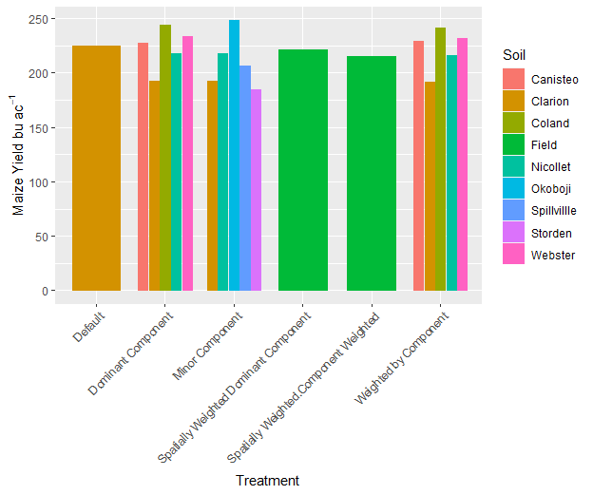
SSURGO treatment impact on maize simulations
Min: 184
Max: 248
Mean: 219
SD: 18.9
Range: 64.1
Min: 2100
Max: 2577
Mean: 2330
SD: 119.2
Range: 477
Graphics generated ggplot2; R stat software (Wickham, 2016; R Core Team, 2020)

Slide 13
Maize Simulation Spatial variability
Biomass (g m⁻² )
Yield (bu ac⁻¹ )
Dominant Component
Component weighted average

Slide 14
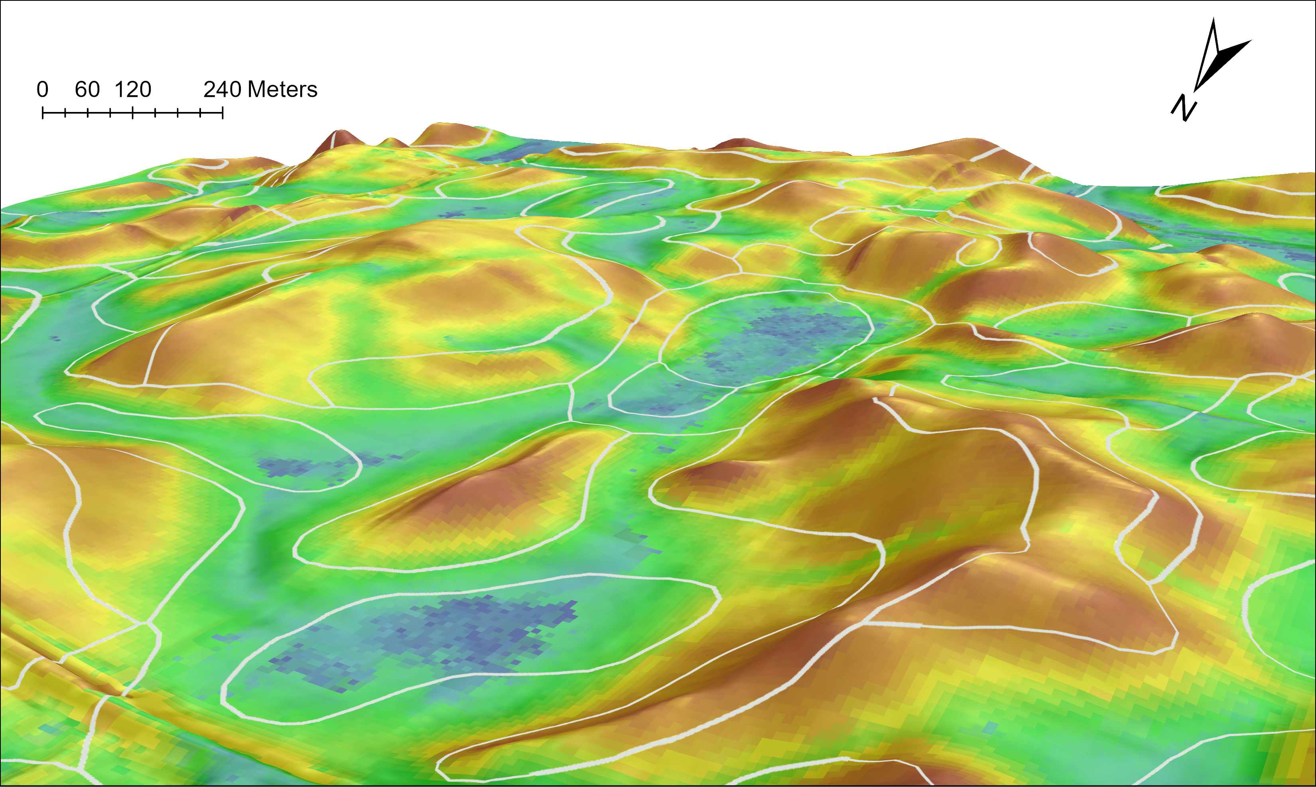
Objective 2
Evaluate the impact of site-specific digital soil maps as soil input data for APSIM simulations.

Slide 15
Digital Soil Maps As inputs
Sampled on site (density ≈ 0.38 samples ac⁻¹ ) in 2019
Derived from machine learning and exhaustive environmental covariate stack
3-m resolution aggregated to 12-m
Maps for Depths:
0-5,5-15,15-30,30-60,60-100,100-150,150-200 cm
Carbon 5-15 cm

Slide 16
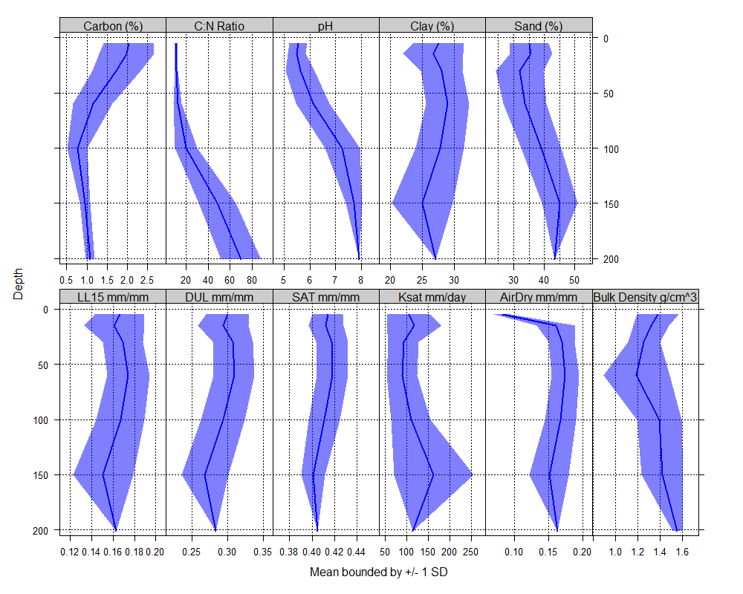
Distribution of DSM Inputs
2030 synthetic profiles
AirDry, LL15, DUL, KSAT, and SAT calculated from sand, clay, and organic matter maps with pedotransfer function.
Additional Inputs
Bulk density (modified)
Soil Carbon & Organic Matter
Soil Carbon to Nitrogen Ratio
pH

Slide 17
DSM Impact on Maize Simulation over Growing Season
Max @ 10% C.I. = 214
Max @ 10% C.I. = 35.2

Slide 18
DSM Maize Simulation Spatial Variability

Slide 19
Objective 3
Compare the impact of DSM vs. SSURGO as soil input data for APSIM Maize simulations.

Slide 20
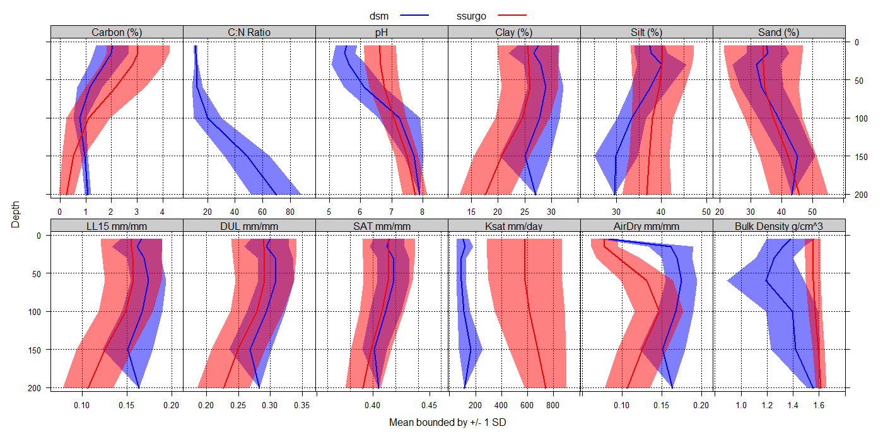
DSM VS SSURGO Property Distributions

Slide 21
DSM vs ssurgo Spatial Variability
Avg. biomass difference DSM =
-193.6 g m⁻² | SD = 128 g m⁻²
Avg. yield difference DSM =
-30.7 bu ac⁻¹ | SD = 18.9 bu ac⁻¹

Slide 22
Key RESULTS
OBJECTIVE 1: SSURGO
OBJECTIVE 2: DSM
Max yield ranged from 184-248 bu ac⁻¹ (64)
Max biomass ranged from 2100-2577 g m⁻² (477)
Max yield ranged from 156-209 bu ac⁻¹ (53)
Max biomass ranged from 1826 - 2262 g m⁻² (436)
OBJECTIVE 3: Comparison (DSM – SSURGO)
Avg. max yield difference: -30.7 bu ac⁻¹ | SD = 18.9 bu ac⁻¹
Avg. max biomass difference: -193.6 g m⁻² | SD = 128 g m⁻²

Slide 23
Research ANSWERS
What are the impacts of different soils spatial model inputs on maize simulations?
DSM simulations predicted substantially lower average max yield and biomass than SSURGO.
To what degree does “within-field” soil spatial variability influence agroecosystem model simulations of maize yield and biomass?
The range for max yield and biomass between DSM (53;436) and SSURGO (64;477) was about the same.

Slide 24
Error Propagation
Dominant component map units from SABR
5.07 million acres in Iowa
2.49 million acres of IA corn 2018 (50%)
76,443,000 bushels under predicted
1,942,200 tons of biomass under predicted
National Agricultural Statistics Service, Cropland Data Layer, 2018

Slide 25
Where do we go from here?
Perform independent validation with field data
Sensitivity analysis – most influential soil properties
Other target variables/crops (C, ET, NO₃⁻ , Soybean, Miscanthus)
Proposal Opportunities

Slide 26
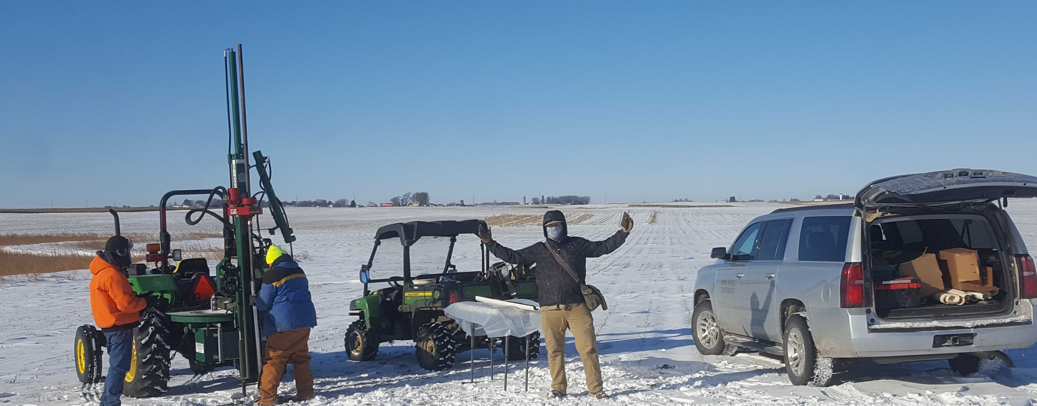
Questions or feedback?
@meyerbohn
MollicMeyer
glsi.iastate.edu
mpbohn@iastate.edu

