Slide 1
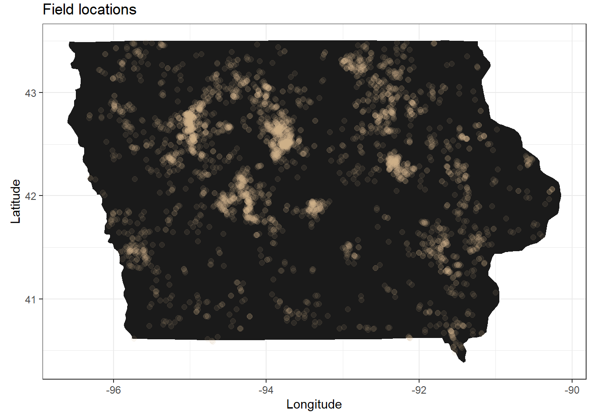
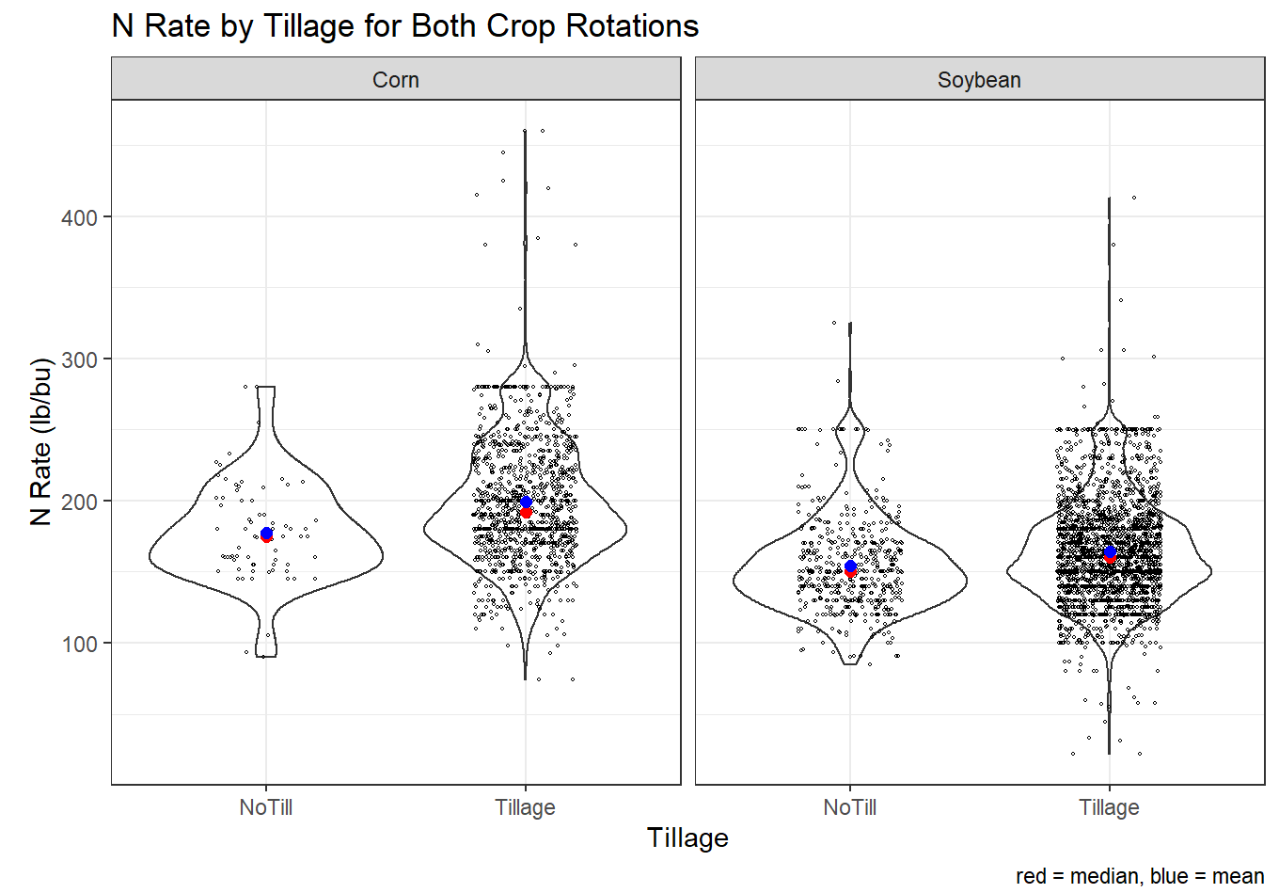
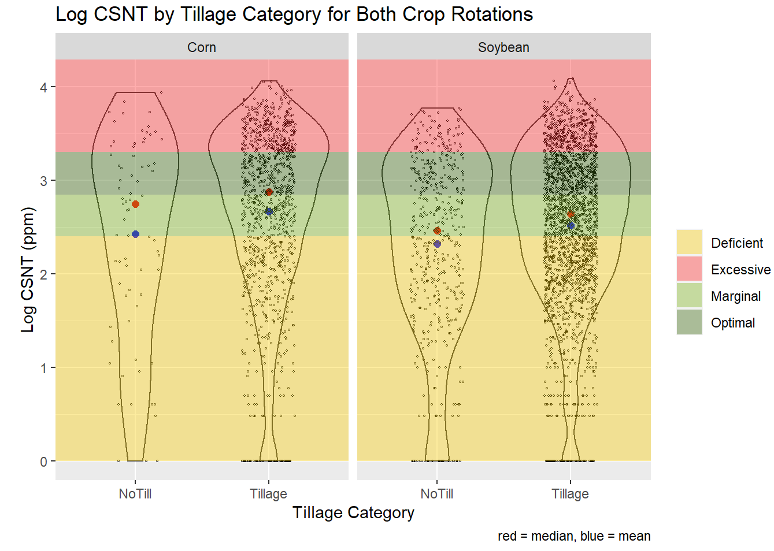
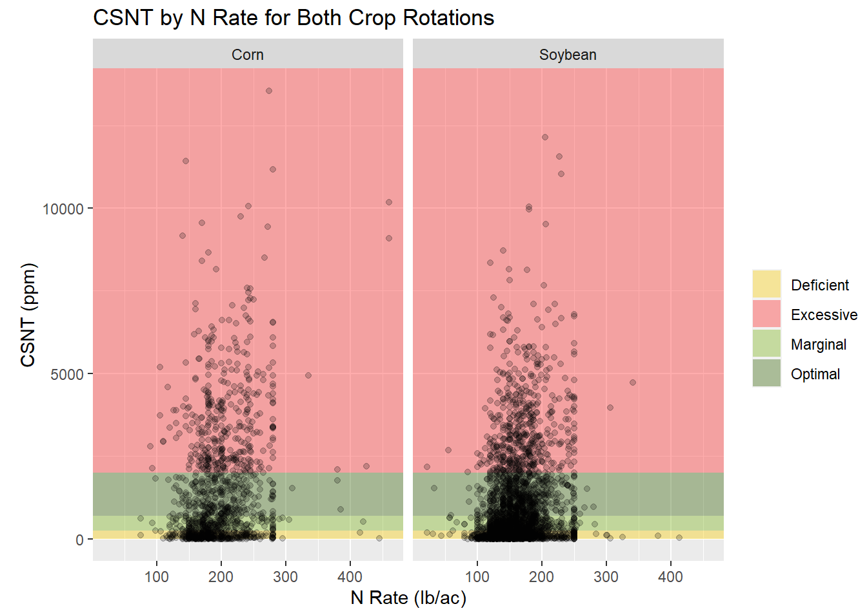
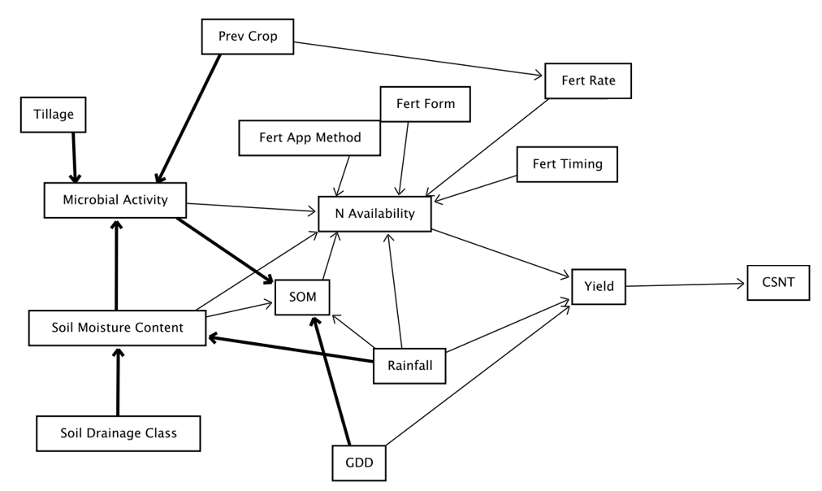
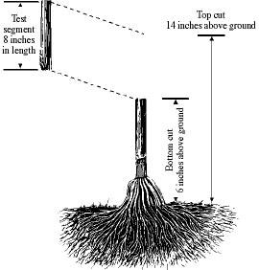
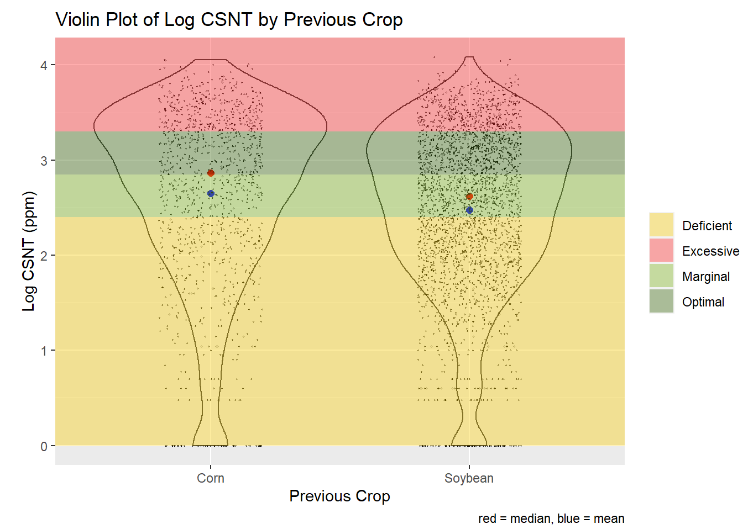
Department of Agronomy
DataFEWSion Annual Symposium
11 January 2022
Alex Cleveringa, Anabelle Laurent, & Fernando Miguez
Univariate Analysis of End-of-Season Corn Stalk Nitrate Test Dataset
Introduction
Results & Discussion
It is estimated that the chance of applying N fertilizer to an individual field at the economic optimal N rate is only 20%, and the chance that the recommended rate might be greater than necessary is about 60% (Morris et al., 2018).
While small-plot experiments will always be extremely valuable, on-farm research trials eliminate some limitations of small-plot experiments. For example, researchers can collect data from real scenarios covering the entire range of implemented practices in producers’ fields. It is also easier to get a larger dataset from farmer networks than collect data oneself. The size and scale of these datasets can reveal insights about N management, about which there is great uncertainty and variability. The dataset here covers 4,125 fields of end-of-season corn stalk nitrate test (CSNT) results collected between 2006 and 2017.
The purpose of this study is to identify relationships between variables that lead to better accuracy in making N availability predictions at the individual field level. The data will be made available for sharing, and a web-based, interactive graphical summary tool will be created for public use.
The data in this study represent a wide range of practices across the state of Iowa (Fig. 2). The continuous corn and corn-soybean rotations were separated because, as a group, the continuous
corn rotations received
about 30 lb./ac more N than the corn-soybean rotations (Fig. 3). Additionally, there does not appear to be a strong relationship between N rate and CSNT. The data were log-transformed to create larger differences in smaller values and smaller differences in larger values. Doing so revealed an observed difference in the median CSNT value between the two crop rotations (Fig. 4), with higher CSNT values in the continuous corn. This difference is likely because of the increased N rate applied to continuous corn rotations observed previously. A slight increase in N rate with tillage compared to no-till (Fig. 5) is also reflected in higher CSNT values (Fig. 6). It should be noted that small differences higher up on the y-axis are larger than they appear due to the log scaling of the graphs. Implementing these preliminary results will help create the directed acyclic graph (DAG, Fig. 7), and attributing variability to true effects will improve the accuracy of the predictions.
Fig 2. Location of 4,125 on-farm replicated trials conducted across Iowa from 2006 to 2017.
Fig 5. Violin plot of N Rate by tillage treatment for each crop rotation.
Fig 6. Log CSNT by tillage treatment for each crop rotation
Background
The end-of-season corn stalk nitrate test measures the sufficiency of available nitrogen to the plant in the season that just ended. A diagram of the portion that is sampled is provided in Fig. 1. The concentration of nitrate in the lower corn stalk relates to N availability during the growing season. Over-fertilization that would reduce profitability and increase nitrate loss is detected because there would be a build-up of excessive N in
the corn stalk at the end of the season.
In situations where there is no
excessive N present in the plant, N is
removed from the stalk during the
grain-filling period, leading to lower
CSNT values. The four levels of
sufficiency include the following:
deficient (1-250 ppm), marginal
(251-700 ppm), optimal
(701-2000 ppm), and
excessive (2000+ ppm).
Fig 3. Graph of CSNT by N Rate for corn-following-corn and corn-following-soybeans
Fig 7. Conceptual DAG of relationship between variables in the dataset
References
Morris, T. F., Murrell, T. S., Beegle, D. B., Camberato, J. J., Ferguson, R. B., Grove, J., ... & Yang, H. (2018). Strengths and limitations of nitrogen rate recommendations for corn and opportunities for improvement. Agronomy Journal, 110(1), 1.
Fig 1. Diagram of end-of-season CSNT
Source: Univ of Nebraska Extension Pub NF01-491
Fig 4. Violin plot of Log CSNT by Previous Crop.

