Slide 1
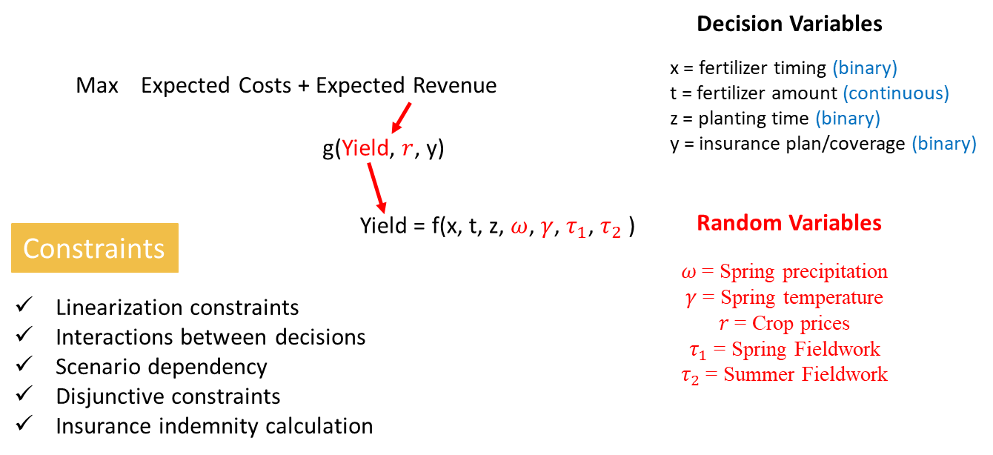
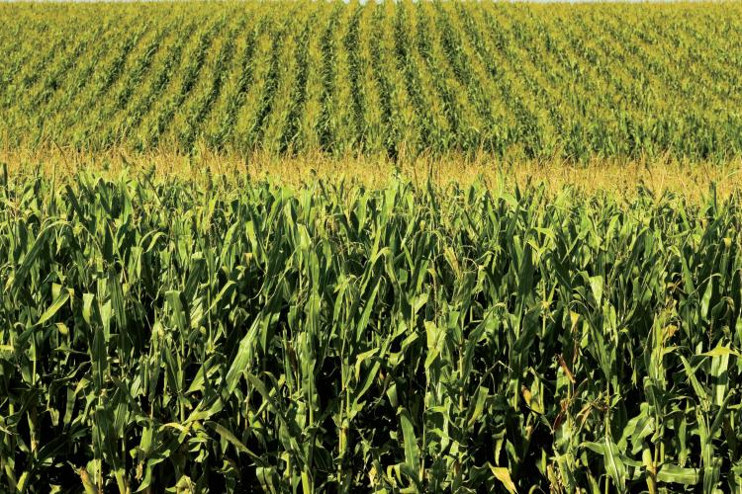
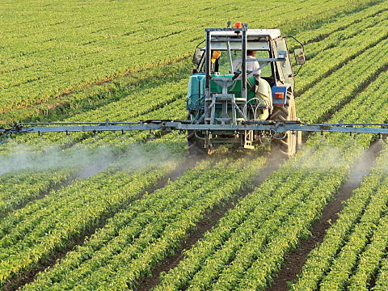
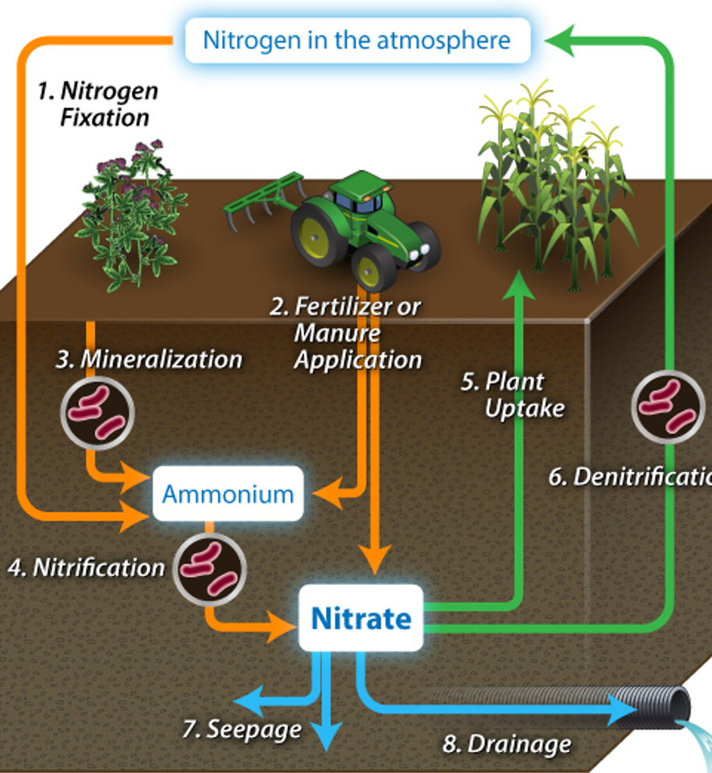
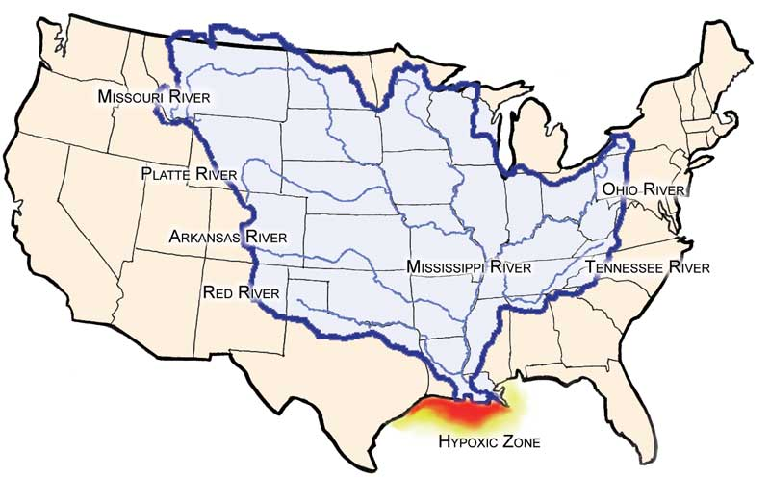
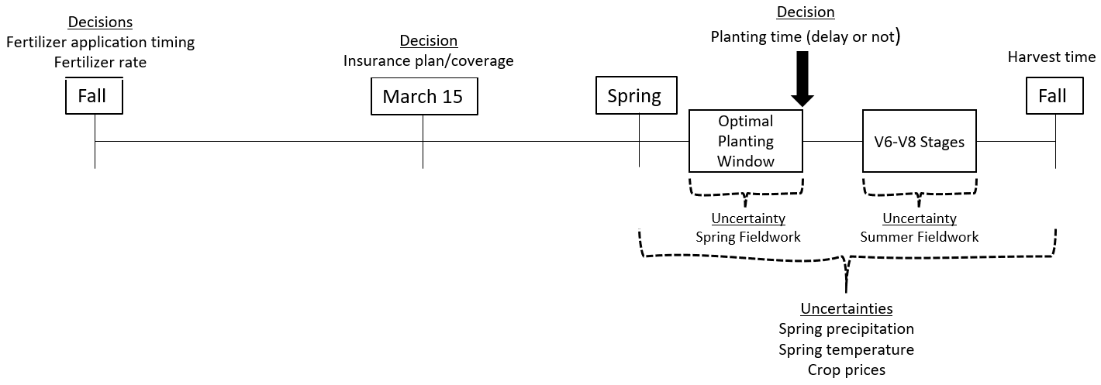
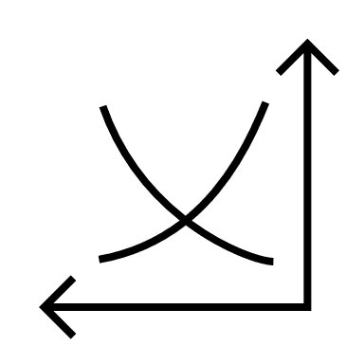
Industrial and Manufacturing Systems Engineering
Water Quality Impacts of Farm Management Optimization under Uncertainty
Gorkem Emirhuseyinoglu and Sarah M. Ryan
BACKGROUND & MOTIVATION
PROBLEM SETTING
MODEL
Two Sides of the Agricultural Production
Major Farming Decisions
Formulation
Planting
Climate Conditions of the regions
Suitable field conditions
Fertilizer Management
How Much?
What is the optimal N application rate?
2.When?
Choose among Fall, Spring, Split
Environmental Impact of the Agricultural Production
Crop Insurance
Agricultural practices add more N to surface waters than they would receive under normal conditions
Nutrients are necessary for agricultural production
Fertilizers are the only means to boost nutrient levels of the soil
Nitrogen (N) is discharged to streams through drainage systems
Reduces farmers’ risk exposure
Choose among several protection plans and coverage levels
Pay the premium for a chance to take an indemnity payment
RESULTS
UW Environmental Resources Center (ERC)
Texas Aquatic Science
Farmer’s Timeline
Shaded regions are labeled by N timing decisions (FA = fall application SS = summer sidedress), type of insurance (RP = revenue protection, YP = yield protection), and insurance coverage rate
Risk and Uncertainties
Two-stage Stochastic MILP
Environmental Implications
Agricultural activities are subject to variety of risks and uncertainties
They affect farmer’s revenue and nutrient runoff
1
2
3
4
Temperature
Crop Prices
Soil Moisture -
Current Iowa N concentration target is around 5-6 mg/L with 41% reduction goal
Fieldwork Suitability

Slide 2
Two Sides of the Agricultural Production
Industrial & Manufacturing Systems Engineering

Slide 6
Farmer’s Timeline
Industrial & Manufacturing Systems Engineering

Slide 7
Two-stage Stochastic MILP
(4 scenarios)
(4 scenarios)
(4 scenarios)
(2 scenarios)
(6 scenarios)
Discrete scenarios (768 in total) are generated assuming random variables are mutually independent.
Industrial & Manufacturing Systems Engineering

Slide 8
Mathematical Model
Farmer Decision Model Objective Function:
Decision Variables
Max Expected Costs + Expected Revenue
x = fertilizer timing (binary)
t = fertilizer amount (continuous)
z = planting time (binary)
y = insurance plan/coverage (binary)
g(Yield, $r$, y)
Yield = f(x, t, z, $ω$, $γ$, $τ_{1}$, $τ_{2}$)
Random Variables
Constraints
$ω$= Spring precipitation
$γ$= Spring temperature
$r$= Crop prices
$τ_{1}$= Spring Fieldwork
$τ_{2}$= Summer Fieldwork
Linearization constraints
Interactions between decisions
Scenario dependency
Disjunctive constraints
Insurance indemnity calculation
Industrial & Manufacturing Systems Engineering

Slide 9
Shaded regions are labeled by N timing decisions (FA = fall application SS = summer sidedress), type of insurance (RP = revenue protection, YP = yield protection), and insurance coverage rate

Slide 10
Environmental Implications
Current Iowa N concentration target is around 5-6 mg/L with 41% reduction goal
What do those results mean for social planners?
Industrial & Manufacturing Systems Engineering
Notes:
I will add the other results, if you like the plot.

